Slide 1
Annual VWAC Training
[Rank and Name]
[Job title/billet]
[Building # & Room #]
[Telephone #]
[email]
Notes:
You must brief at least slides 1, 52-63 (GOOD)
If you have the want a little better brief then do slides 1, 44-63 (BETTER), and
If you have the time then brief them all (BEST).
If you have any questions please feel free to contact me.
William Yables Jr.
Paralegal Specialist
Installation Victim Witness Liaison Officer
Marine Corps Air Station New River PSC Box 21002 Jacksonville, NC 28545-1002
(910) 449-7159 Fax-6096
http://www.newriver.marines.mil/StaffJudgeAdvocate/VWAP.aspx

Slide 2
HOW IT WORKS
Installation commanders are responsible for implementing VWAP and shall be the central points of contact for VWAP issues aboard the installation.
Installation Commander manages through Installation Victim Witness Liaison Officer (VWLO), VWAP Council and Victim Witness Assistance Coordinators for commands.

Slide 3
INSTALLATION LEVEL: WHO DOES WHAT
RVWLO – Manages VWAP throughout the Commander’s area of responsibility
VWLO - Manages base programs for Commander
NCIS/CID/PMO – Normally first responsibility is to inform crime victims and witnesses of rights under program; perform threat assessment; assist in contacting other services; safeguard property; contact command VWACs
Prosecutors and legal personnel - Have a continuing responsibility to ensure rights and services afforded victims and witnesses
Corrections personnel - Manage post-trial confinement forms, reports & notifications
Notes:
Who should be the VWLO? Your duty is to the commander – so for many this falls on the TCs. LAOs perhaps the better choice? Legal Assistance officers is a thought – however how do you deal with the issue that occurs when the VWLO has a client and now the interests are adverse?

Slide 4
INSTALLATION LEVEL: WHO DOES WHAT
Sexual Assault Prevention and Response Program/ SARC – Education and training
Victim Legal Counsel – Represents eligible victims
Family Advocacy Program – Victim advocates
Transitional Compensation – HQMC via commanders
Unit Commanders – Security, military protective orders, and notifications
UVAs – Victim advocates
Chaplain – Counseling and comfort
Medical - Services
Civilian advocacy services - Social services & Medical

Slide 5
VWAP OFFICIALS
USMC - SJA to CMC
CMC provides DoD VWAP Council Rep – That’s me!
CMC (PSL) Corrections
MCI Regional Commanding Generals RVWLO
Installation commanders – VWLO
Unit commanders – Bn/Sq and above – VWAC
Law enforcement - VWAP Representative
Legal representatives - VWAP Representative
Corrections Personnel - VWAP Representative
Service providers (advocates, chaplain, & medical) - VWAP Representatives

Slide 6
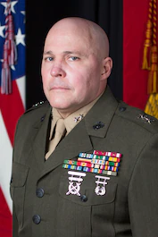
SJA to CMC
Coordinate, implement and manage the VWAP
Receive complete VWAP reports (2706) and forward to SecNav
Designate a Functional Area Manager for MCO 5800.16, Chapter 4
Major General David J. Bligh Staff Judge Advocate to the Commandant
Notes:
Headquarters Marine Corps Roles and Responsibilities
The SJA to CMC. The SJA to CMC has responsibility for oversight and administration of the VWAP. In this role, the SJA to CMC shall:
1) Coordinate and manage the VWAP.
2) Ensure victim and witness assistance materials are available for law enforcement and investigative personnel, trial counsel, legal assistance attorneys, RVWLOs, VWLOs, and VWACs.
Receive and compile the reports required by reference (b) and prepare the annual report (DD Form 2706) for submission to the Assistant Secretary of the Navy (Manpower and Reserve Affairs).
Provide a representative to the DoD VWAP Council established by reference (b).
Maintain a current list of all RVWLOs and VWLOs.
Ensure legal assistance counsel are available to provide information and advice to victims and witnesses of crimes pursuant to law and regulation.
Serve as· the Responsible Official for the VWAP Functional Area Checklist (FAC) and designate a Functional Area
Manager (FAM) responsible for providing required FAC updates.

Slide 7
VWAP Director
Hosts annual VWAP training.
Conduct program policy development.
Receive complete VWAP reports (2706) and forward to SecNav.
julie.lindahl@usmc.mil

Slide 8
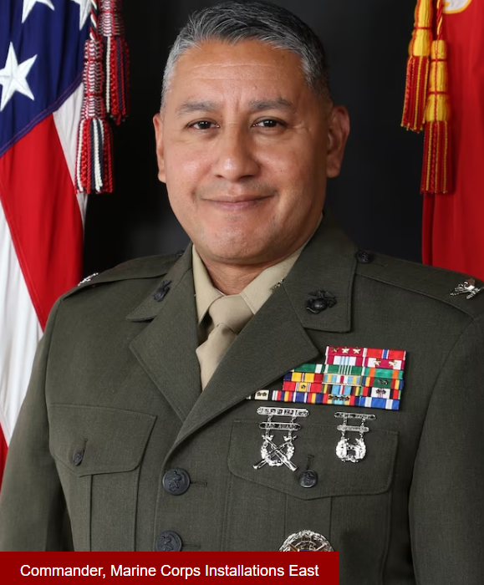
MCI-EAST Commander
MCI-EAST Commander
Ensure that the VWAP is properly implemented by installation Commanders
Appoint a Regional VWLO to ensure compliance with VWAP
Report data to HQMC on how many DD form 27XX were issued
Adolfo Garcia Jr.
Colonel
Commanding General Marine Corps Installations East
Notes:
Command Roles and Responsibilities
COMMCICOM, COMMARFORRES, and Regional MCI Commanding Generals (CGs)
1) Regional MCI CGs are responsible for ensuring that the VWAP is properly implemented by installation VWLOs in their region. COMMCICOM is responsible for the VWAP in the National
Capital Region. COMMARFORRES is responsible for the VWAP in the Marine Reserve.
2) COMMCICOM, COMMARFORRES, and regional MCI CGs shall appoint in writing, by name, title, duty address, and telephone number, a RVWLO.
3) The RVWLO is responsible for ensuring that all installations under the cognizance of their respective commander or commanding general comply with the law and applicable orders and regulations.
4) The RVWLO shall be an officer or civilian employee of appropriate grade, experience, and maturity.
5) The RVWLO may also serve as an installation VWLO.

Slide 9
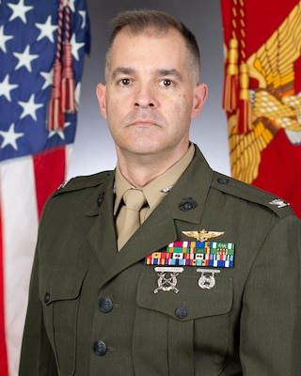
MCAS New River Commander
Installation commanders are responsible for implementing VWAP and shall be the central points of contact for VWAP issues aboard the installation.
Installation Commander manages through Installation Victim Witness Liaison Officer (VWLO), VWAP Council and Victim Witness Assistance Coordinators for commands.
Colonel Garth W. Burnett Commanding Officer
Marine Corps Air Station New River
Notes:
Installation Commanders. Installation commanders possessing General Court-Martial Convening Authority (GCMCA) and other installation commanders as practical are designated as the Local Responsible Officials pursuant to references (a} and (c). These Installation commanders are responsible for implementing and maintaining a VWAP on their respective installations and subordinate installations. Local Responsible Officials shall.
Ensure close coordination between. local VWACs and VWAP representatives from NCIS, legal service providers, military police, commanding officers, medical facilities, Marine and Family Programs, corrections facilities, and chaplains;
Appoint, in writing, by name, title, duty address, and telephone number, a VWLO. The VWLO shall be an officer or civilian employee on the installation commander's staff and shall not serve as a trial counsel, senior trial counsel, regional trial counsel, Defense Counsel, Senior Defense Counsel, Regional Defense Counsel, Staff Judge Advocate, or legal assistance attorney. VWLO responsibilities are outlined in paragraph 3.b. of this enclosure.
Ensure all VWAP representatives aboard the installation are provided the VWLO's name and phone number.
Establish a local Victim and Witness Assistance Council, chaired by the installation VWLO, to coordinate a comprehensive assistance program and comply with VWAP notification and reporting requirements;
When a Marine Corps confinement facility is located aboard the installation, appoint, in writing, by name, title, duty address, and telephone number; a confinement facility representative to serve as the confinement facility VWAC and representative to the local Victim and Witness Assistance Council.
Construct and maintain, with the assistance of the local Marine and Family Programs office, a directory of military and civilian programs, services, and crime victim compensation funds available to victims and witnesses, and ensure the directory is published on the installation's public website. When appropriate, and after consultation with the cognizant Staff Judge Advocate, enter into Memoranda of Agreement {MOA) with civilian agencies to ensure victims and witnesses are provided required services.
Ensure that victims and witnesses are receiving the information and services as required under the VWAP until an accused enters post-trial confinement.
Ensure processes are in place to maintain data on the number of victims and witnesses who received DD Forms 2701-2703 and elect notification via DD Form 2704.

Slide 10
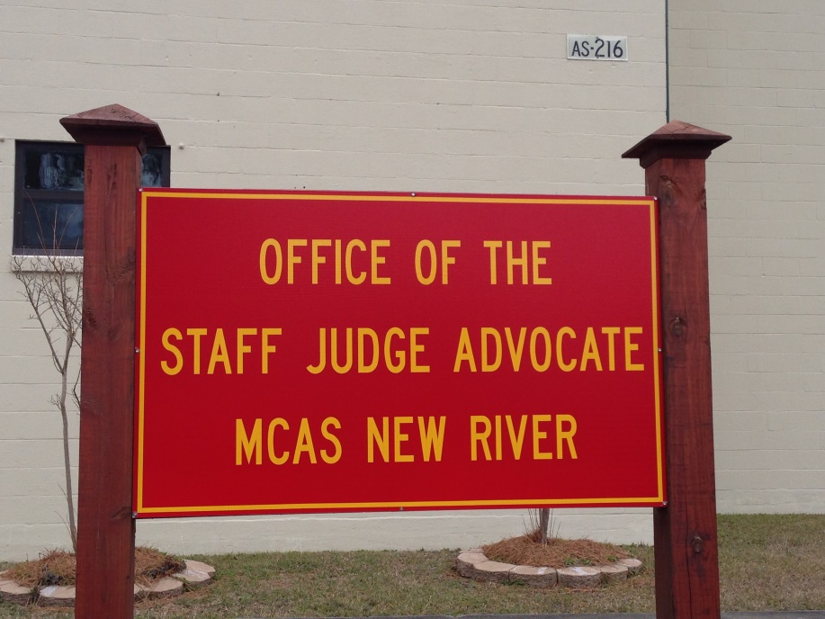
Staff Judge Advocate
Advise the Commander on the VWAP
Major Kevin L. Hoffman
SJA, MCAS New River
Council member:
Mr. William Yables
SJA, Building AS-216
next to the MAG-26 HQ
(910) 449-7158
VWAP Council member
Notes:
Staff Judge Advocate (SJA)
Provide advice and guidance to convening authorities and commanders with regard to VWAP.
Provide a copy of the CAA to the trial counsel in those cases where a victim or a witness has elected to be informed of the CAA.

Slide 11
RVWLO REQUIREMENTS
Ensures training is available to all VWLOs and VWACs
Maintains list of all VWLOs in region
Chair semi-annual Regional VWLO Meeting
Ensure data (2701-2704) collection for the region
Assist CGIP during the preparation and conduct inspections of installation.
Notes:
This list is ever changing – difficult for you to get a handle on.
Installation level.

Slide 12
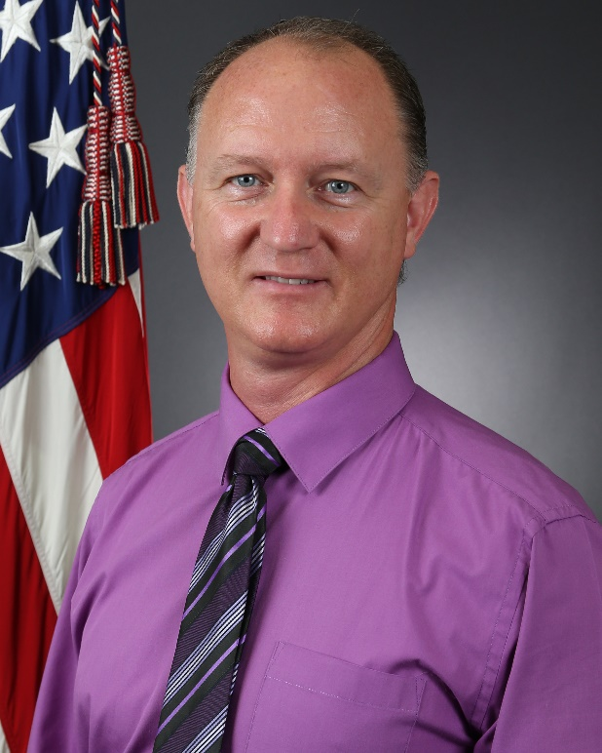
Installation Victim Witness Liaison Officer
Ensure that CMC and RVWLO are informed when a new VWLO is appointed.
Assist victims in exercising their rights and obtaining support, when appropriate.
Maintain an installation VWAP website.
Coordinate with PMO and NCIS with VWACs information.
Conducts annual training.
Chairs VWAP Council and conduct quarterly meetings.
William Yables Jr.
Paralegal Specialist
Marine Corps Air Station New River
(910) 449-7159
SJA, Bld AS-216 next to MAG-26 HQ
VWAP Council member
Notes:
Installation Commanders. Installation commanders possessing General Court-Martial Convening Authority (GCMCA) and other installation commanders as practical are designated as the Local Responsible Officials pursuant to references (a} and (c). These Installation commanders are responsible for implementing and maintaining a VWAP on their respective installations and subordinate installations. Local Responsible Officials shall.
Ensure close coordination between. local VWACs and VWAP representatives from NCIS, legal service providers, military police, commanding officers, medical facilities, Marine and Family Programs, corrections facilities, and chaplains;
Appoint, in writing, by name, title, duty address, and telephone number, a VWLO. The VWLO shall be an officer or civilian employee on the installation commander's staff and shall not serve as a trial counsel, senior trial counsel, regional trial counsel, Defense Counsel, Senior Defense Counsel, Regional Defense Counsel, Staff Judge Advocate, or legal assistance attorney. VWLO responsibilities are outlined in paragraph 3.b. of this enclosure.
Ensure all VWAP representatives aboard the installation are provided the VWLO's name and phone number.
Establish a local Victim and Witness Assistance Council, chaired by the installation VWLO, to coordinate a comprehensive assistance program and comply with VWAP notification and reporting requirements;
When a Marine Corps confinement facility is located aboard the installation, appoint, in writing, by name, title, duty address, and telephone number; a confinement facility representative to serve as the confinement facility VWAC and representative to the local Victim and Witness Assistance Council.
Construct and maintain, with the assistance of the local Marine and Family Programs office, a directory of military and civilian programs, services, and crime victim compensation funds available to victims and witnesses, and ensure the directory is published on the installation's public website. When appropriate, and after consultation with the cognizant Staff Judge Advocate, enter into Memoranda of Agreement {MOA) with civilian agencies to ensure victims and witnesses are provided required services.
Ensure that victims and witnesses are receiving the information and services as required under the VWAP until an accused enters post-trial confinement.
Ensure processes are in place to maintain data on the number of victims and witnesses who received DD Forms 2701-2703 and elect notification via DD Form 2704.

Slide 13
VWLO REQUIREMENTS
Maintains list of all VWACs, service providers and SJAs aboard the installation.
Conducts annual training.
Maintains copy of all appointment letters.
Ensures VWACs have relevant information, including VWAC roster and directory of local services/programs.
Chairs VWAP Council and conduct quarterly meetings.
Ensures victims and witness are notified of their rights via services providers, PMO, NCIS, TC and command VWACs.
Assists Installation CO in reporting requirements
Notes:
This list is ever changing – difficult for you to get a handle on.
Installation level.

Slide 14
VWLO REQUIREMENTS
Maintain a directory of military and civilian programs and services within geographic area.
Coordinate with PMO and NCIS with VWACs information.
Ensure deploying unit have VWAP training prior to deploying.
Ensure that CMC and RVWLO are informed when a new VWLO is appointed.
Assist victims in exercising their rights and obtaining support, when appropriate.
VWLO – Maintain an installation VWAP website.
Notes:
Would like to have this directory of programs on the page that is on the Marine Corps webpage

Slide 15
Unit Commanders Requirements
Appoint a VWAC in writing.
VWAC’s are immediately notified when a member of the unit is a victim or witness.
Protect victims and witnesses to all extent possible.
Provide annual VWAP training to their personnel.
Coordinate with LSSS for SCM with confinement.
Forward a copy to the VWLO within 5 days.
No Contact orders or Military Protection Order
Need documentation (slides and rosters)
Notes:
Unit Commanders, Commanding Officers, and Officers-in­ Charge. Unit commanders, commanding officers, and officers-in­ charge are responsible for understanding and aggressively supporting the VWAP and ensuring compliance with this Order and all applicable regulations supporting the VWAP. All rights, responsibilities, and procedures associated with the VWAP apply to the total force.
Every commander (battalion/squadron-level or equivalent and above) shall appoint, in writing, by name, title, duty address, and telephone number, a VWAC. The VWAC may be an Officer, Staff Non-Commissioned Officer or civilian employee on the commander's staff. The appointment order shall indicate any geographically separate detachment or subunit supported by the VWAC. A copy of this appointment letter will be provided to the installation VWLO and the detachment or subunit. The VWAC should not serve as a Uniformed Victim Advocate.
Commanders shall ensure that VWACs are immediately notified when a member of the unit is a victim or witness as defined in this Order.
In cases of summary courts-martial where confinement is adjudged and approved, commanders shall coordinate with a trial counsel assigned to the Legal Services support Team (LSST) supporting their command prior to completing the DD Form 2704.
Commanders shall make every appropriate effort to protect victims of violence or abuse from further harm. When necessary commanders shall request a brief on the threat assessment conducted by either law enforcement or investigative personnel in order to create a reasonable plan to ensure the safety of victims and witnesses. The cognizant VWAC(s) should attend this brief. Commanders shall ensure victims and witnesses are made aware of the resources that may be available to promote their safety, including military protective orders (MPO). In situations where one party to the MPO resides off- base, the commander shall ensure that an MOA between the installation PMO and local police and/or sheriff departments exists in accordance with reference (i).
Commanders shall provide annual VWAP training to unit personnel to ensure that unit personnel know the identity of their VWAC and understand victim and witness rights.

Slide 16
Unit Commanders Requirements
Appoint a VWAC in writing.
VWAC’s are immediately notified when a member of the unit is a victim or witness.
Protect victims and witnesses to all extent possible.
Provide annual VWAP training to their personnel.
Coordinate with LSSS for SCM with confinement.
Forward a copy to the VWLO within 5 days.
No Contact orders or Military Protection Order
Need documentation (slides and rosters)
Notes:
Unit Commanders, Commanding Officers, and Officers-in­ Charge. Unit commanders, commanding officers, and officers-in­ charge are responsible for understanding and aggressively supporting the VWAP and ensuring compliance with this Order and all applicable regulations supporting the VWAP. All rights, responsibilities, and procedures associated with the VWAP apply to the total force.
Every commander (battalion/squadron-level or equivalent and above) shall appoint, in writing, by name, title, duty address, and telephone number, a VWAC. The VWAC may be an Officer, Staff Non-Commissioned Officer or civilian employee on the commander's staff. The appointment order shall indicate any geographically separate detachment or subunit supported by the VWAC. A copy of this appointment letter will be provided to the installation VWLO and the detachment or subunit. The VWAC should not serve as a Uniformed Victim Advocate.
Commanders shall ensure that VWACs are immediately notified when a member of the unit is a victim or witness as defined in this Order.
In cases of summary courts-martial where confinement is adjudged and approved, commanders shall coordinate with a trial counsel assigned to the Legal Services support Team (LSST) supporting their command prior to completing the DD Form 2704.
Commanders shall make every appropriate effort to protect victims of violence or abuse from further harm. When necessary commanders shall request a brief on the threat assessment conducted by either law enforcement or investigative personnel in order to create a reasonable plan to ensure the safety of victims and witnesses. The cognizant VWAC(s) should attend this brief. Commanders shall ensure victims and witnesses are made aware of the resources that may be available to promote their safety, including military protective orders (MPO). In situations where one party to the MPO resides off- base, the commander shall ensure that an MOA between the installation PMO and local police and/or sheriff departments exists in accordance with reference (i).
Commanders shall provide annual VWAP training to unit personnel to ensure that unit personnel know the identity of their VWAC and understand victim and witness rights.

Slide 17
VWAC Requirements
Must be an Officer/SNCO/Civilian
Victims:
Ensure victim understands rights
Provided 2701, track “if one has not already been provided.”
Find out if victim feels in danger/needs MPO
Ensure victim is in touch with MFS, VLCO, UVA & SAPR if appropriate
Assist in obtaining counseling as necessary
Discuss availability of transitional companion and other civilian resources
Determine how to be contacted
Do you they want to be informed and how?
Do they want to be informed about pretrial confinement?
VWAP Council member
Notes:
Unit. Victim Witness Assistance Coordinators (VWAC)
The VWAC shall be an Officer, SNCO, or civilian member of the commander's staff of appropriate experience, temperament, and rank.
In cases involving victims, witnesses, or accused from different commands, the VWACs for these commands may have overlapping duties and responsibilities. VWACs must ensure close coordination with VWAP personnel as set forth in this order, to include other VWACs, law enforcement, and trial counsel as appropriate.
Ensure that victims and witnesses understand the rights afforded them under the law and this order and are provided with a completed Initial Information for Victims and Witnesses of Crime (DD Form 2701) if one has not already been provided.
Ensure processes are in place to maintain data on the number of victims and witnesses who receive DD Forms 2701.
Ensure that the total number of victims and witnesses provided DD Form 2701 is reported to the installation VWLO per Enclosure (4).
When the Victim or Witness is a Member of the VWAC's Command
Once the command is aware that a member of their command is a victim or a witness, the VWAC shall ensure that the victim or witness is advised of applicable rights and provided DD Form 2701, if one has not already been provided.
Coordinate with the MF to ensure the victim or witness receives, when appropriate, information concerning the availability of resources, including information on compensation programs available to victims of intra-familial abuse offenses when the offender is a service member.
Assist the victim and/or witness in obtaining necessary counseling.
Maintain contact with all VWACs and VWAP personnel involved in the victim's or witness's case.
Assist the victim or witness, as appropriate and necessary, in the exercise of their rights. For cases pending judicial action, the trial counsel will provide notifications, assistance, and explanation of rights (as contained in DD Forms 2702 and 2703).
Where the VWAC's Command is the Convening Authority.
Once the command is aware that an accused is a member of the command, the VWAC shall identify the victim and, if applicable, witnesses. For victims and witnesses from another command, the VWAC will notify the appropriate command VWAC. For victims or witnesses from the accused's command, the VWAC will provide the necessary assistance as outlined above.
After charges have been preferred, the VWAC shall ensure that victims and witnesses have been provided the necessary notifications under VWAP. The VWAC must coordinate with PMO, the trial counsel, and VWACs of the victims' or witnesses' command to ensure these notifications are made and understood by the victims and/or witnesses.
The VWAC shall confirm that the trial counsel detailed to the case has obtained the victim's views, if any, concerning pretrial plea negotiations and has forwarded that information to the convening authority. Additionally, the VWAC shall verify that the trial counsel has notified the victim of the nature of the charges, date of preferral, and the commander's decisions concerning prosecution.
Confirm that the trial counsel has complied with the victim's request to be notified of the following, when applicable: 1. The date charges are referred and the nature of the charges. 2. Acceptance of a pretrial agreement. 3. The court-martial findings concerning guilt. 4. The sentence adjudged. 5. The Convening Authority's Action (CAA) on the findings and sentence of the court-martial.
In the event a case is not referred to court­rnartial, a VWAC may perform the above notifications and confer with victims; however, the VWAC should consult with trial counsel prior to doing so.
8) In pretrial confinement cases where the victim or witness has requested notification, the VWAC shall notify the victim or witness of changes in the accused's pretrial confinement status.
9) The VWAC shall obtain and distribute VWAP materials and provide VWAP training to the members of the command on an annual basis.
10) Generally the VWAC should not serve as a victim advocate due to potentially conflicting roles, responsibilities, and duties to the victim and command.
11) Unit VWACs have separate roles and responsibilities from VWACs assigned to support organizations (i.e. Confinement Facilities, LSSTs, PMO, MF).
12) In those commands where all members of the command are also members of a respective Headquarters or Headquarters and Service Battalion (e.g., Headquarters,-·Marine Corps; Marine Corps Forces Pacific; Marine Corps Forces Command) there is no requirement for the higher headquarters to have a separate VWAC.
13) The unit VWAC shall not serve as a trial counsel, defense counsel, or legal assistance attorney.

Slide 18
VWAC Requirements
If charges preferred
Ensure TC accounts for victim’s views about trial/sentencing/PTA
Ensure victim is aware of ALL trial milestones and rights including right to a copy of the Record of Trial
Provide annual VWAP training to the Command.
Need documentation (slides and rosters)
Notes:
Working in the legal profession and for legal officer in particular, it is important to be on the look-out for victim and witness issues. In meeting the challenge of the daily workload of disciplinary cases, victim and witness concerns may be at risk of being marginalized. This should never happen. In every case, there should be a quick analysis:
Are there victims or witnesses in this case?
What type of help does this individual need?
Simply taking a few minutes to listen can be incredibly beneficial.

Slide 19
Service Providers
Depends on who you are seeing.
VWAP
VWAP
VWAP
LEGAL
SARP
VLCO
VA
BRIG
UVA
NCIS
EO
PMO/CID
MEDICAL/DENTAL
CHAPLAIN
LEGAL ASSISTANCE
Notes:
Service Providers.
5. Those personnel responsible for providing support services including, but not limited to: Marine Corps Family Programs (MF) and Family Advocacy personnel (such as counselors and victim advocates); chaplains; legal assistance attorneys; and health care professionals.
Per DoDI 1030.2
5.2.6. Establish a Victim and Witness Assistance Council, when practicable, at each military installation, to ensure victim and witness service providers follow an interdisciplinary approach. These providers may include law enforcement personnel, criminal investigators, chaplains, family advocacy personnel, emergency room personnel, family service center personnel, equal opportunity personnel, judge advocates, unit commanding officers, corrections personnel, and other persons designated by the Secretaries of the Military Departments.

Slide 20
Contact Information
Shanna Colman
Sexual Assault Response Coordinator
Office: (910) 449-5243 Cell: (910) 320-4108
Civilian Victim Advocate
Office: (910) 449-5254 Cell: (910) 389-4682
Building AS-90
24/7 Support Line 910-750-5852
VWAP Council member
Notes:
This is our contact information. Our 24/7 Sexual Assault Support Line covered Camp Lejeune and New River. Our victim advocates carry the phone and are available to assist 24/7.

Slide 21
Sexual Assault Prevention & Response
Provide crisis intervention and support to victims of sexual assault 24 hours a day, 365 days a year.
Provide information and referral to support services.
Provide DD 2701 forms to victims; maintain and forward data on the number of victims provided DD 2701s
Notes:
This list is ever changing – difficult for you to get a handle on.
Installation level.

Slide 22
Sexual Assault Response Coordinator
Ensure victims receive appropriate response and care.
Serves as a source of support and expertise to the installation and tenant commander as well as the Command SARCs.
Provide oversight and responsibility for the SAPR CVA/UVA within assigned units.
Co-chairs monthly case management group meeting.
Oversee all sexual assault awareness, prevention and response training.

Slide 23
Victim Advocate
Ms. Katherine Light
(910) 449-4435
Building AS-90
Office Hours: M-F: 0800-1630 (910) 449-6110
24/7 Helpline (910) 376-2155
VWAP Council member

Slide 24
Religious Ministry Team
Chaplain Mike Beasley
662.643.9312
michael.beasley@usmc.mil
(910) 449-6801 / 7500
Chapel, Building AS-236
VWAP Council member

Slide 25
Medical
HM1 Hildreth
(910) 449-6500 x292
Building AS-100, MCAS New River
HOURS OF OPERATION: Monday-Thursday 0700-1600
Friday 0700-1300 / Duty Crew available from 1300-1600 on case by case basis
VWAP Council member

Slide 26
Provost Marshal Office & Criminal Investigation Division
Agent Daniel J. Hardesty
(910) 499-5733 / (910) 431-5216 (Cell)
Building AS-302, MCAS New River
Criminal Intelligence
(910) 451-3053
VWAP Council member
Notes:
Definition of Investigative and Law Enforcement Personnel:
Naval Criminal Investigative Service (NCIS), Criminal Investigative Division (CID), military police, installation security, and other individuals with authority to conduct a criminal investigation or inquire into a crime. For the purposes of this chapter, this term does not include individuals appointed to conduct investigations under chapter II of JAGINST 5800.7F.
Installation Investigative and Law Enforcement Personnel
Each law enforcement agency or office shall appoint a Law Enforcement VWAC. The Law Enforcement VWAC shall: a) Sit on the Victim and Witness Assistance Council.
b) Ensure DD Form 2701s are provided to victims and witnesses and contain accurate contact information.
c) Accurately track the number of victims and witnesses provided with DD Form 2701 and report that data to the installation VWLO
d) Conduct annual training of law enforcement personnel on the requirements of the VWAP and applicable orders regarding the treatment of victims and witnesses.
2) All investigative and law enforcement personnel must understand the VWAP and provide crime victims and witnesses the information described in this order. Law enforcement personnel shall identify victims and witnesses of crime, treat them with fairness, and respect their dignity and privacy.
3) Threat Assessment. All investigative and law enforcement personnel have a continuing duty to take reasonable measures to protect victims and witnesses from further threat, harm, and intimidation. To that end, investigative and law enforcement personnel shall immediately assess the situation and take action to minimize the threat to the victim or witness. Investigative and law enforcement personnel shall exercise care when discussing available protective measures to avoid creating unrealistic expectations concerning the level of protection measures available.
4) The individual in charge of a criminal investigation will ensure that victims and witnesses understand their rights under the law and this chapter and receive a completed··DD Form 2701. The form shall include the name and telephone number of the investigator, the VWLO, and the cognizant command VWAC, and, when appropriate, a number to contact a victim advocate. The home address and telephone number of victims and witnesses will not be included in investigative reports unless they are specifically pertinent (e.g., crime scene at the victim's home).
5) All investigative and law enforcement personnel shall assist victims and witnesses, upon request, in contacting the persons responsible for providing the services and relief described in DD Form 2701. The VWLO is responsible for maintaining a directory of service and relief providers and unit VWACs. Investigative and law enforcement personnel shall familiarize themselves with this directory and supply victims and witnesses with appropriate phone numbers and addresses.
6) If requested by the victim, the individual in charge of a criminal investigation will keep the victim apprised of the status of the investigation/inquiry, to the extent it will not interfere with the investigation.
7) If requested by the victim, the individual in charge of a criminal investigation shall promptly notify victims and witnesses when a suspect is apprehended.
8) Investigative and law enforcement personnel shall safeguard victims' and witnesses' property held as evidence and shall assist in returning it as soon as possible.
9) Investigative and law enforcement personnel shall ensure accurate record keeping of the total number of victims and witnesses provided with DD Form 2701. Investigative and law enforcement personnel shall report the number of victims and witnesses contacted to the installation VWLO in accordance with Enclosure (4).
10) Notification to the Command VWAC. To ensure command VWACs.are notified of criminal investigations requiring action under this chapter, the following notifications shall be made, as applicable:
a) If both the accused and victim are military members, the individual in charge of a criminal investigation
will provide the identity of the victim to the VWAC of the accused's command, the VWAC of the victim's command, and the
installation VWLO.
b) If only the accused is a military member, the individual in charge of a criminal investigation will provide the identity of the victim to the VWAC of the accused's command and the installation VWLO.
c) If only the victim is a military member, in those instances where a DoD investigative agency is involved in the investigation, the individual in charge of the criminal investigation will provide the identity of the victim to the VWAC of the victim's command, and the installation VWLO. In those i stances where the investigative agency is a non-DoD agency, the local law enforcement liaison will liaise with the non-DoD agency in an effort to obtain the identity of the victim and once identified, will provide that information to the VWAC
of the victim's command, and the installation VWLO.

Slide 27
Law Enforcement
Appoint a VWAC to the Victim Witness Council
Provide DD 2701 forms to victims and witnesses
Maintain data on the number of victims and witnesses provided DD 2701s
Provide a threat assessment as required
Notify Command VWAC when investigation cases with an accused or victim that is the member of the command
Notes:
This list is ever changing – difficult for you to get a handle on.
Installation level.

Slide 28
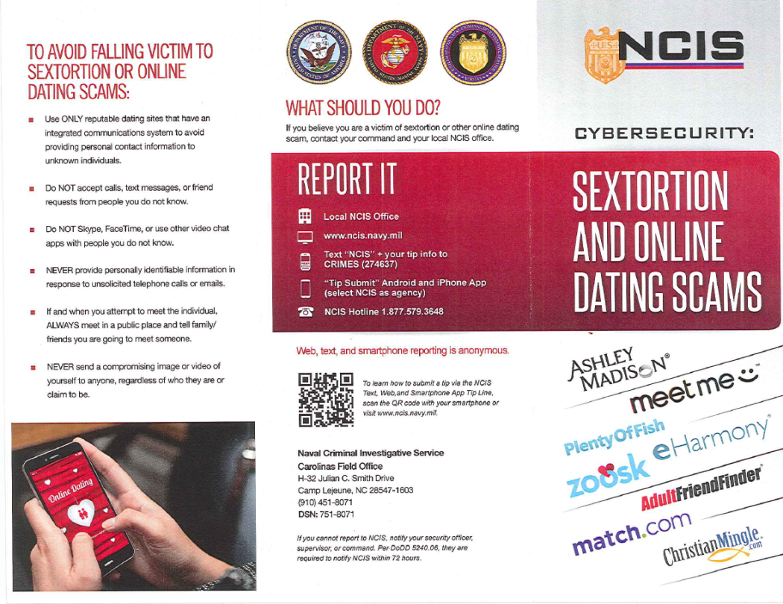
Crime Trends
Assault (Sexual/Domestic/Child abuse/Aggravated)
Internet Scams (Craigslist/POF/IRS/Sextortion)
LARCENY
Drugs

Slide 29
Naval Criminal Investigative Service
Special Agent Special Michael C. Cote
(910) 449-6012
Building AS-302, MCAS New River
Notes:
Definition of Investigative and Law Enforcement Personnel:
Naval Criminal Investigative Service (NCIS), Criminal Investigative Division (CID), military police, installation .security, and other individuals with authority to conduct a criminal investigation or inquire into a crime. For the purposes of this chapter, this term does not include individuals appointed to conduct investigations under chapter II of JAGINST 5800.7F.

Slide 30
LSST OIC
Appoint a VWAC to the Victim Witness Council
Supervise TCs
Ensure CMS data regarding VWAP is entered correctly and completely
Notes:
This list is ever changing – difficult for you to get a handle on.
Installation level.

Slide 31
Legal
Mrs. Latoya Hill
(VWAC)
(910) 451-8028
TSO SNCOIC
(910) 451-0142
Legal Services Support Team (LSST)
Building (Trailer) 59F
Camp Lejeune, NC
VWAP Council member

Slide 32
What or how you support VWAP
Provide victims and witnesses with 2701, 2702, 2703.
Complete 2704 if accused is sentenced with confinement.
Complete 54e, for cases with victims.
Coordinate/complete all travel arrangements for victims and witnesses.
Notify victims/witnesses of alternate dispo

Slide 33
Trial Counsel
Once assigned to a case must:
Identify victims and witnesses
Provide DD 2701 (if not already provide) and 2702
Ensure victims/witnesses are provided information about MJ process, including what to expect from the system, what the system expects from them, and the stages of the MJ process
Comply with notification requirements
Comply with consultation requirement

Slide 34
TC - Notification Requirements
When a victim has requested notification, must advised of:
Pretrial confinement status of suspected offender
Date charges are preferred and / or referred and the nature of the charges
Acceptance of a pretrial agreement
Scheduling of court proceedings
Findings of a court-martial
Sentence adjudged
Convening authority’s action regarding findings and sentence
TC must notify all victims who have been scheduled to attend any MJ proceedings of scheduling changes that affect their appearance
TC must notify of right to the record of trial in a sexual assault case

Slide 35
TC - Consultation Requirement
Victims have a designated advisory role in decisions involving prosecutorial discretion such as plea bargaining
TC shall ensure victims are aware of the right to act in this advisory capacity
When a victim has elected to act in advisory capacity, TC shall ensure victim’s views regarding prosecution and plea negotiations are obtained and forwarded to convening authority

Slide 36
TC - Other Assistance
Separate waiting room (upon requested)
Provide victims/witnesses with information concerning services such as transportation, parking, child care, lodging, translators and interpreters
Take reasonable steps to inform employers that victim/witness is involved in court-martial (upon request)
Contact creditor if victim/witness subject to serious financial strain caused by crime or cooperation in investigation / prosecution
Safeguard victim’s property held as evidence and return it as soon as possible
Notes:
TC shall ensure, to the extent possible, that victims and prosecution witnesses are provided with a waiting area during court-martial proceedings that is removed from and out of sight of accused and defense witnesses

Slide 37
TC - Sentencing
Inform victims of the opportunity to present evidence to the court at sentencing, including statement concerning impact of the crime, such as financial, psychological and physical harm

Slide 38
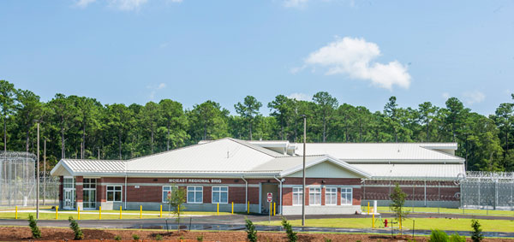
(910) 451-1308
Appoint a VWAC to the Victim Witness Assistance Council
Manage victim and witness information in a central repository
Provide notification with regards to prisoner status change pursuant to DD 2704 election

Slide 39
Victim’s Legal Counsel Organization
The Marine Corps Victims' Legal Counsel Organization is fully committed to provide legal advice and, when detailed, representation to victims of sexual assault and other crimes, and to protect victims' rights at all stages of the military justice process.

Slide 40
Location
Building 403
L Street

Slide 41
Contact Information
Major Kay Hill
Regional Victims’ Legal Counsel
(910) 451-5165 office
(910) 915-9774 gov cell
kay.hill@usmc.mil
Ms. Talana Diggs
VLC Paralegal
(910) 451-8519 office
(703) 859-5310 gov cell
talana.diggs@usmc.mil
**Call to schedule appointments

Slide 42
Contact Information
Capt Dennis Scanlon
Victims’ Legal Counsel
910-451-3122
dennis.scanlon@usmc.mil
Capt Christopher Kim
Victims’ Legal Counsel
910-450-2499
christopher.c.kim@usmc.mil
Capt Robert Pyatt
Victims’ Legal Counsel
910-451-2545
robert.c.pyatt@usmc.mil

Slide 43
Cherry Point
Capt Mark Marsella
Victims’ Legal Counsel
(252) 466-5649
mark.marsella@usmc.mil
Parris Island
Capt Brittany Berosky
Victims’ Legal Counsel
(843) 228-3581
brittany.berosky@usmc.mil
Mr. Derick Cheeks
VLC Paralegal
(843) 228-4801
derick.l.cheeks@usmc.mil,

Slide 44
COORDINATION IS KEY
All offices are responsible for a part of the military justice process (including, but not limited to, law enforcement and criminal investigative agencies, convening authorities, legal, corrections) are responsible for ensuring a smooth transition of victim and witness assistance at each stage of the criminal justice process. This means that close coordination is required among the VWAP personnel assigned to each of these offices during the transition from one phase of the criminal justice process to the next.
Ensure right contact information is given on each DD Form to each Victim or Witness
Ensure continuing coverage for Victims/Witnesses of services and rights.

Slide 45
PURPOSE & GOALS
Satisfied the annual training requirement.
Ensure that all victims and witnesses are treated with dignity and respect.
Ensure all victims are aware of their rights and are provided services they need.
Protect victims from further harm or hardship.
Employ a multi-disciplinary approach to assisting victims and witnesses by combining the services of law enforcement, family advocacy, medical, legal, corrections, and command personnel.
Improve Installation program to provide best support to our victims and witnesses.
Notes:
2 questions to think about: What’s currently required by the program? What can we do to ensure we do this in the best possible way?

Slide 46
REFERENCES
Victim Witness Protection Act of 1982 – establishes VWAP
Victims of Crime Act of 1984 – DOJ funded/Victims have fund
Crime Control Act of 1990 – Victims right to information about offenders
NDAA 1994 – mandates notification of inmate status changes
18 U.S.C. § 3771(a) “Justice for All Act of 2004” – most recent
DoDI 1030.02 of Sept 2, 2020 “Victim and Witness Assistance”
SECNAVINST 5800.11B of 5 Jan 2006 “Victim and Witness Assistance Program”
JAGINST 5800.7G of 19 Jan 2021 “Manual of the Judge Advocate General”
MCO 5800.16 W/CH7 Vol 16, Chap 4 of 26 Aug 2021 “Victim and Witness Assistance Program”
ASO 5800.1A of 24 Aug 2021“Victim and Witness Assistance Program”

Slide 47
VWAP vs SAPR
VWAP is an overarching assistance program for victim(s) and witness(es) of any crime, regardless of type and criminal proceeding.
SAPR is a specialized victim assistance program for sexual assault cases.
The main requirements of VWAP are for the necessary personnel to inform victim(s) and witness(es) of their rights, providing appropriate information (forms/notification), and track the status of a confined individual if requested.
Under SAPR, the obligations are much more labor intensive and require constant coordination of all parties.
Notes:
VWAP
040101. Applicability of VWAP
A. The VWAP is not limited to criminal offenses prosecuted at courts-martial. Except as specified, the notification responsibilities described in this Chapter also pertain when offenses are adjudicated at non-judicial punishment (NJP), ADSEP proceedings, or via other administrative means.
B. Particular attention shall be paid to cases involving unrestricted reports of violations of Articles 120, 130 (Article 120a if alleged to have been committed prior to Janua1y 1, 2019), 120 b, 120c, 125 (if alleged to have been committed prior to Janua1y 1, 2019), and Article 80 attempts of these offenses under the Uniform Code of Military Justice. Such unrestricted reports create additional notification requirements and rights under JAGINST 5800.7G, which are discussed further in this chapter.
C. The Marine Corps Sexual Assault Prevention and Response Office (SAPRO) supervises and has cognizance over all programs and services provided to adult sexual assault victims, as defined in reference MCO 1752.5C. In all cases involving allegations of sexual assault, personnel shall review MCO l 752 .5C for supplemental guidance.
SAPR
Applies to all victims of sexual assault (note: these victims still retain rights under VWAP leaving a great deal of overlap between the two programs) Sexual assault is defined as intentional sexual contact, characterized by use of force, physical threat, or abuse of authority or when the victim does not or cannot consent

Slide 48
VWAP vs SAPR Purpose
VWAP
To reduce the trauma, frustration and inconvenience experienced by victims and witnesses of crime; inform victims of their statutory rights; and assist victim and witness understanding of the military justice process.
SAPR
To eliminate the occurrence of sexual assault by strengthening a culture of prevention through risk reduction, education and training, response capability, victim support, reporting procedures and offender accountability, as appropriate, that enhance the safety and well-being of all.
Notes:
VWAP
To uniformly notify victims/witnesses of their rights throughout the criminal justice process including rights before, during and after court-martial and the right to be notified of status changes of the confinee
SAPR
To eliminate sexual assaults within the Marine Corps and to assist those Marines affected by sexual assault; to provide standardized requirements, guidelines, protocols, and instructional materials on awareness and prevention of sexual assault; to provide an immediate, trained response capability for each report of sexual assault in all locations; and to ensure support of effective command programs and criminal justice procedures for persons to be held accountable

Slide 49
VWAP vs SAPR Applicability
VWAP
Applies to all victims of crimes committed in violation of the UCMJ, or in violation of the law of another jurisdiction.
SAPR
Applies to all eligible victims of sexual assault.
Notes:
VWAP
Applies to all victims of crimes committed in violation of the UCMJ, or in violation of the law of another jurisdiction if any portion of the investigation is conducted primarily by the DoD components, and to all witnesses of similar crimes (but not to defense witnesses or an individual involved in the crime as a perpetrator or accomplice)
SAPR
Applies to all victims of sexual assault (note: these victims still retain rights under VWAP leaving a great deal of overlap between the two programs)
Sexual assault is defined as intentional sexual contact, characterized by use of force, physical threat, or abuse of authority or when the victim does not or cannot consent

Slide 50
VWAP vs SAPR Personnel Involved
VWAP
Victim Witness Assistance Coordinators (VWAC)
SAPR
Uniform Victims Advocates (UVA)
Question:
Can the UVA and VWAC be the same person?
NO! Look at the job title – different roles and responsibilities evident
Notes:
SAPR
Deputy Commandant for Manpower and Reserve Affairs
Establish a SARP program and staff
Commanders
Appoints a Sexual Assault Response Coordinator (SARC)
SARC
Receives training, appoints UVAs, ensures that each victim has an assigned VA, track support services provided to sexual assault victims, and ensures victim receives DD Form 2701. Additionally, the SARC is responsible for informing the victim of any obligations after restricted reporting
Commander
Appoint a SARC
Victim Advocate
Uniformed Victim Advocate
Structure
VWAP
Installation Commanders manage VWAP for the base (and appoint a VWLO who is responsible for the day-to-day operation of VWAP)
NCIS/CID/PMO normally have the first responsibility to inform crime victims and witnesses of rights under VWAP
Trial Counsel and other legal personnel have a continuing reasonability to ensure victims and witnesses are afforded their rights and the services under VWAP
Corrections personnel manage post-trial confinement forms, reports, and notifications to victims/witnesses of changes in prisoner status
Service provider and other personnel support VWAP through close coordination and knowledge of services and rights
SAPR
The SARC monitors the case status and disposition of all sexual assault cases for their command
The CMG meets monthly to review the status of each unrestricted sexual assault case
The unit SARC monitors all sexual assault cases within the unit
The VAs/UVAs meet with the victim regularly and ensure that the victim’s rights are being upheld, including confidentiality.

Slide 51
DOD POLICY
Role of victims/witnesses should be enhanced/protected.
Do all that is possible to assist victims/witnesses without infringing on the rights of the accused.
Particular attention should be paid to victims of serious, violent crime, including sexual assault, child abuse, and domestic violence.

Slide 52
Who is a victim?
Definition:
A person who has suffered direct physical, emotional, or pecuniary harm as a result of the commission of a crime in violation of the Uniform Code of Military Justice (UCMJ), or in violation of the law of another jurisdiction if any case where military authorities have been notified.
Notes:
Who are these people?
Credit Card theft
Barracks thief stole my TV.
Junior LCpl or PFC hazed by the “Senior LCpl”
Sexual Harassment victim
Victim. A person who has suffered direct physical, emotional, or pecuniary harm as a result of the commission of a crime in violation of the Uniform Code ofMilita1y Justice or the laws of another jurisdiction in any case where military authorities have been notified. Victims include, but are not limited to, the following:
a. Military members and their family members.
b. When stationed outside the continental United States, DoD civilian employees and contractors, if provided for in the contract, and their family members. This program applies to services not available to DoD civilian employees and contractors, and their family members, in stateside locations, such as medical care in military medical facilities.
c. When a victim is under 18 years of age, incompetent , incapacitated, or deceased, the term includes either: a legal guardian, spouse, parent, child, sibling, family member , or another person the court designates , local responsible official, or designee.
d. The term does not include any individual involved in the crime as a perpetrator or accomplice, even if individual meets one of the other groups listed above.
e. An authorized representative of an institutional entity that meats the direct loss requirement. Federal Department, State, and local agencies are not eligible for services as institutional entity victims.

Slide 53
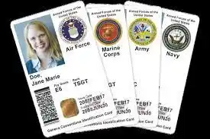
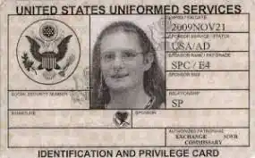
Who is a victim cont.
Victims shall include, but is not limited to:
Military members and their family members.
Outside the Continental U.S. - DoD civilian employees, contractors, and family members.
If victim is under 18, incompetent, incapacitated, or deceased, the term includes either: legal guardian, spouse, parent, child, sibling, family member, or another person designated by court.
The term does not include any individual involved in the crime as a perpetrator or accomplice, even if individual meets one of the other groups listed above.
An authorized representative of an institutional entity that meats the direct loss requirement. Federal Departments, State, and local agencies are not eligible for services as institutional entity victims.
Notes:
Per MCO 5800.14, Encl 2
The VWAP is not limited to criminal offenses prosecuted at courts-martial. Crime victims and witnesses do not forfeit their status when offenses are disposed of at nonjudicial punishment (NJP), administrative separation (ADSEP) proceedings, or via other administrative means.
Victim. A person who has suffered direct physical, emotional, or pecuniary harm as a result of the commission of a crime in violation of the Uniform Code ofMilita1y Justice or the laws of another jurisdiction in any case where military authorities have been notified. Victims include, but are not limited to, the following:
a. Military members and their family members.
b. When stationed outside the continental United States, DoD civilian employees and contractors, if provided for in the contract, and their family members. This program applies to services not available to DoD civilian employees and contractors, and their family members, in stateside locations, such as medical care in military medical facilities.
c. When a victim is under 18 years of age, incompetent , incapacitated, or deceased, the term includes either: a legal guardian, spouse, parent, child, sibling, family member , or another person the court designates , local responsible official, or designee.
d. The term does not include any individual involved in the crime as a perpetrator or accomplice, even if individual meets one of the other groups listed above.
e. An authorized representative of an institutional entity that meats the direct loss requirement. Federal Department, State, and local agencies are not eligible for services as institutional entity victims.

Slide 54
VICTIMS’ RIGHTS
In addition to any other rights afforded to third parties, a crime victim has the right to:
Be reasonably protected from the accused offender.
Be provide with a reasonable, accurate, and timely notice of:
(1) A public hearing concerning the continuation of pretrial confinement of the accused.
(2) A preliminary hearing pursuant to Article 32, UCMJ, relating to the offense. Including the right to receive a copy of the appointing order directing the preliminary hearing.
(3) A court-martial relating to the offense, including any open hearing held pursuant to Article 39a, UCMJ, and any post-trial vacation hearing.
(4) A public proceeding of the Military Department Clemency and Parole Board relating to the offense.
(5) The release or escape of the accused, unless such notice may endanger the safety of any person.
MPO or No Contact Orders
Initial Review Officer’s(IRO) Hearing
Notes:
Sexual Assault victims have different rights as the VLC has discussed.
i.e. right to attend vs notice of public proceedings.
To be reasonably protected from the accused.
To reasonable, accurate, and timely notice of any public court proceeding, or any parole proceeding, involving the crime or of any release or escape of the accused.
Not to be excluded from any such public court proceeding, unless the court, after receiving clear and convincing evidence, determines that testimony by the victim would be materially altered if the victim heard other testimony at that proceeding.
To be reasonably heard at any public proceeding involving release, plea, sentencing, or any parole proceeding.
To full and timely restitution as provided in law.
To proceedings free from unreasonable delay.
To be treated with fairness and with respect for the victim's dignity and privacy.
The reasonable right to confer with the attorney for the Government in the case.
Victim’s rights do not provide authority for a legal “cause of action” against the Government
MCM Article 6b
(a) RIGHTS OF A VICTIM OF AN OFFENSE UNDER THIS CHAPTER.—A victim of an offense under this chapter has the following rights:
(1) The right to be reasonably protected from the accused.
(2) The right to reasonable, accurate, and timely notice of any of
the following:
(A) A public hearing concerning the continuation of
confinement prior to trial of the accused.
(B) A preliminary hearing under section 832 of this title (article
32) relating to the offense.
(C) A court-martial relating to the offense.
(D) A public proceeding of the service clemency and parole
board relating to the offense.
(E) The release or escape of the accused, unless such notice
may endanger the safety of any person.
(3) The right not to be excluded from any public hearing or
proceeding described in paragraph (2) unless the military judge or
preliminary hearing officer, as applicable, after receiving clear
and convincing evidence, determines that testimony by the victim of
an offense under this chapter would be materially altered if the
victim heard other testimony at that hearing or proceeding.
(4) The right to be reasonably heard at any of the following:
(A) A public hearing concerning the continuation of
confinement prior to trial of the accused.
(B) A sentencing hearing relating to the offense.
(C) A public proceeding of the service clemency and parole
board relating to the offense.
(5) The reasonable right to confer with the counsel representing
the Government at any proceeding described in paragraph (2).
(6) The right to receive restitution as provided in law.
(7) The right to proceedings free from unreasonable delay.
(8) The right to be treated with fairness and with respect for the
dignity and privacy of the victim of an offense under this chapter.

Slide 55
VICTIMS’ RIGHTS Cont.
(6) The date and time of any review of the accused’s case by an appellate court, the scheduling (including changes and delays) of each public appellate court proceeding the victim is entitled to attend, and the decision of any appellate court or judge advocate review.
(7) Any post-trial motion, filing, or hearing that addresses either the findings or sentence of a court-martial involving the accused, the unsealing of privileged or private information of the victim, or which may result in the release of the accused.
C. The right to receive, upon request, a copy of, or access to, the recording of a preliminary hearing held under Article 32, UCMJ, as soon as practicable following the conclusion of the hearing.
D. The right to not be excluded from any public hearing or proceeding described in paragraph 040401.E. of this chapter except under such circumstances as permitted exclusion under Military Rule of Evidence 615 of reference (g). E. Be reasonably heard, personally or through counsel, at:
(1) A public hearing concerning the continuation of confinement before the court-martial of the accused.
Notes:
Sexual Assault victims have different rights as the VLC has discussed.
i.e. right to attend vs notice of public proceedings.
To be reasonably protected from the accused.
To reasonable, accurate, and timely notice of any public court proceeding, or any parole proceeding, involving the crime or of any release or escape of the accused.
Not to be excluded from any such public court proceeding, unless the court, after receiving clear and convincing evidence, determines that testimony by the victim would be materially altered if the victim heard other testimony at that proceeding.
To be reasonably heard at any public proceeding involving release, plea, sentencing, or any parole proceeding.
To full and timely restitution as provided in law.
To proceedings free from unreasonable delay.
To be treated with fairness and with respect for the victim's dignity and privacy.
The reasonable right to confer with the attorney for the Government in the case.
Victim’s rights do not provide authority for a legal “cause of action” against the Government
MCM Article 6b
(a) RIGHTS OF A VICTIM OF AN OFFENSE UNDER THIS CHAPTER.—A victim of an offense under this chapter has the following rights:
(1) The right to be reasonably protected from the accused.
(2) The right to reasonable, accurate, and timely notice of any of
the following:
(A) A public hearing concerning the continuation of
confinement prior to trial of the accused.
(B) A preliminary hearing under section 832 of this title (article
32) relating to the offense.
(C) A court-martial relating to the offense.
(D) A public proceeding of the service clemency and parole
board relating to the offense.
(E) The release or escape of the accused, unless such notice
may endanger the safety of any person.
(3) The right not to be excluded from any public hearing or
proceeding described in paragraph (2) unless the military judge or
preliminary hearing officer, as applicable, after receiving clear
and convincing evidence, determines that testimony by the victim of
an offense under this chapter would be materially altered if the
victim heard other testimony at that hearing or proceeding.
(4) The right to be reasonably heard at any of the following:
(A) A public hearing concerning the continuation of
confinement prior to trial of the accused.
(B) A sentencing hearing relating to the offense.
(C) A public proceeding of the service clemency and parole
board relating to the offense.
(5) The reasonable right to confer with the counsel representing
the Government at any proceeding described in paragraph (2).
(6) The right to receive restitution as provided in law.
(7) The right to proceedings free from unreasonable delay.
(8) The right to be treated with fairness and with respect for the
dignity and privacy of the victim of an offense under this chapter.

Slide 56
VICTIMS’ RIGHTS Cont.
(2) Preliminary hearings conducted pursuant to Article 32, UCMJ, and court-martial proceedings relating to Rules 412, 513, and 514 of the Military Rules of Evidence or regarding other rights provided by statute, regulation, or case law. (3) A public sentencing hearing relating to the offense. (4) A public Military Department Clemency and Parole Board hearing relating to the offense. F. The right to confer with the attorney for the U.S. Government at any proceeding described in paragraph 040401.B of this chapter. G. The right to be consulted and express their opinion concerning:
(1) Pretrial confinement of the accused and release of the accused from pretrial confinement. (2) Regarding offense(s) committed against the victim, any decision to not prefer charges and any decision to dispose of the charges by means other than court-martial. (3) Regarding offense(s) committed against the victim, any decision concerning whether to dismiss or refer charges. (4) The proposed terms and conditions of any plea agreement.
Sexual behavior/Psychotherapist-patient privilege/Victim Advocate-victim privilege
Notes:
Rule 412. Sex offense cases: The victim’s sexual behavior or predisposition
Evidence generally inadmissible. The following evidence is not admissible in any proceeding involving an alleged sexual offense except as provided in subdivisions (b) and (c):
Evidence offered to prove that a victim engaged in other sexual behavior; or
Evidence offered to prove a victim’s sexual predisposition.
Exceptions. In a proceeding, the following evidence is admissible, if otherwise admissible under these rules:
evidence of specific instances of a victim’s sexual behavior, if offered to prove that someone other than the accused was the source of semen, injury, or other physical evidence;
evidence of specific instances of a victim’s sexual behavior with respect to the person accused of the sexual misconduct, if offered by the accused o
prove consent or if offered by the prosecution; and
(3) evidence the exclusion of which would violate the accused’s constitutional rights.
Procedure to determine admissibility.
A party intending to offer evidence under subdivision (b) must—
file a written motion at least 5 days prior to entry of pleas specifically describing the evidence and stating the purpose for which it is offered unless the military judge, for good cause shown, requires a different time for filing or permits filing during trial; and
(B) serve the motion on the opposing party and the military judge and notify the victim or, when appropriate, the victim’s guardian or representative.
(2) Before admitting evidence under this rule, the military judge must conduct a hearing, which shall be closed. At this hearing, the parties may call witnesses, including the victim, and offer relevant evidence. The victim must be afforded a reasonable opportunity to attend and be heard. However, the hearing may not be unduly delayed for this purpose. The right to be heard under this rule includes the right to be heard through counsel, including Special Victims’ Counsel under section 1044e of title 10, United States Code. In a case before a court-martial composed of a military judge and members, the military judge shall conduct the hearing outside the presence of the members pursuant to Article 39(a). The motion, related papers, and the record of the hearing must be sealed in accordance with R.C.M. 1113 and remain under seal unless the military judge, the Judge Advocate General, or an appellate court orders otherwise.
(3) If the military judge determines on the basis of the hearing described in paragraph (2) of this subdivision that the evidence that the accused seeks to offer is relevant for a purpose under subdivision (b)(1) or (2) of this rule and that the probative value of such evidence outweighs the danger of unfair prejudice to the victim’s privacy, or that the evidence is described by subdivision (b)(3) of this rule, such evidence shall be admissible under this rule to the extent an order made by the military judge specifies evidence that may be offered and areas with respect to which the victim may be examined or cross-examined. Any evidence introduced under this rule is subject to challenge under Mil. R. Evid. 403.
(d) Definitions. For purposes of this rule, the term “sexual offense” includes any sexual misconduct punishable under the Uniform Code of Military Justice, federal law or state law. “Sexual behavior”
includes any sexual behavior not encompassed by the alleged offense. The term “sexual predisposition” refers to a victim’s mode of dress, speech, or lifestyle that does not directly refer to sexual activities or thoughts but that may have a sexual connotation for the fact finder. For purposes of this rule, the term “victim” includes an alleged victim.
Rule 513. Psychotherapist—patient privilege
General Rule. A patient has a privilege to refuse to disclose and to prevent any other person from disclosing a confidential communication made between the patient and a psychotherapist or an assistant to the psychotherapist, in a case arising under the Uniform Code of Military Justice, if such communication was made for the purpose of facilitating diagnosis or treatment of the patient’s mental or emotional condition.
Definitions. As used in this rule:
“Patient” means a person who consults with or is examined or interviewed by a psychotherapist for purposes of advice, diagnosis, or treatment of a mental or emotional condition.
“Psychotherapist” means a psychiatrist, clinical psychologist, clinical social worker, or other mental health professional who is licensed in any State, territory, possession, the District of Columbia, or Puerto Rico to perform professional services as such, or who holds credentials to provide such services as such, or who holds credentials to provide such services from any military health care facility, or is a person reasonably believed by the patient to have such license or credentials.
“Assistant to a psychotherapist” means a person directed by or assigned to assist a psychotherapist in providing professional services, or is reasonably believed by the patient to be such.
A communication is “confidential” if not intended to be disclosed to third persons other than those to whom disclosure is in furtherance of the rendition of professional services to the patient or those reasonably necessary for such transmission of the communication.
“Evidence of a patient’s records or communications” means testimony of a psychotherapist, or assistant to the same, or patient records that pertain to communications by a patient to a psychotherapist, or assistant to the same, for the purposes of diagnosis or treatment of the patient’s mental or emotional condition.
Who May Claim the Privilege. The privilege may be claimed by the patient or the guardian or conservator of the patient. A person who may claim the privilege may authorize trial counsel, defense counsel, or any counsel representing the patient to claim the privilege on his or her behalf. The psychotherapist or
assistant to the psychotherapist who received the communication may claim the privilege on behalf of the patient. The authority of such a psychotherapist, assistant, guardian, or conservator to so assert the privilege is presumed in the absence of evidence to the contrary.
Exceptions. There is no privilege under this rule:
when the patient is dead;
when the communication is evidence of child abuse or of neglect, or in a proceeding in which one spouse is charged with a crime against a child of either spouse;
when federal law, state law, or service regulation imposes a duty to report information contained in a communication;
when a psychotherapist or assistant to a psychotherapist believes that a patient’s mental or emotional condition makes the patient a danger to any person, including the patient;
if the communication clearly contemplated the future commission of a fraud or crime or if the services of the psychotherapist are sought or obtained to enable or aid anyone to commit or plan to commit what the patient knew or reasonably should have known to be a crime or fraud;
when necessary to ensure the safety and security of military personnel, military dependents, military property, classified information, or the accomplishment of a military mission; or
when an accused offers statements or other evidence concerning his mental condition in defense, extenuation, or mitigation, under circumstances not covered by R.C.M. 706 or Mil. R. Evid. 302. In such situations, the military judge may, upon motion, order disclosure of any statement made by the accused to a psychotherapist as may be necessary in the interests of justice.
Procedure to Determine Admissibility of Patient Records or Communications.
In any case in which the production or admission of records or communications of a patient other than the accused is a matter in dispute, a party may seek an interlocutory ruling by the military judge. In order to obtain such a ruling, the party must:
file a written motion at least 5 days prior to entry of pleas specifically describing the evidence and stating the purpose for which it is sought or offered, or objected to, unless the military judge, for good cause
shown, requires a different time for filing or permits filing during trial; and
(B) serve the motion on the opposing party, the military judge and, if practical, notify the patient or the patient’s guardian, conservator, or representative that the motion has been filed and that the patient has an opportunity to be heard as set forth in subdivision (e)(2).
Before ordering the production or admission of evidence of a patient’s records or communication, the military judge must conduct a hearing, which shall be closed. At the hearing, the parties may call witnesses, including the patient, and offer other relevant evidence. The patient must be afforded a reasonable opportunity to attend the hearing and be heard. However, the hearing may not be unduly delayed for this purpose. The right to be heard under this rule includes the right to be heard through counsel, including Special Victims’ Counsel under section 1044e of title 10, United States Code. In a case before a court-martial composed of a military judge and members, the military judge must conduct the hearing outside the presence of the members.
The military judge may examine the evidence or a proffer thereof in camera, if such examination is necessary to rule on the production or admissibility of protected records or communications. Prior to conducting an in-camera review, the military judge must find by a preponderance of the evidence that the moving party showed:
a specific, credible factual basis demonstrating a reasonable likelihood that the records or communications would contain or lead to the discovery of evidence admissible under an exception to the privilege;
that the requested information meets one of the enumerated exceptions under subdivision (d) of this rule;
that the information sought is not merely cumulative of other information available; and
that the party made reasonable efforts to obtain the same or substantially similar information through non-privileged sources.
Any production or disclosure permitted by the military judge under this rule must be narrowly tailored to only the specific records or communications, or portions of such records or communications, that meet the requirements for one of the enumerated exceptions to the privilege under subdivision (d) of this Rule and
are included in the stated purpose for which the records or communications are sought under subdivision (e)(1)(A) of this Rule.
To prevent unnecessary disclosure of a patient’s records or communications, the military judge may issue protective orders or may admit only portions of the evidence.
The motion, related papers, and the record of the hearing must be sealed in accordance with R.C.M. 701(g)(2) or 1113 and must remain under seal unless the military judge, the Judge Ad ral, or an
appellate court orders otherwise.
Rule 514. Victim advocate—victim privilege
General Rule. A victim has a privilege to refuse to disclose and to prevent any other person from disclosing a confidential communication made between the alleged victim and a victim advocate or between the alleged victim and Department of Defense Safe Helpline staff, in a case arising under the UCMJ, if such communication was made for the purpose of facilitating advice or assistance to the alleged victim.
Definitions. As used in this rule:
“Victim” means any person who is alleged to have suffered direct physical or emotional harm as the result of a sexual or violent offense.
“Victim advocate” means a person, other than a prosecutor, trial counsel, any victims’ counsel, law enforcement officer, or military criminal investigator in the case, who:
is designated in writing as a victim advocate in accordance with service regulation;
is authorized to perform victim advocate duties in accordance with service regulation and is acting in the performance of those duties; or
is certified as a victim advocate pursuant to federal or state requirements.
“Department of Defense Safe Helpline staff” are persons who are designated by competent authority in writing as Department of Defense Safe Helpline staff.
A communication is “confidential” if made in the course of the victim advocate-victim relationship or Department of Defense Safe Helpline staff-victim relationship and not intended to be disclosed to third persons other than those to whom disclosure is made in furtherance of the rendition of advice or assistance to the alleged victim or those reasonably necessary for such transmission of the communication
(5) “Evidence of a victim’s records or communications” means testimony of a victim advocate or Department of Defense Safe Helpline staff, or records that pertain to communications by a victim to a victim advocate or Department of Defense Safe Helpline staff, for the purposes of advising or providing assistance to the victim.
Who May Claim the Privilege. The privilege may be claimed by the victim or the guardian or conservator of the victim. A person who may claim the privilege may authorize trial counsel or a counsel representing the victim to claim the privilege on his or her behalf. The victim advocate or Department of Defense Safe Helpline staff who received the communication may claim the privilege on behalf of the victim. The authority of such a victim advocate, Department of Defense Safe Helpline staff, guardian, conservator, or a counsel representing the victim to so assert the privilege is presumed in the absence of evidence to the contrary.
Exceptions. There is no privilege under this rule:
when the victim is dead;
when federal law, state law, Department of Defense regulation, or service regulation imposes a duty to report information contained in a communication;
when a victim advocate or Department of Defense Safe Helpline staff believes that a victim’s mental or emotional condition makes the victim a danger to any person, including the victim;
if the communication clearly contemplated the future commission of a fraud or crime, or if the services of the victim advocate or Department of Defense Safe Helpline staff are sought or obtained to enable or aid anyone to commit or plan to commit what the victim knew or reasonably should have known to be a crime or fraud;
when necessary to ensure the safety and security of military personnel, military dependents, military property, classified information, or the accomplishment of a military mission; or
when admission or disclosure of a communication is constitutionally required.
Procedure to Determine Admissibility of Victim Records or Communications.
In any case in which the production or admission of records or communications of a victim is a matter in dispute, a party may seek an interlocutory ruling by the
military judge. In order to obtain such a ruling, the party must:
file a written motion at least 5 days prior to entry of pleas specifically describing the evidence and stating the purpose for which it is sought or offered, or objected to, unless the military judge, for good cause shown, requires a different time for filing or permits filing during trial; and
serve the motion on the opposing party, the military judge and, if practicable, notify the victim or the victim’s guardian, conservator, or representative that the motion has been filed and that the victim has an opportunity to be heard as set forth in subdivision (e)(2).
Before ordering the production or admission of evidence of a patient’s records or communication, the military judge must conduct a hearing, which shall be closed. At the hearing, the parties may call witnesses, including the victim, and offer other relevant evidence. The victim must be afforded a reasonable opportunity to attend the hearing and be heard. However, the hearing may not be unduly delayed for this purpose. The right to be heard under this rule includes the right to be heard through counsel, including Special Victims’ Counsel under section 1044e of title 10, United States Code. In a case before a court-martial composed of a military judge and members, the military judge must conduct the hearing outside the presence of the members.
The military judge may examine the evidence or a proffer thereof in camera, if such examination is necessary to rule on the production or admissibility of protected records or communications. Prior to conducting an in camera review, the military judge must find by a preponderance of the evidence that the moving party showed:
a specific, credible factual basis demonstrating a reasonable likelihood that the records or communications would contain or lead to the discovery of evidence admissible under an exception to the privilege;
that the requested information meets one of the enumerated exceptions under subdivision (d) of this rule;
that the information sought is not merely cumulative of other information available; and
that the party made reasonable efforts to obtain the same or substantial formation
through non-privileged sources.
Any production of disclosure permitted by the military judge under this rule must be narrowly tailored to only the specific records or communications, or portions of such records or communications, that meet the requirements for one of the enumerated exceptions to the privilege under subdivision (d) of this Rule and are included in the stated purpose for which the records or communications are sought under subdivision (e)(1)(A) of this rule.
To prevent unnecessary disclosure of evidence of a victim’s records or communications, the military judge may issue protective orders or may admit only portions of the evidence.
The motion, related papers, and the record of the hearing must be sealed in accordance with R.C.M. 701(g)(2) or 1113 and must remain under seal unless the military judge, the Judge Ad ral, or an
appellate court orders otherwise.

Slide 57
VICTIMS’ RIGHTS Cont.
(5) About testifying as a witness. Note: while the convening authority and trial counsel should strongly consider the victim preference concerning whether to provide testimony, the victim’s to Article 39a, UCMJ, and any post-trial vacation hearing. Preference against testimony does not prevent the government using subpoena, or other appropriate legal process, to require victim testimony in the interest of justice. H. Crime victims and their dependents who are eligible for legal assistance may consult with a military legal assistance attorney in accordance with DoDI 1030.02 Paragraph 3.4 and Volume 5 of this manual. Additionally, victims may elect to seek the advice of a private attorney, at their own expense. I. Victims of an offense alleged under Articles 120, 120a, 120b, or 120c or forcible sodomy under the UCMJ or attempts to commit such offenses under Article 80, UCMJ, who are eligible for legal assistance per Military Department or National Guard Bureau policies or in accordance with Sections 1044 or 1044e of Title 10, U.S.C., may consult with a VLC in accordance with DoDI 1030.02 Paragraph 3.5 and Volume 4 of this Manual. Victims of these covered offenses will be informed by a sexual assault response coordinator (SARC), victim advocate, victim witness liaison, military criminal investigator, trial counsel, or other responsible official that they have the right to consult with a VLC as soon as they seek assistance in accordance with Section 1565b of Title 10, U.S.C., and as otherwise authorized by Military Department and National Guard Bureau policy.

Slide 58
VICTIMS’ RIGHTS Cont.
J. Receive restitution as provided in accordance with state and federal law. K. Proceedings free from unreasonable delay. L. Be treated with fairness and respect for his or her dignity and privacy. M. Express his or her views to the commander or convening authority as to disposition of the case. N. Not be prevented from, or charged for, receiving a medical forensic examination. O. Have a sexual assault evidence collection kit or its probative contents preserved, without charge. P. Be provided a copy of any reports arising from result of a sexual assault evidence collection kit, including a deoxyribonucleic acid (DNA) profile match, toxicology report, or other information collected as part of a medical forensic examination, unless doing so would impede or compromise an ongoing investigation. Q. Be informed in writing of policies governing the collection and preservation of a sexual assault evidence collection kit.
Plea Agreements, Personnel Claims Act or Article 139 Claims

Slide 59
VICTIMS’ RIGHTS Cont.
R. Upon written request, receive written notification from the appropriate official with custody not later than 60 days before the date of the intended destruction or disposal of a sexual assault evidence collection kit. S. Upon written request, be granted further preservation of the kit or its probative contents. T. For victims of sex-related offenses committed in the United States, to be provided an opportunity to express a preference regarding whether the
offense should be prosecuted by court-martial or in a civilian court with jurisdiction over the offense. Additional details concerning this notification requirement are outlined in paragraph 040402 of this Volume. U. Where the accused was found guilty of an offense tried at a court-martial, the right to submit a written statement to the convening authority after the sentence is adjudged. V. The right to petition the Navy and Marine Corps Court of Criminal Appeals for a writ of mandamus contesting a ruling in an Article 32, UCMJ, preliminary hearing or court-martial if the victim believes the ruling violates the victim’s rights as enumerated in Article 6b, UCMJ, or afforded by Military Rule of Evidence (MRE) 412, MRE 513, MRE 514, or MRE 615 pursuant to Article 6b(e), UCMJ.
Sexual behavior/Psychotherapist-patient privilege/Victim Advocate-victim privilege/excluding witnesses
Notes:
Rule 412. Sex offense cases: The victim’s sexual behavior or predisposition
Evidence generally inadmissible. The following evidence is not admissible in any proceeding involving an alleged sexual offense except as provided in subdivisions (b) and (c):
Evidence offered to prove that a victim engaged in other sexual behavior; or
Evidence offered to prove a victim’s sexual predisposition.
Exceptions. In a proceeding, the following evidence is admissible, if otherwise admissible under these rules:
evidence of specific instances of a victim’s sexual behavior, if offered to prove that someone other than the accused was the source of semen, injury, or other physical evidence;
evidence of specific instances of a victim’s sexual behavior with respect to the person accused of the sexual misconduct, if offered by the accused o
prove consent or if offered by the prosecution; and
(3) evidence the exclusion of which would violate the accused’s constitutional rights.
Procedure to determine admissibility.
A party intending to offer evidence under subdivision (b) must—
file a written motion at least 5 days prior to entry of pleas specifically describing the evidence and stating the purpose for which it is offered unless the military judge, for good cause shown, requires a different time for filing or permits filing during trial; and
(B) serve the motion on the opposing party and the military judge and notify the victim or, when appropriate, the victim’s guardian or representative.
(2) Before admitting evidence under this rule, the military judge must conduct a hearing, which shall be closed. At this hearing, the parties may call witnesses, including the victim, and offer relevant evidence. The victim must be afforded a reasonable opportunity to attend and be heard. However, the hearing may not be unduly delayed for this purpose. The right to be heard under this rule includes the right to be heard through counsel, including Special Victims’ Counsel under section 1044e of title 10, United States Code. In a case before a court-martial composed of a military judge and members, the military judge shall conduct the hearing outside the presence of the members pursuant to Article 39(a). The motion, related papers, and the record of the hearing must be sealed in accordance with R.C.M. 1113 and remain under seal unless the military judge, the Judge Advocate General, or an appellate court orders otherwise.
(3) If the military judge determines on the basis of the hearing described in paragraph (2) of this subdivision that the evidence that the accused seeks to offer is relevant for a purpose under subdivision (b)(1) or (2) of this rule and that the probative value of such evidence outweighs the danger of unfair prejudice to the victim’s privacy, or that the evidence is described by subdivision (b)(3) of this rule, such evidence shall be admissible under this rule to the extent an order made by the military judge specifies evidence that may be offered and areas with respect to which the victim may be examined or cross-examined. Any evidence introduced under this rule is subject to challenge under Mil. R. Evid. 403.
(d) Definitions. For purposes of this rule, the term “sexual offense” includes any sexual misconduct punishable under the Uniform Code of Military Justice, federal law or state law. “Sexual behavior”
includes any sexual behavior not encompassed by the alleged offense. The term “sexual predisposition” refers to a victim’s mode of dress, speech, or lifestyle that does not directly refer to sexual activities or thoughts but that may have a sexual connotation for the fact finder. For purposes of this rule, the term “victim” includes an alleged victim.
Rule 513. Psychotherapist—patient privilege
General Rule. A patient has a privilege to refuse to disclose and to prevent any other person from disclosing a confidential communication made between the patient and a psychotherapist or an assistant to the psychotherapist, in a case arising under the Uniform Code of Military Justice, if such communication was made for the purpose of facilitating diagnosis or treatment of the patient’s mental or emotional condition.
Definitions. As used in this rule:
“Patient” means a person who consults with or is examined or interviewed by a psychotherapist for purposes of advice, diagnosis, or treatment of a mental or emotional condition.
“Psychotherapist” means a psychiatrist, clinical psychologist, clinical social worker, or other mental health professional who is licensed in any State, territory, possession, the District of Columbia, or Puerto Rico to perform professional services as such, or who holds credentials to provide such services as such, or who holds credentials to provide such services from any military health care facility, or is a person reasonably believed by the patient to have such license or credentials.
“Assistant to a psychotherapist” means a person directed by or assigned to assist a psychotherapist in providing professional services, or is reasonably believed by the patient to be such.
A communication is “confidential” if not intended to be disclosed to third persons other than those to whom disclosure is in furtherance of the rendition of professional services to the patient or those reasonably necessary for such transmission of the communication.
“Evidence of a patient’s records or communications” means testimony of a psychotherapist, or assistant to the same, or patient records that pertain to communications by a patient to a psychotherapist, or assistant to the same, for the purposes of diagnosis or treatment of the patient’s mental or emotional condition.
Who May Claim the Privilege. The privilege may be claimed by the patient or the guardian or conservator of the patient. A person who may claim the privilege may authorize trial counsel, defense counsel, or any counsel representing the patient to claim the privilege on his or her behalf. The psychotherapist or
assistant to the psychotherapist who received the communication may claim the privilege on behalf of the patient. The authority of such a psychotherapist, assistant, guardian, or conservator to so assert the privilege is presumed in the absence of evidence to the contrary.
Exceptions. There is no privilege under this rule:
when the patient is dead;
when the communication is evidence of child abuse or of neglect, or in a proceeding in which one spouse is charged with a crime against a child of either spouse;
when federal law, state law, or service regulation imposes a duty to report information contained in a communication;
when a psychotherapist or assistant to a psychotherapist believes that a patient’s mental or emotional condition makes the patient a danger to any person, including the patient;
if the communication clearly contemplated the future commission of a fraud or crime or if the services of the psychotherapist are sought or obtained to enable or aid anyone to commit or plan to commit what the patient knew or reasonably should have known to be a crime or fraud;
when necessary to ensure the safety and security of military personnel, military dependents, military property, classified information, or the accomplishment of a military mission; or
when an accused offers statements or other evidence concerning his mental condition in defense, extenuation, or mitigation, under circumstances not covered by R.C.M. 706 or Mil. R. Evid. 302. In such situations, the military judge may, upon motion, order disclosure of any statement made by the accused to a psychotherapist as may be necessary in the interests of justice.
Procedure to Determine Admissibility of Patient Records or Communications.
In any case in which the production or admission of records or communications of a patient other than the accused is a matter in dispute, a party may seek an interlocutory ruling by the military judge. In order to obtain such a ruling, the party must:
file a written motion at least 5 days prior to entry of pleas specifically describing the evidence and stating the purpose for which it is sought or offered, or objected to, unless the military judge, for good cause
shown, requires a different time for filing or permits filing during trial; and
(B) serve the motion on the opposing party, the military judge and, if practical, notify the patient or the patient’s guardian, conservator, or representative that the motion has been filed and that the patient has an opportunity to be heard as set forth in subdivision (e)(2).
Before ordering the production or admission of evidence of a patient’s records or communication, the military judge must conduct a hearing, which shall be closed. At the hearing, the parties may call witnesses, including the patient, and offer other relevant evidence. The patient must be afforded a reasonable opportunity to attend the hearing and be heard. However, the hearing may not be unduly delayed for this purpose. The right to be heard under this rule includes the right to be heard through counsel, including Special Victims’ Counsel under section 1044e of title 10, United States Code. In a case before a court-martial composed of a military judge and members, the military judge must conduct the hearing outside the presence of the members.
The military judge may examine the evidence or a proffer thereof in camera, if such examination is necessary to rule on the production or admissibility of protected records or communications. Prior to conducting an in-camera review, the military judge must find by a preponderance of the evidence that the moving party showed:
a specific, credible factual basis demonstrating a reasonable likelihood that the records or communications would contain or lead to the discovery of evidence admissible under an exception to the privilege;
that the requested information meets one of the enumerated exceptions under subdivision (d) of this rule;
that the information sought is not merely cumulative of other information available; and
that the party made reasonable efforts to obtain the same or substantially similar information through non-privileged sources.
Any production or disclosure permitted by the military judge under this rule must be narrowly tailored to only the specific records or communications, or portions of such records or communications, that meet the requirements for one of the enumerated exceptions to the privilege under subdivision (d) of this Rule and
are included in the stated purpose for which the records or communications are sought under subdivision (e)(1)(A) of this Rule.
To prevent unnecessary disclosure of a patient’s records or communications, the military judge may issue protective orders or may admit only portions of the evidence.
The motion, related papers, and the record of the hearing must be sealed in accordance with R.C.M. 701(g)(2) or 1113 and must remain under seal unless the military judge, the Judge Ad ral, or an
appellate court orders otherwise.
Rule 514. Victim advocate—victim privilege
General Rule. A victim has a privilege to refuse to disclose and to prevent any other person from disclosing a confidential communication made between the alleged victim and a victim advocate or between the alleged victim and Department of Defense Safe Helpline staff, in a case arising under the UCMJ, if such communication was made for the purpose of facilitating advice or assistance to the alleged victim.
Definitions. As used in this rule:
“Victim” means any person who is alleged to have suffered direct physical or emotional harm as the result of a sexual or violent offense.
“Victim advocate” means a person, other than a prosecutor, trial counsel, any victims’ counsel, law enforcement officer, or military criminal investigator in the case, who:
is designated in writing as a victim advocate in accordance with service regulation;
is authorized to perform victim advocate duties in accordance with service regulation and is acting in the performance of those duties; or
is certified as a victim advocate pursuant to federal or state requirements.
“Department of Defense Safe Helpline staff” are persons who are designated by competent authority in writing as Department of Defense Safe Helpline staff.
A communication is “confidential” if made in the course of the victim advocate-victim relationship or Department of Defense Safe Helpline staff-victim relationship and not intended to be disclosed to third persons other than those to whom disclosure is made in furtherance of the rendition of advice or assistance to the alleged victim or those reasonably necessary for such transmission of the communication
(5) “Evidence of a victim’s records or communications” means testimony of a victim advocate or Department of Defense Safe Helpline staff, or records that pertain to communications by a victim to a victim advocate or Department of Defense Safe Helpline staff, for the purposes of advising or providing assistance to the victim.
Who May Claim the Privilege. The privilege may be claimed by the victim or the guardian or conservator of the victim. A person who may claim the privilege may authorize trial counsel or a counsel representing the victim to claim the privilege on his or her behalf. The victim advocate or Department of Defense Safe Helpline staff who received the communication may claim the privilege on behalf of the victim. The authority of such a victim advocate, Department of Defense Safe Helpline staff, guardian, conservator, or a counsel representing the victim to so assert the privilege is presumed in the absence of evidence to the contrary.
Exceptions. There is no privilege under this rule:
when the victim is dead;
when federal law, state law, Department of Defense regulation, or service regulation imposes a duty to report information contained in a communication;
when a victim advocate or Department of Defense Safe Helpline staff believes that a victim’s mental or emotional condition makes the victim a danger to any person, including the victim;
if the communication clearly contemplated the future commission of a fraud or crime, or if the services of the victim advocate or Department of Defense Safe Helpline staff are sought or obtained to enable or aid anyone to commit or plan to commit what the victim knew or reasonably should have known to be a crime or fraud;
when necessary to ensure the safety and security of military personnel, military dependents, military property, classified information, or the accomplishment of a military mission; or
when admission or disclosure of a communication is constitutionally required.
Procedure to Determine Admissibility of Victim Records or Communications.
In any case in which the production or admission of records or communications of a victim is a matter in dispute, a party may seek an interlocutory ruling by the
military judge. In order to obtain such a ruling, the party must:
file a written motion at least 5 days prior to entry of pleas specifically describing the evidence and stating the purpose for which it is sought or offered, or objected to, unless the military judge, for good cause shown, requires a different time for filing or permits filing during trial; and
serve the motion on the opposing party, the military judge and, if practicable, notify the victim or the victim’s guardian, conservator, or representative that the motion has been filed and that the victim has an opportunity to be heard as set forth in subdivision (e)(2).
Before ordering the production or admission of evidence of a patient’s records or communication, the military judge must conduct a hearing, which shall be closed. At the hearing, the parties may call witnesses, including the victim, and offer other relevant evidence. The victim must be afforded a reasonable opportunity to attend the hearing and be heard. However, the hearing may not be unduly delayed for this purpose. The right to be heard under this rule includes the right to be heard through counsel, including Special Victims’ Counsel under section 1044e of title 10, United States Code. In a case before a court-martial composed of a military judge and members, the military judge must conduct the hearing outside the presence of the members.
The military judge may examine the evidence or a proffer thereof in camera, if such examination is necessary to rule on the production or admissibility of protected records or communications. Prior to conducting an in camera review, the military judge must find by a preponderance of the evidence that the moving party showed:
a specific, credible factual basis demonstrating a reasonable likelihood that the records or communications would contain or lead to the discovery of evidence admissible under an exception to the privilege;
that the requested information meets one of the enumerated exceptions under subdivision (d) of this rule;
that the information sought is not merely cumulative of other information available; and
that the party made reasonable efforts to obtain the same or substantial formation
through non-privileged sources.
Any production of disclosure permitted by the military judge under this rule must be narrowly tailored to only the specific records or communications, or portions of such records or communications, that meet the requirements for one of the enumerated exceptions to the privilege under subdivision (d) of this Rule and are included in the stated purpose for which the records or communications are sought under subdivision (e)(1)(A) of this rule.
To prevent unnecessary disclosure of evidence of a victim’s records or communications, the military judge may issue protective orders or may admit only portions of the evidence.
The motion, related papers, and the record of the hearing must be sealed in accordance with R.C.M. 701(g)(2) or 1113 and must remain under seal unless the military judge, the Judge Ad ral, or an
appellate court orders otherwise.
Rule 615. Excluding witnesses
At a party’s request, the military judge must order witnesses excluded so that they cannot hear other witnesses’ testimony, or the military judge may do so sua sponte. This rule does not authorize excluding:
the accused;
a member of an Armed service or an employee of the United States after being designated as a representative of the United States by trial counsel;
a person whose presence a party shows to be essential to presenting the party’s case;
a person authorized by statute to be present; or
a victim of an offense from the trial of an accused for that offense, unless the military judge, after receiving clear and convincing evidence, determines that testimony by the victim would be materially altered if the victim mony at that
hearing or proceeding.

Slide 60
VICTIMS’ RIGHTS Cont.
W. In all cases arising after 1 January 2019, the victim has the following additional rights.
(1) The right to petition for an Article 30a, UCMJ, hearing before a military judge for matters arising under Article 6b(c) and (e), UCMJ. (2) The right to petition for an Article 30a, UCMJ, hearing before a military judge for relief or quashing of an investigative subpoena. (3) The right to decline an interview with defense counsel, or to condition such interview in the presence of trial counsel, victim advocate, and/or victims legal counsel. (4) If named in a specification being considered in an Article 32, UCMJ, preliminary hearing, the right to submit supplemental materials for the preliminary hearing officer’s consideration within 24 hours of the preliminary hearing officer’s closing the hearing. (5) The right, upon request, to receive a redacted recording of all open sessions of the court-martial. (6) The right, upon request, to receive a redacted copy of the court-martial record of trial, provided the victim was named in a specification for which the accused was charged. (7) In any case in which the victim testified, the right to receive a redacted copy of the court-martial record of trial, regardless of the findings. (8) The right to receive a copy of any post-trial action taken by the convening authority, if applicable. (9) The right receive a copy of the Entry of Judgement.

Slide 61
VICTIMS’ RIGHTS Cont.
X. For victims of sex-related offenses, a right to receive notifications in accordance with sections 0128(i), 0142a, and 0142b of the JAGMAN. Additional details concerning these notification requirements are outlined in paragraphs 040402 and 040403 of this Volume.
Y. Notification of disposition of the case, to include the acceptance of a plea of “guilty.” This also includes the right to be notified of any decision to dispose of an alleged offense at NJP or ADSEP proceeding, and the right to notification of the time, location, and outcome of the NJP or ADSEP proceeding.
Notes:
040402. Specific Notification Requirements for Victims of Sex-Related Offenses to be Conducted by Trial Services Organization Personnel
A. Pursuant to paragraph O142a of the JAGMAN, TSO personnel are responsible for ensuring that Service member and civilian victims of sex-related offenses receive notifications of the following significant events in the military justice process:
Conclusion of the investigation.
The initial disposition decision;
Pre-trial confinement hearings;
Preferral of charges ;
Article 32, UCMJ hearings;
ReferraI of charges ;
All court proceedings, including arraignment, motions hearings, and trial dates;
Withdrawal of charges;
Dismissal of charges;
Post-trial hearings;
Vacation hearings; and
Clemency submissions.
Pursuant to R.C.M. 306(e) and paragraphs 0128(a) and 0128(b) of the JAGMAN, TSO personnel shall provide a victim of a sex-related offense, when committed in the United States, the opportunity to express the victim's preference for jurisdiction of prosecution. If the victin1 expresses a preference for a civilian jurisdiction to prosecute the offense, the convening authority is responsible for notifying the civilian jurisdiction of the victim 's preference. To ensure this occurs, TSO personnel shall coordinate with the cognizant SJA. Additionally, if the commander (or the convening authority if charges are preferred) learns of any decision by the civilian authority to prosecute or not prosecute the offense in civilian court, the commander or convening authority shall ensure the victim is notified.
The notifications of significant events and of the victim's opportunity to express a preference for jurisdiction must be documented and maintained within a system of records. Accordingly, TSO personnel shall ensure that these notifications are maintained within the VWAP section for each case in the milita1y justice electronic case management system. Additionally, to document the victim's preference for jurisdiction , TSO personnel shall document the victim' s preference for jurisdiction using the standard Victim Preference Letter (VPL) which shall be signed by the victim and the trial counsel and uploaded into the electronic case management system. See appendix A-1-q of the JAGMAN.
For purposes of the notification requirements within this paragraph, sex -related offenses include allegations of the following : Articles 120, 120a (if alleged to have been committed prior to January 1, 2019), 120b , 120c, 125 (if alleged to have been committed prior to January 1, 2019), 130, and 80 attempts of these listed offenses of the UCMJ.
040403. Specific Notification Requirements for Victims of Sex-Related Offenses to be Conducted by the Commander or the Commander 's Designee
In accordance with paragraph 0142b of the JAGMAN, a commai1der who, pursuant to R.C.M. 40 l (c)( l ), dismisses a preferred sex-related offense , must provide monthly notifications to the victim concerning the status of a final determination on further action of the dismissed sex-related offense, whether nonjudicial punishment, other administrative action, or no action. These monthly notifications must continue until final disposition of the sex-related offense. In certain circumstances, a final disposition of the sex-related offense may occur prior to, or contemporaneously with, the dismissal of the offense. In that circumstance, the commander will satisfy this notification requirement by providing the victim with immediate notice of the dismissal and the nature of the final disposition concerning the sex-related offense.
In accordance with paragraph 0142b(c)(3) of the JAGM AN, these notifications may be provided by the commander or the commander's designee. Normally , these notifications will fall under the purview of the unit's VWAC. Notifications shall be documented using the commai1der notification form available at https://p01tal.secnav.na vv.mil/orgs/ JAG/20 /SitePages /Home.aspx .
Under no circumstance shall the notifications required by this paragraph be conducted by the SARC. In many circumstances, this notification requirement will overlap with the notifications and updates provided to a victim pursuant to the requirements of DoDI 6495.02 (Sexual Assault Prevention and Response). However, the notifications required by this paragraph are distinct from the DoDI 6495.02 notifications in two important ways. First, the monthly notifications pursuant to DoDI 6495.02 are conducted by the victim's commander. See DoDI 6495.02, Enclosure 5 at paragraph 3.g.(2), Enclosure 9 at paragraph 2.f. In contras t, the notifications required by this paragraph must be made by the accused's commander-the commander dismissing the prefe1Ted sex-related offense. Second, the notifications required pursuant to DoDI 6495.02 do not apply "to victims of sexual assault perpetrated by a spouse or intimate partner .. . or military dependents under the age of 18 who are sexually assaulted. ' See DoDI 6495.02, paragraph 2.b. However, the notification required by this paragraph must be made to those categories of victims. Accordingly, the notifications made pursuant to DoDI 6495.02, in many cases, will not satisfy the notification requirements of th.is paragraph.
Normally, the unit VWAC shall be responsible for ensuring the commander complies with the notification required by this paragraph
For purposes of the notification requirements within this paragraph, sex-related offenses include allegations of the following: Articles 120, 120a (if alleged to have been committed prior to January I 2019), 120b, 120c, 125 (if alleged to have been committed prior to January 1, 2019), 130, and 80 attempts of these listed offenses of the Unifo1m Code ofMilita1y Justice. Although no withholding policy exists for Article 120c and 130 offenses, Staff Judge Advocates should track all Article 120c and 130 offenses within the subordinate units of their GCMCAs, to ensure these notifications occur, when required.

Slide 62
WHO IS A Witnesses?
Definition:
“A person possessing information or evidence about a crime within the investigative jurisdiction of the Marine Corps and who provides that knowledge to investigative and law enforcement personnel or to a Marine Corps representative. When the witness is a minor, the term "witness" includes an adult family member, legal guardian, or other person responsible for the minor witness. The term does not include a non-percipient character witness, expert witnesses, or any individual involved in the crime as a perpetrator or accomplice.”
Notes:
A person possessing information or evidence about a crime within the investigative jurisdiction of the Marine Corps and who provides that knowledge to investigative and law enforcement personnel or to a Marine Corps representative. When the witness is a minor, the term "witness" includes an adult family member, legal guardian, or other person responsible for the minor witness. The term does not include a non-percipient character witness, expert witnesses, or any individual involved in the crime as a perpetrator or accomplice.

Slide 63
Witness’ Rights
A witness has the right:
A. To be treated with fairness and respect for the witness's dignity and privacy.
B. To be reasonably protected from the accused.
C. To be notified of any scheduling changes that will affect the witness 's appearance at court-martial or ADSEP proceeding.
D. To be notified of any decision to dispose of an alleged offense at court-martial, NJP, or ADSEP proceedings.
E. To be provided information about the resolution of the case to include ADSEP decisions, any punishment awarded to the offender, sentencing, imprisonment and release of the offender, if confined.
F. To be notified of the apprehension of an accused, the initial appearance of an accused before a military judge, the release of the accused pending court-martial, any escape of the accused, and the time and location of any trial, NJP, or ADSEP proceedings (including entry of guilty pleas and sentencing).
MPO or No Contact Orders

Slide 64
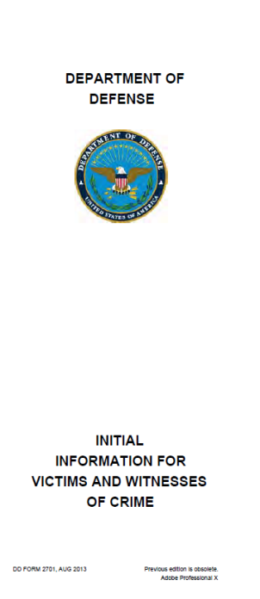
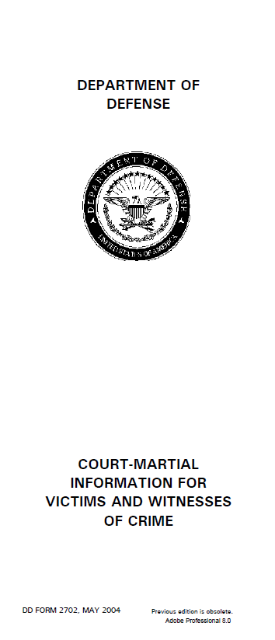
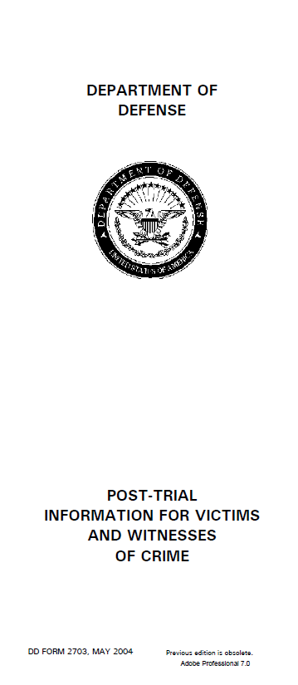
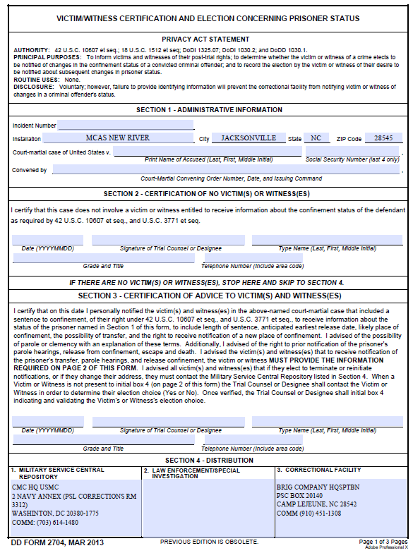
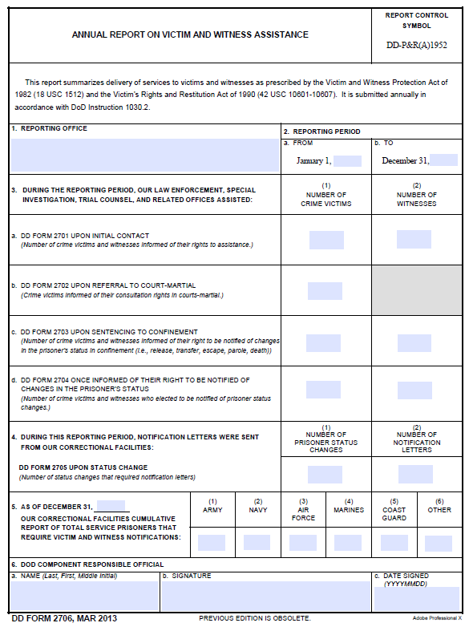
VWAP FORMS/LETTERS
DD Forms 2701-2706 do not replace genuine service and support.

Slide 65
Initial Information and Service Letter (IISL)
040502. Initial Information and Services
A. Immediately after identifying a crime victim or witness the unit Victim Witness Assistance Coordinator (VWAC), the LSST VW AC, or trial counsel will explain and provide a copy of DD Form 2701 , "Initial Information for Victims and Witness of Crime" and provide the below information.
(1) Contact information for the appropriate victim and witness services, including NCIS/CID, the command Victim and Witness Liaison, the trial counsel office, victim compensation personnel, legal assistance, VLC, and the Inspector General's office.
(2) Record the date on which the DD Form 2701 was provided to the victim or witness. Proper completion and recording of this completion serves as evidence the victim or witness was timely notified of his or her rights.
(3) Information about available military and civilian emergency medical and social services, victim advocacy services for victims of domestic violence or sexual assault. When necessary, party administering DD Form 2701 will provide assistance in seeming such services.
(4) Information about restitution or other relief a victim may be entitled to, and the manner in which such relief may be obtained.
(5) To victims of intra-familial abuse, information on the availability of limited transitional compensation benefits and possible entitlement a portion of the active duty Service member's retirement benefits pursuant to Sections 1059 and 1408 of Title 10, U.S.C., and DoDI 1342.24.
Notes:
Vol 16, Chapter 4 (Page 36)
040502.
Initial Information and Services
A
Immediately after identifying a crime victim or witness the unit Victim Witness
Assistance Coordinator 0fWAC), the LSST VWAC, or trial counsel will explain and provide a copy of DD Form
2701 , "Initial Information for Victims and Witness of Crime" and provide the below information.
(1) Contact information for the appropriate victim and witness services, including
NCIS/CID, the c01mnand Victim and Witness Liaison, the trial counsel office, victim compensation personnel, legal
assistance, VLC, and the Inspector General's office.
(2) Record the date on which the DD Form 2701 was provided to the victim or witness. Proper completion and recording of this completion se1ves as evidence the victim or witness was timely notified of his or her tights.
(3) Information about available military and civilian emergency medical and social services, victim advocacy se1vices for victims of domestic violence or sexual assault. When necessary, party administering DD Form 2701 will provide assistance in seeming such services.
(4) Information about restitution or other relief a victim may be entitled to, and the manner in which such relief may be obtained.
(5) To victims of intra-familial abuse, information on the availability of limited transitional compensation benefits and possible entitlement a po1tion oft11e active duty Se1vice member's retirement benefits pursuant to Sections 1059 and 1408 of Title 10, U.S.C., and DoDI 1342.24.
(6) Information about public and private programs available to provide counseling, treatment, and other support, including available compensation through federal, state, and local agencies.
(7) Information about the prohibition agaiI1St intimidation and harassment of victims and witnesses, and arrangements for the victim or witness to receive reasonable protection from threat, harm, or intimidation from an accused offender and from people acting in conceit with or under the control of the accused offender.
(8) Information concerning military and civilian protective orders, as appropriate.
(9) If necessary, provide assistance in contacting the people responsible for administering victim and witness services and relief.
(10) If approp1iate, explain how victim or witness experiencing reprisal as a result of their making, prepa1ing to make, or being perceived as making or being prepared to make a protected communication in accordance with Section 1034 of Title 10, U.S.C. and DoD 7050.06 may file a military whistleblower complaiI1t with the Inspector General's Office.
(11) Information about the victim's right to seek the advice of an attorney with respect to his or her rights as a crime victim pursuant to federal law and DoD policy. This includes the right of Service members and their dependents to consult a military legal assistance attorney or a VLC.

Slide 66
Initial Information and Service Letter (IISL) cont.
(6) Information about public and private programs available to provide counseling, treatment, and other support, including available compensation through federal, state, and local agencies.
(7) Information about the prohibition against intimidation and harassment of victims and witnesses, and an arrangements for the victim or witness to receive reasonable protection from threat, harm, or intimidation from an accused offender and from people acting in conceit with or under the control of the accused offender.
(8) Information concerning military and civilian protective orders, as appropriate.
(9) If necessary, provide assistance in contacting the people responsible for administering victim and witness se1vices and relief.
(10) If appropriate, explain how victim or witness experiencing reprisal as a result of their making, prepa1ing to make, or being perceived as making or being prepared to make a protected communication in accordance with Section 1034 of Title 10, U.S.C. and DoD 7050.06 may file a military whistleblower complaiI1t with the Inspector General's Office.
(11) Information about the victim's right to seek the advice of an attorney with respect to his or her rights as a crime victim pursuant to federal law and DoD policy. This includes the 1ight of Service members and their dependents to consult a military legal assistance attorney or a VLC.
Notes:
Vol 16, Chapter 4 (Page 36)
040502.
Initial Information and Services
A
Immediately after identifying a crime victim or witness the unit Victim Witness
Assistance Coordinator 0fWAC), the LSST VWAC, or trial counsel will explain and provide a copy of DD Form
2701 , "Initial Information for Victims and Witness of Crime" and provide the below information.
(1) Contact information for the appropriate victim and witness services, including
NCIS/CID, the c01mnand Victim and Witness Liaison, the trial counsel office, victim compensation personnel, legal
assistance, VLC, and the Inspector General's office.
(2) Record the date on which the DD Form 2701 was provided to the victim or witness. Proper completion and recording of this completion se1ves as evidence the victim or witness was timely notified of his or her tights.
(3) Information about available military and civilian emergency medical and social services, victim advocacy se1vices for victims of domestic violence or sexual assault. When necessary, party administering DD Form 2701 will provide assistance in seeming such services.
(4) Information about restitution or other relief a victim may be entitled to, and the manner in which such relief may be obtained.
(5) To victims of intra-familial abuse, information on the availability of limited transitional compensation benefits and possible entitlement a po1tion oft11e active duty Se1vice member's retirement benefits pursuant to Sections 1059 and 1408 of Title 10, U.S.C., and DoDI 1342.24.
(6) Information about public and private programs available to provide counseling, treatment, and other support, including available compensation through federal, state, and local agencies.
(7) Information about the prohibition agaiI1St intimidation and harassment of victims and witnesses, and arrangements for the victim or witness to receive reasonable protection from threat, harm, or intimidation from an accused offender and from people acting in conceit with or under the control of the accused offender.
(8) Information concerning military and civilian protective orders, as appropriate.
(9) If necessary, provide assistance in contacting the people responsible for administering victim and witness services and relief.
(10) If approp1iate, explain how victim or witness experiencing reprisal as a result of their making, prepa1ing to make, or being perceived as making or being prepared to make a protected communication in accordance with Section 1034 of Title 10, U.S.C. and DoD 7050.06 may file a military whistleblower complaiI1t with the Inspector General's Office.
(11) Information about the victim's right to seek the advice of an attorney with respect to his or her rights as a crime victim pursuant to federal law and DoD policy. This includes the right of Service members and their dependents to consult a military legal assistance attorney or a VLC.

Slide 67
VWAP FORMS/LETTERS
DD Forms 2701-2706 do not replace genuine service and support.

Slide 68
Initial Information and Service Letter (IISL)
040502. Initial Information and Services
A. Immediately after identifying a crime victim or witness the unit Victim Witness Assistance Coordinator (VWAC), the LSST VW AC, or trial counsel will explain and provide a copy of DD Form 2701 , "Initial Information for Victims and Witness of Crime" and provide the below information.
(1) Contact information for the appropriate victim and witness services, including NCIS/CID, the command Victim and Witness Liaison, the trial counsel office, victim compensation personnel, legal assistance, VLC, and the Inspector General's office.
(2) Record the date on which the DD Form 2701 was provided to the victim or witness. Proper completion and recording of this completion serves as evidence the victim or witness was timely notified of his or her rights.
(3) Information about available military and civilian emergency medical and social services, victim advocacy services for victims of domestic violence or sexual assault. When necessary, party administering DD Form 2701 will provide assistance in seeming such services.
(4) Information about restitution or other relief a victim may be entitled to, and the manner in which such relief may be obtained.
(5) To victims of intra-familial abuse, information on the availability of limited transitional compensation benefits and possible entitlement a portion of the active duty Service member's retirement benefits pursuant to Sections 1059 and 1408 of Title 10, U.S.C., and DoDI 1342.24.
Notes:
Vol 16, Chapter 4 (Page 36)
040502.
Initial Information and Services
A
Immediately after identifying a crime victim or witness the unit Victim Witness
Assistance Coordinator 0fWAC), the LSST VWAC, or trial counsel will explain and provide a copy of DD Form
2701 , "Initial Information for Victims and Witness of Crime" and provide the below information.
(1) Contact information for the appropriate victim and witness services, including
NCIS/CID, the c01mnand Victim and Witness Liaison, the trial counsel office, victim compensation personnel, legal
assistance, VLC, and the Inspector General's office.
(2) Record the date on which the DD Form 2701 was provided to the victim or witness. Proper completion and recording of this completion se1ves as evidence the victim or witness was timely notified of his or her tights.
(3) Information about available military and civilian emergency medical and social services, victim advocacy se1vices for victims of domestic violence or sexual assault. When necessary, party administering DD Form 2701 will provide assistance in seeming such services.
(4) Information about restitution or other relief a victim may be entitled to, and the manner in which such relief may be obtained.
(5) To victims of intra-familial abuse, information on the availability of limited transitional compensation benefits and possible entitlement a po1tion oft11e active duty Se1vice member's retirement benefits pursuant to Sections 1059 and 1408 of Title 10, U.S.C., and DoDI 1342.24.
(6) Information about public and private programs available to provide counseling, treatment, and other support, including available compensation through federal, state, and local agencies.
(7) Information about the prohibition agaiI1St intimidation and harassment of victims and witnesses, and arrangements for the victim or witness to receive reasonable protection from threat, harm, or intimidation from an accused offender and from people acting in conceit with or under the control of the accused offender.
(8) Information concerning military and civilian protective orders, as appropriate.
(9) If necessary, provide assistance in contacting the people responsible for administering victim and witness services and relief.
(10) If approp1iate, explain how victim or witness experiencing reprisal as a result of their making, prepa1ing to make, or being perceived as making or being prepared to make a protected communication in accordance with Section 1034 of Title 10, U.S.C. and DoD 7050.06 may file a military whistleblower complaiI1t with the Inspector General's Office.
(11) Information about the victim's right to seek the advice of an attorney with respect to his or her rights as a crime victim pursuant to federal law and DoD policy. This includes the right of Service members and their dependents to consult a military legal assistance attorney or a VLC.

Slide 69
Initial Information and Service Letter (IISL) cont.
(6) Information about public and private programs available to provide counseling, treatment, and other support, including available compensation through federal, state, and local agencies.
(7) Information about the prohibition against intimidation and harassment of victims and witnesses, and an arrangements for the victim or witness to receive reasonable protection from threat, harm, or intimidation from an accused offender and from people acting in conceit with or under the control of the accused offender.
(8) Information concerning military and civilian protective orders, as appropriate.
(9) If necessary, provide assistance in contacting the people responsible for administering victim and witness se1vices and relief.
(10) If appropriate, explain how victim or witness experiencing reprisal as a result of their making, prepa1ing to make, or being perceived as making or being prepared to make a protected communication in accordance with Section 1034 of Title 10, U.S.C. and DoD 7050.06 may file a military whistleblower complaiI1t with the Inspector General's Office.
(11) Information about the victim's right to seek the advice of an attorney with respect to his or her rights as a crime victim pursuant to federal law and DoD policy. This includes the 1ight of Service members and their dependents to consult a military legal assistance attorney or a VLC.
Notes:
Vol 16, Chapter 4 (Page 36)
040502.
Initial Information and Services
A
Immediately after identifying a crime victim or witness the unit Victim Witness
Assistance Coordinator 0fWAC), the LSST VWAC, or trial counsel will explain and provide a copy of DD Form
2701 , "Initial Information for Victims and Witness of Crime" and provide the below information.
(1) Contact information for the appropriate victim and witness services, including
NCIS/CID, the c01mnand Victim and Witness Liaison, the trial counsel office, victim compensation personnel, legal
assistance, VLC, and the Inspector General's office.
(2) Record the date on which the DD Form 2701 was provided to the victim or witness. Proper completion and recording of this completion se1ves as evidence the victim or witness was timely notified of his or her tights.
(3) Information about available military and civilian emergency medical and social services, victim advocacy se1vices for victims of domestic violence or sexual assault. When necessary, party administering DD Form 2701 will provide assistance in seeming such services.
(4) Information about restitution or other relief a victim may be entitled to, and the manner in which such relief may be obtained.
(5) To victims of intra-familial abuse, information on the availability of limited transitional compensation benefits and possible entitlement a po1tion oft11e active duty Se1vice member's retirement benefits pursuant to Sections 1059 and 1408 of Title 10, U.S.C., and DoDI 1342.24.
(6) Information about public and private programs available to provide counseling, treatment, and other support, including available compensation through federal, state, and local agencies.
(7) Information about the prohibition agaiI1St intimidation and harassment of victims and witnesses, and arrangements for the victim or witness to receive reasonable protection from threat, harm, or intimidation from an accused offender and from people acting in conceit with or under the control of the accused offender.
(8) Information concerning military and civilian protective orders, as appropriate.
(9) If necessary, provide assistance in contacting the people responsible for administering victim and witness services and relief.
(10) If approp1iate, explain how victim or witness experiencing reprisal as a result of their making, prepa1ing to make, or being perceived as making or being prepared to make a protected communication in accordance with Section 1034 of Title 10, U.S.C. and DoD 7050.06 may file a military whistleblower complaiI1t with the Inspector General's Office.
(11) Information about the victim's right to seek the advice of an attorney with respect to his or her rights as a crime victim pursuant to federal law and DoD policy. This includes the right of Service members and their dependents to consult a military legal assistance attorney or a VLC.

Slide 70
Victim Witness Program Four Phases of Assistance
Ensure that V/W have received and if not issue it!
TC will pass out 2702-4
Brig does the 2705
Notes:
TC will take carry of 2702-4 unless it’s a summary court-martial (SCM) then it on the command (Legal Officer, VWAC or SCM officer) after you are authorized by the TC to sign as their designee!

Slide 71
Pretrial / DD Form 2701
DD Form 2701 provides initial rights advisement, discusses impact of various crimes, explains basic services and notifies V/W where to get further assistance.
PMO, CID, or NCIS normally provide V/Ws with DD Form 2701.
Always double check and ensure they received it!
Trial Counsel, Victim Advocates, UVAs, VLC, Medical, Chaplain, VWACs and VWLO also issue 2701’s.
Have to ask who gave it to them and when (VWAP Intake Form and for LSSS’s Case Management System)
Add to VWAP tracker if necessary.
Notes:
DD Form 2701 provides initial rights advisement, discusses impact of various crimes, explains basic services and notifies V/W where to get further assistance.
PMO, CID, or NCIS normally provide V/Ws with DD Form 2701.
Always double check and ensure they received it!
Trial Counsel, Victim Advocates, UVAs, VLC, Medical, Chaplain, VWACs and VWLO also issue 2701’s.
Have to ask who gave it to them and when (VWAP Intake Form and for LSSS’s Case Management System)
Add to VWAP tracker if necessary.
Trial Counsel shall identify victims and witnesses in a case prior to preferring charges and ensure each individual receives a DD Form 2701. In most cases Trial Counsel should contact victims and witnesses prior to the preferral of charges. Victims and witnesses identified after preferral of charges shall be treated the same as those identified prior to preferral, to include issuance of DD Form 2701.

Slide 72
Military Trial Process / DD Form 2702
Upon first contact with victim or witness, the Prosecution (TC) will provide DD Form 2702.
DD Form 2702 explains military trial process, gives tips and restates rights.
Includes rights regarding participating in trial process.
Also provides VWAP responsible official contact information and prosecutor contact information
Notes:
After preferral of charges, provide all victims and witnesses in a case with DD Form 2702 (Court-Martial Information for Victims and Witnesses of Crime), and determine their elections as to those rights . Ensure that victims and witnesses are notified of their rights, as set forth in Enclosure (2), and provided information concerning the criminal justice process, including information regarding what to expect from the military justice system, the stages in the criminal justice process, and their respective role(s) in that process. Contact the applicable VWACs to ensure that proper support and resources are provided;

Slide 73
Post Trial / DD Form 2703
Prosecution provides at the conclusion of a court-martial resulting in a conviction, trial counsel shall inform victims and witnesses of basic information about the post-trial process and provide each with a completed DD Form 2703 (Post-Trial Information for Victims and Witnesses).
Includes the right to receive information about the conviction, sentencing, imprisonment, parole eligibility and release of the accused.
Provides primary Contact info for Service Central Repository (CMC PSL (Corrections)), Confinement Facility, Service Clemency and Parole Board and any other necessary agency/office.
Notes:
Post-Trial Information. At the conclusion of a court-martial resulting in a conviction, trial counsel shall inform victims and witnesses of basic information about the post-trial process and provide each with a completed DD Form 2703 (Post-Trial Information for Victims and Witnesses).

Slide 74
Post Trial / DD Form 2703
Prosecution provides victim or witness with DD Form 2703 upon the finding of guilty at a Special or General court-martial trial or VWAC/Summary court-martial officer for Summary court-martials.
Includes “Right to receive information about the conviction, sentencing, imprisonment, parole eligibility and release of the accused”
Provides Contact info for Service Central Repository (CMC PSL (Corrections)), Confinement Facility, Service Clemency and Parole Board and any other necessary agency/office
From this point on the V/Ws POC will be the confinement facility or the Service Central Repository listed on the back of this page.
Notes:
Post-Trial Information. At the conclusion of a court-martial resulting in a conviction, trial counsel shall inform victims and witnesses of basic information about the post-trial process and provide each with a completed DD Form 2703 (Post-Trial Information for Victims and Witnesses).

Slide 75
Post Trial / DD Form 2704
Trial Counsel provides brig with DD Form 2704 at finish of trial for Special and General Courts-martial.
Command VWAC provides brig with DD Form 2704 at finish of trial for Summary Courts-martial.
Requires election by each V/W whether to receive information on confinement status.
Provided to victims and witnesses upon request (redacted).
The 2700s are never included in the Record of Trial (ROT) – these have personal info of victims and witnesses and should not be shared.
Notes:
At the conclusion of every court-martial in where confinement is adjudged and approved, including SCM the trial counsel shall complete a DD Form 2704 and provide copies to the confinement facility, victim and witnesses if requested, and responsible VWAC
Requires election by each V/W whether to receive information on confinement status.
Provided to victims and witnesses upon request (redacted) - redacted means to black out others PII information except for the accused info on the front. Recommendation is that you only put one v/w per page.
None of these forms (2701-4’s) are never included in the ROT!
The DD Form 2704 has personal info of victims and witnesses and should not be shared!
Post-Trial Confinement Status of Accused.
At the conclusion of every court - martial in which confinement is adjudged, including summary courts-martial, as a part of the ongoing duty to notify victims and witnesses of the rights and services available, trial counsel shall confer with each victim and witness to determine whet her the respective victim or witness desires to receive information about the confinement status of the accused. Additionally, trial counsel shall complete a DD Form 2704 and shall ensure copies are provided to:
(a) The confinement facility.
(b) Victims and witnesses whose entitlement to receive information has been certified by trial counsel (victim and witness copies shall be redacted so that only that particular victim's or witness's information is visible).
(c) The responsible VWACs (VWAC copies shall be properly redacted).

Slide 76
Post Trial / DD Form 2704
-A DD Form 2704 must accompany a prisoner if a sentence to confinement is adjudged, regardless if there are no victims and witnesses.
-If there is a minor, a parent or guardian must be listed. The age of the minor must be provided.
-Notifications to victims and witnesses are made via certified mail. A complete mailing address should be provided. (Not a barracks address)

Slide 77
Questions

