Slide 1
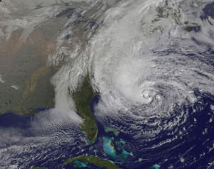
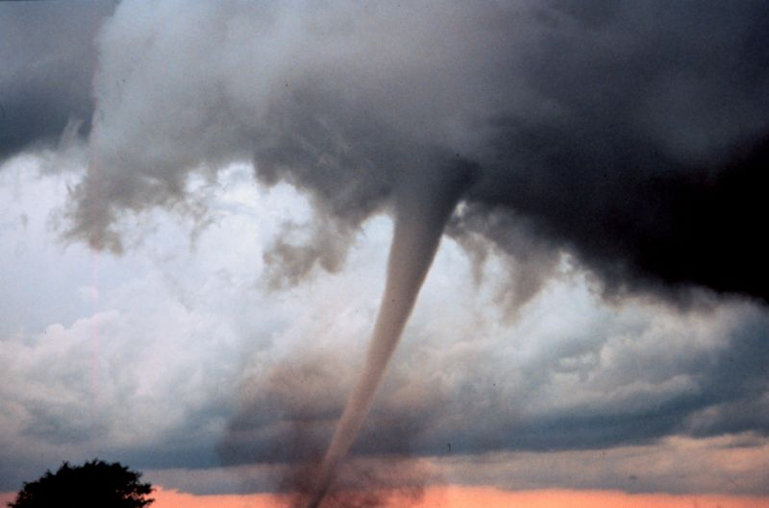
Destructive Weather Legal Brief
LtCol Mike Cava
MCAS NR SJA
17 April 2013

Slide 2
Destructive Weather
Authority: DOD Directive 5515.10 Sep 24, 2004
The Military Personnel and Civilian Employees’ Claims Act of 1964,31 U.S.C. § 3721 (1982) (Personnel Claims Act [PCA]),
“Gratuitous payment statute intended to maintain morale
by compensating service members and other federal employees for personal property that is lost, damaged, or destroyed incident to service. “

Slide 3
Homeowners and Renters Insurance
What happens if I own my home? Homeowners insurance should cover both your home and contents.
What happens if I rent a house/apartment off base? Commercial renters insurance should cover both your home and contents .
What happens if I live on base? AMCC automatically provides small renters insurance ($20K). Not enough? Purchase more insurance.
Take photos and document prior to the storm!

Slide 4
Food & Hurricane Supplies
Save receipts: If you buy perishable food before the hurricane hits, save the receipts!
No electricity: If food spoils b/c of a power outage, on base residents may seek reimbursement from the government via Personnel Claims Act (PCA).
Take photos: If you throw food out because of spoilage, take photos and document.
Hurricane preparedness supplies (i.e. generators, plywood, etc) are not reimbursable by the gov’t.

Slide 5
Evacuations
Base CO has the authority to direct evacuations of service members.
Off base: If you live off base & evacuate without orders from the Base CO, you are responsible for your own expenses (i.e. no government reimbursement for hotels, transportation, etc).
On base: If you live on base & evacuate with orders from the Base CO, you will more than likely be sent to an on base shelter were food, water, sleeping accommodations, etc will be provided until it is safe to return home.
If you decide NOT to go to a designated shelter = you are responsible for your own expenses. No reimbursements.
Pets cannot be accommodated at a shelter = you are responsible for your own expenses if you go someplace else.
Family member with special needs = you may qualify for reimbursement, coordinate with the Command ASAP.

Slide 6
Population in housing on board MCAS New River
Total of 1,090 people live on MCAS New River.
Officers at w/depn is a total of 325
Enlisted at w/depn is a total of 679
Civilian at w/depn is a total of 86

Slide 7
Post Hurricane Damages
Live on base:
First step: Contact your insurance company and file a claim (take pictures).
Second step: After your private insurance claim has been fully completed, submit a claim for ALL damaged property to the US Government via PCA.
Government reimbursement is only available for property that belongs to the service member and tenants (i.e. no in-laws property).

Slide 8
Post Hurricane Damages
Live off base:
Contact your insurance company
Off base damage is NOT reimbursable via the Personnel Claims Act

Slide 9
Post Hurricane Vehicle Damage
Who qualifies? Any Federal Employee or Service member.
Step1: Contact your auto insurance carrier (take pictures) and complete the entire claim
Step 2: Get at least 2 written estimates
Step 3: Provide proof that the vehicle was owned by the service member or Fed employee (no compensation for family members, friends, etc unless Fed EE or military)
Step 4: File the claim
If your car was damaged while located on base for a legitimate purpose (i.e. live on base or ordered to work as essential personnel), then you can submit a claim.
Do not park your car on base just in hopes of getting reimbursed! This is fraud…
No reimbursement for rental cars or insurance deductibles.

Slide 10
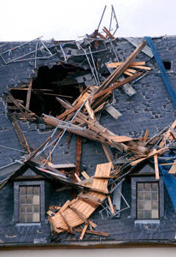
Rented Damaged homes/apartments
If you are renting a home or apartment and you cannot live there anymore because of hurricane damage (i.e. damaged roof, windows, etc), call legal assistance immediately.
Why? You may break the lease but you need to act promptly to preserve rights under NC state law
Landlord refuses to fix hurricane damages? Contact legal assistance.

Slide 11
Questions & Answers
I left town with my family to ensure they would be safe, can I be compensated for my evacuation expenses?
If you live off base, some homeowners insurance or renters insurance covers certain evacuation expenses.
If you live off base, and the Base CO ordered an evacuation, you may be compensated for hotel, gas, etc. However, if you evacuate without orders from the Base CO, gov’t reimbursements are not available.
Keep all receipts!

Slide 12
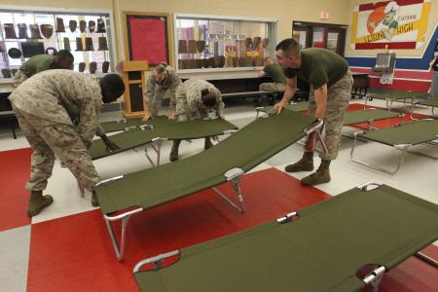
Questions & Answers
I stayed in a hotel while the power to my on-base home was shut off, can I be reimbursed for the cost of that hotel?
No. Neither the PCA nor AMCC’s renter’s insurance policy will reimburse hotel expenses for on-base residents that sought shelter off-base.
Remedy = on base shelters.

Slide 13
Questions & Answers
Will the government reimburse me for my insurance deductibles?
No. The PCA does not compensate for insurance deductibles.

Slide 14
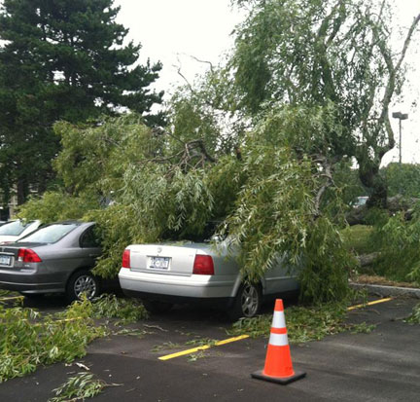
Questions & Answers
I parked my car on base (because I live on base or I was essential personnel ordered to work) and the vehicle was damaged. Can I file a claim?
Yes. If your auto insurance does not cover all the damage, you may submit a claim to the government.
Even if your auto insurance does cover the damage, you may still submit a claim with the government. Extra compensation may be available.

Slide 15
Questions & Answers
I live on base, and my in-laws were visiting us from out of town when their vehicle was damaged by the storm in our driveway, can they file a claim?
No. The owner of the vehicle must be a federal EE or a service member.

Slide 16
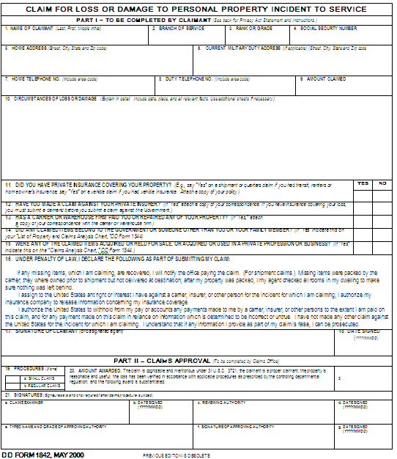
Points of Contact
MCAS New River Claims Office
William Yables (910) 449-7159
MCIEAST Regional Claims Office
Kathy Butler (910) 451-7075
HQMC, Personal Property Claims (MFP-2)
Jennifer Durand (703) 784-9533

Slide 17
Questions?

