Slide 1
NJP and the UPB

Slide 2
Nonjudicial Punishment
Provides commanders with a means of maintaining good order and discipline.
Promotes positive behavior changes without stigma of a court-martial conviction.
Only one form of punishment a commander may impose.
MCM V-1, par 1a-c

Slide 3
Authority To Impose
Commanding Officers
Designated Officers in Charge
Successor of command due to death, transfer, incapacity or absence of previous commander.
LEGADMINMAN pg 3-3

Slide 4
Jurisdiction
Accused must be a member of the command.
LEGADMINMAN PAGE 3-3, par. 3001

Slide 5
Punishments
The maximum punishment depends on:
- Commanding Officer’s rank
- Rank of the accused
- Commanding Officer’s authority
MCM pg V-4

Slide 6



Field Grade
Confinement on bread and water for 3 days
Correctional Custody for 30 days
Forfeiture ½ mo pay per mo for 2 months
Red one pay grade
Extra duty for 45 days
Restriction for 60 days

Slide 7

Company Grade
Confinement on bread and water for 3 days
Correctional Custody for 7 days
Forfeiture of 7 days pay
Extra duty X 14 days
Restriction X 14 days
Refer to MCM Part V-5

Slide 8

Forfeitures
Whole dollar amounts
Example $100.00 vice $100.50
Can only take pay at the rate to which the
accused was reduced.
LEGADMINMAN pg 3-5, par 3004

Slide 9
Limitations on
Punishments
Cpl and above cannot receive correctional custody
or confinement on bread and water.
Extra duties cannot be a known safety hazard
(2 hrs per day).
Reduced one rank at a time.
Restriction may not exceed maximum extra duty if
both is imposed (45).
MCM pg V-6

Slide 10
Execution of Punishment
No suspension; begins date of NJP.
If suspended or vacated; effective date is the
date vacated.
If punishment is stayed pending an appeal –
effective date is the date punishment starts.

Slide 11
Suspension of Punishment
CO can suspend all or part (no more than 6 mos).
If accused violates suspension, CO can vacate
suspension.
CO can specify in writing additional conditions of
the suspension.
MCM pg V-4, par 6

Slide 12
Appeals
Two grounds for an appeal:
- Punishment is unjust:
Exceeds CO’s authority (reduce 2 pay grades).
- Disproportionate to the offense:
Max punishment for 10 min UA.
MCM pg V-8, par 7

Slide 13
Appeals
Submitted to next higher commander.
Must be in writing.
Submitted within 5 working days.

Slide 14
What is the UPB?
NAVMC 10132 is used to record the NJP for
enlisted personnel.
Chapter 3, MCO P5800.16A LEGADMINMAN
MARADMIN 301/02
MARADMIN 542/02

Slide 15
Preparation
UPB form will be prepared in duplicate
AUTHORIZED abbreviations
May be typewritten or handwritten (legibly) in black ink.
Duplicate UPB form does not require original signatures or initials
LEGADMINMAN, pg 3-6, par 3006

Slide 16
Summary of Proceedings
JAGMAN, App A-1-e is a guide to be used by the CO and the clerk taking notes at the NJP.
Use the summary provided in the scenario as a source document to type the UPB.
JAGMAN pg A-1-e and A-1-f

Slide 17
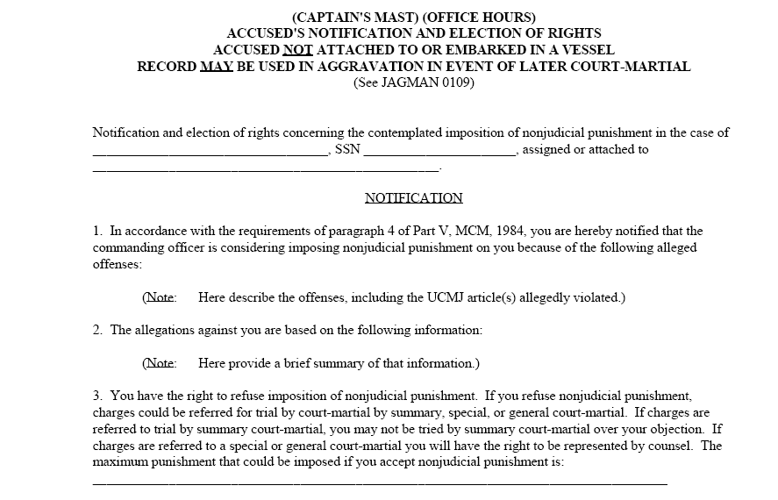

Slide 18
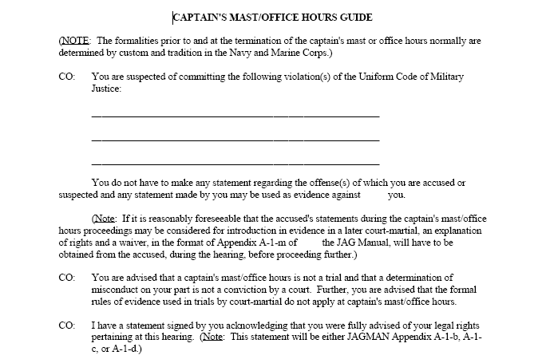

Slide 19
NJP Charge Drafting
Use the MCM to figure out what to charge
  Appendix 12 very useful
Reference: MCO P5800.16 (Chapter 3)
Elements of the article that state the offense
  Who, What, When, Where, and How did the accused commit the offense.
  On active duty did,!

Slide 20
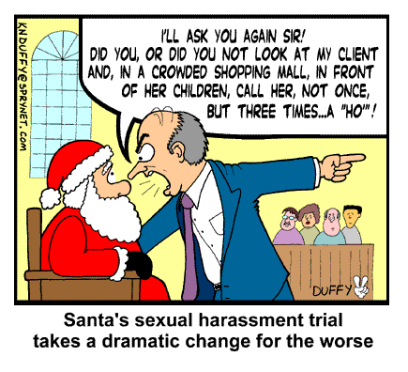

Slide 21
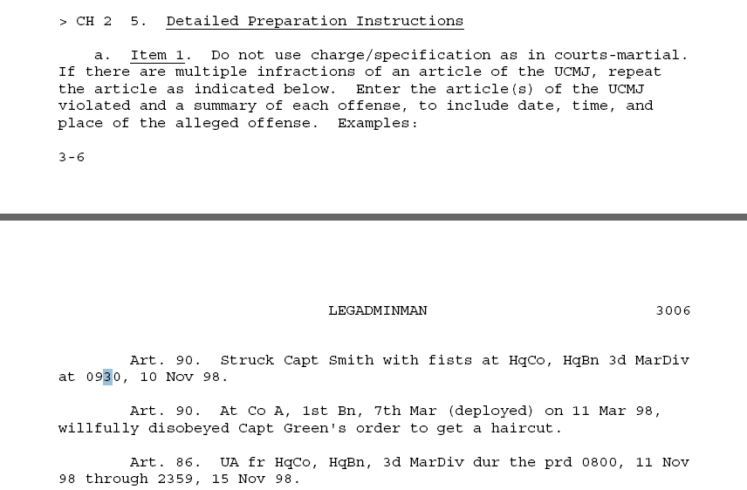

Slide 22
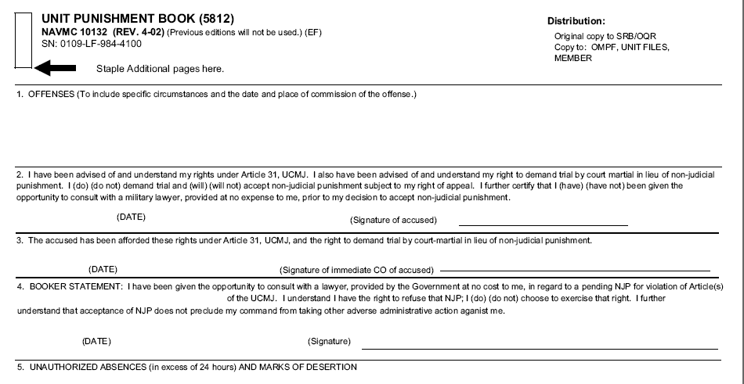
(SEE SUPPLEMENTAL PAGE)

Slide 23
ARTICLE 86
In that Lance Corporal John D. Wrongway, U.S. Marine Corps, on active duty did,
on or about 17 September 2007, without authority, absent himself from his unit to wit: Your Unit, 2d Marine Aircraft Wing, located at Marine Corps Air Station, Cherry Point, North Carolina, and did remain so absent until on or about 18 September 2007.
ARTICLE 92
In that Lance Corporal John D. Wrongway, U.S. Marine Corps, on active duty did having knowledge of a lawful order issued by Lieutenant Colonel Brandon D. Wilkerson, the Commanding Officer of Your Unit, 2d Marine Aircraft Wing, Marine Corps Air Station, Cherry Point, North Carolina to wit: Pretrial Restriction Order, dated 18 September 2007, an order which it was his duty to obey, did, on board Marine Corps Air Station, Cherry Point, North Carolina, between on or about 27 October 2007 through on or about 28 October 2007, fail to obey the same by wrongfully leaving the geographic area of Marine Corps Air Station, Cherry Point, North Carolina
ARTICLE 112a
In that Lance Corporal John D. Wrongway, U.S. Marine Corps, on active duty did, at an unknown location, between on or about 11 September 2007 through on or about 18 September 2007, wrongfully use cocaine.

Slide 24
Great link for drafting charges: http://www.jag.navy.mil/html/TSOwestTrialServices.htm
Article 80
In that Seaman John Q. Public, U. S. Navy, on active duty, did, at Joe’s Auto Shop, located in Lemon Grove, California, on or about 20 January 2000, with intent, attempt to defraud, falsely pretend to Joe’s Auto Shop that he was Seaman David Q. Victim, then knowing that the pretenses were false, and by means thereof did wrongfully attempt to obtain services, of a value of about $385.00, to wit: by attempting to use Seaman David Q. Victim’s Visa Debit card at Joe’s Auto Shop in order to pay for the repair and replacement of the brakes on his 1985 Buick Skylark automobile.
Article 81
Specification: In that Seaman John Q. Public, U. S. Navy, on active duty, did, at or near San Diego, California, on or about December 1999, conspire with Seaman David Q. Thief and Seaman Paul Z. Criminal to commit an offense under the Uniform Code of Military Justice, to wit: to possess and distribute methlenedioxymethamphetamine, a schedule I controlled substance, ketamine a schedule III controlled substance, in order to effect the object of the conspiracy the said Seaman John Q. Public maintained, purchased, and distributed methlenedioxymethamphetamine, and ketamine.
Article 85
Specification: In that Seaman John Q. Public, U.S. Navy, on active duty, did, on or about 30 June 1999, without authority and with intent to remain away therefrom permanently, absent himself from his unit, to wit: USS NEVERSAIL (DD 99), located at San Diego, California, and did remain so absent in desertion until he was apprehended on or about 1 July 1999.

Slide 25
Article 87
In that Seaman John Q. Public, U.S. Navy, on active duty, did, at or near San Diego, California, on or about 10 September 1999, through design, miss the movement of USS NEVERSAIL (DD 99) with which he was required in the course of duty to move.
In that Seaman John Q. Public, U.S. Navy, on active duty, did, at or near San Diego, California, on or about 10 September 1999, through neglect miss the movement of USS NEVERSAIL (DD 99) with which he was required in the course of duty to move.
Article 125
In that Lieutenant John Q. Public, U.S. Navy, on active duty, did, at or near San Diego, California, from about December 1998 to about June 1999, on divers occasions, commit sodomy with Jane Q. Victim, a child under the age of sixteen years.
Article 127
In that Seaman John Q. Public, U.S. Navy, on active duty, did, at 10 Sesame Street, San Diego, California, on or about 5 January 1999, with intent unlawfully to obtain an advantage, to wit: a dissolution of marriage granting full custody of their community property to Seaman John Q. Public, U.S. Navy, communicate to Seaman Jane Q. Victim, U.S. Navy, a threat to kill her if these demands were not met.

Slide 26
Article 134
General Article
Possession of stolen explosives
In that Seaman John Q. Public, U.S. Navy, on active duty, did, at or near San Diego, California, on or about 4 February 1997, knowingly possess and store stolen explosive materials, in violation of Title 18 U.S.C. Section 842 (h).
Possession of classified information
In that Seaman John Q. Public, U. S. Navy, on active duty, did, at or near 1600 Sesame Street, San Diego, California, on or about 31 May 2000, have possession of documents containing classified information of the United States, which he knowingly removed, without authority, and with the intent to retain such documents at an unauthorized location in violation of Title 18 United States Code Section 1924.
Use of telephone lines to conduct drug transaction
In that, Seaman John Q. Public, U. S. Navy, on active duty, did, at or near San Diego, California, on divers occasions between 17 December 1999 and 20 May 2000, violate Title 21, United States Code, Section 843(b), by knowingly and intentionally using a communicator facility, to wit: a telephone, to cause and facilitate the commission of a controlled substance offense, in violation of Title 21, United States Code, Section 846, to wit: distribution of methlenedioxymethamphetamine, a schedule I controlled substance, and lysergic acid diethylamide.
Possession of child pornography
In that Lieutenant John Q. Public, U.S. Navy, on active duty, did, at or near San Diego, California, on or about 31 January 2000, knowingly possess a computer hard-drive containing visual depictions of minors engaging in sexually explicit conduct, with said visual depictions having been transported in interstate commerce, thus violating 18 United States Code, Section 2252A(a)(5)(B).

Slide 27
Mails: Taking, opening
In that Seaman James R. Public, U.S. Navy, on active duty, did, between on or about 10 July and 19 July 1999, at or near San Diego, California, wrongfully steal certain mail matter, to wit: a box of blank checks, addressed to Seaman Jane Q. Victim, which was then located in the said Seaman Jane Q. Victim’s barracks room for the purpose of distribution, and which mail matter was stolen before it was delivered to the addressee, the said Seaman Jane Q. Victim, U.S. Navy.
Obstruction of Justice
In that Seaman James Q. Public, U.S. Navy, on active duty, did at or near San Diego, California, on various occasions between January 1998 and December 1999, wrongfully endeavor to influence the actions of Mrs. Jane Doe as a witness in the case of United States versus Seaman James Q. Public, U.S. Navy, by giving to the said Mrs. Jane Doe the sum of approximately $7000.00 , if she, the said Mrs. Jane Doe, would wrongfully prevent the communication of information relating to Seaman James Q. Public’s sexual relationship and sexual intercourse with his daughter Jane Public to the police and/or appropriate legal authorities.
Breaking Restriction
In that Lieutenant John Q. Public, U. S. Navy, on active duty, having been restricted to the limits of USS NEVERSAIL (DD 99), by a person authorized to do so, did, onboard USS NEVERSAIL (DD 99), on or about 22 September 1999, break said restriction.
Solicitation of another to commit an offense
In that Lieutenant John Q. Public, U. S. Navy, on active duty, did, at or near San Diego, California on or about 31 May 2000 wrongfully solicit Seaman Jane Q. Victim, U.S. Navy, to purchase Ketamine.
Communicating a threat
In that Seaman John Q. Public, U.S. Navy, on active duty, did, at 110 Sesame Street, San Diego, California, on or about 15 August 1999, wrongfully communicate to Seaman Jane Q. Victim, U.S. Navy, a threat to injure her daughter, Jean Q. Victim, by shooting and killing said daughter, or words to that effect.

Slide 28
Item 1 - Offenses
UNIT PUNISHMENT BOOK (5812) Distribution:
NAVMC 10132 (REV. 4-02) (Previous edition will not be used.) (EF) Original copy to SRB/OQR
SN: 0109-LF-984-4100 Copy to: OMPF, UNIT FILES, MEMBER
Staple Additional pages here.
1. OFFENSE (To include the specific circumstance and the date and time of the commission of the offense.)
Art. 92. Did willfully disobey SSgt Smith’s order to get ready
for gd du, on 11 Jun 07 at 0730, at COA, 1st Bn, 10th Mar,
2d MarDiv, CamLej.

Slide 29
Item 2 - Art. 31 Rights
Completed prior to the NJP.
Accused is advised of Art. 31 Rights.
If Marine refuses to sign in item 2 type:
“See item #16”
In item 16 type:
“Marine refuses to indicate intentions or to sign item 2. Case forwarded recommending (Special Court- Martial), (Summary Court-Martial), etc…"

Slide 30
Item 2 - Art. 31 Rights
UNIT PUNISHMENT BOOK (5812) Distribution:
NAVMC 10132 (REV. 4-02) (Previous edition will not be used.) (EF) Original copy to SRB/OQR
SN: 0109-LF-984-4100 Copy to: OMPF, UNIT FILES, MEMBER
Staple Additional pages here.
1. OFFENSE (To include the specific circumstance and the date and time of the commission of the offense.)
2. I have been advised of and understand my rights under Article 31, UCMJ. I also have been advised of and understand
my right to demand trial by court-martial in lieu of non-judicial punishment. I (do) (do not) demand trial and (will) (will not)
accept non-judicial punishment subject to my right of appeal. I further certify that I (have) (have not) been given the
opportunity to consult with a military lawyer, provided at no expense to me, prior to my decision to accept non-judicial
Punishment.
(DATE) _____________________ (Signature of Accused) _______________________________________
Art. 92. Did willfully disobey SSgt Smith’s order to get ready for gd du, on 11 Jun 07 at 0730, at COA, 1st Bn, 10th Mar, 2d MarDiv, CamLej.
__
__
2007/06/14 RONALD B. PARE

Slide 31
Item 3 - CO Acknowledgement
CO of the accused will sign/date in this block after
advising accused of Art. 31 Rights.
3. The accused has been afforded these rights under Article 31, UCMJ, and the right to demand trial by court-martial in lieu
of non-judicial punishment.
(DATE) _____________________ (Signature of immediate CO of Accused)___________________________
2007/06/14 J. A. BEGOOD

Slide 32

Item 4 - Booker Statement
Marine acknowledgement.
Marine accepts NJP or trial by a court-martial.

Slide 33
Item 4 - Booker Statement
4. BOOKER STATEMENT: I have been given the opportunity to consult with a lawyer, provided by the Government at no cost to me, in regard to a pending NJP for violation of Article(s) _________________________________ of the UCMJ. I understand I have the right to refuse that NJP; I (do) (do not) choose to exercise that right. I further understand that acceptance of NJP does not preclude my command from taking other adverse administrative action against me.
(DATE) _____________________ (Signature of Accused) _______________________________________
92
2007/06/12 RONALD B. PARE

Slide 34
Item 5 - UA
UA is when a member of the armed forces is
(member’s own fault) not at appointed place of duty.
UA entries are proof of an absence offense and
must be free of errors.
Must be properly authenticated to be allowed as
evidence in a court-martial.

Slide 35
Item 5 - UA
If Marine was not UA, leave blank.
5. UNAUTHORIZED ABSENCES (in excess of 24 hours) MARKS OF DESERTION
6 Feb 07. UA (AWOL) fr this org since 0801, 5 Feb 07.
Abs rpt by RUC 12001 on UD 0028 dtd 6 Feb 07.

Slide 36
Item 6 - Final Disposition
6. FINAL DISPOSITION TAKEN AND DATE.
Forf of $250 pay per mo for 1 mo. Total forf $250. 14 Jun 07.
Do not enter “No Punishment”.

Slide 37
Item 7 - Suspension
7. SUSPENSION OF EXECUTION OF PUNISHMENT, IF ANY.
14 Jun 07. Forf of $250 pay per mo for 1 mo, susp for 6 mos, at which time, unless sooner vacated, the forf will be rem w/o further act.
If no suspension
type the word
“NONE.”

Slide 38
Item 8 - Final Disposition Taken By
8. FINAL DISPOSITION TAKEN BY (Name, Grade, Title)
J. A. BEGOOD, 1stLt, CO

Slide 39
Item 9 - CO Taking Final Disposition
Officer imposing punishment determines whether
offenses are properly punishable under Article 15.
9. Upon consideration of the facts and circumstances surrounding (this offense) (these offenses) 10. DATE OF NOTICE
and upon further consideration of the needs of military discipline in the command, I have TO ACCUSED OF
determined the offense(s) involved herein to be minor and properly punishable under FINAL DISPOSITION
Article 15, UCMJ, such punishment to be that indicated. TAKEN.
(Signature of CO who took final disposition in 6) _____________________________________
J. A. BEGOOD

Slide 40
Item 10
Date accused is notified of the punishment.
9. Upon consideration of the facts and circumstances surrounding (this offense) (these offenses) 10. DATE OF NOTICE
and upon further consideration of the needs of military discipline in the command, I have TO ACCUSED OF
determined the offense(s) involved herein to be minor and properly punishable under FINAL DISPOSITION
Article 15, UCMJ, such punishment to be that indicated. TAKEN.
(Signature of CO who took final disposition in 6) _____________________________________
J. A. BEGOOD
2007/06/14

Slide 41
Item 11 - Right To Appeal
CO signs
11. The accused has been advised of the 12. Having been advised of and understanding 13. DATE OFAPPEAL,
right to appeal. My right of appeal, at this time I (intend) IF ANY.
(do not intend) to file an appeal.
______________________________________ ___________ _________________________
(DATE) (Signature of CO who took final action in 9) (DATE) (Signature of Accused)
2007/06/14 J. A. BEGOOD

Slide 42
Item 12
Marine signs, acknowledging understanding the
right of appeal and indicates intentions.
If Marine refuses to sign item 12 type:
  - “See item 16”
  - In item 16 type:
  “Marine refuses to indicate intentions or sign item 12”.

Slide 43
Item 12
11. The accused has been advised of the 12. Having been advised of and understanding 13. DATE OFAPPEAL,
right to appeal. My right of appeal, at this time I (intend) IF ANY.
(do not intend) to file an appeal.
___________________________________ ___________ _________________________
(DATE) (Signature of CO who took final action in 9) (DATE) (Signature of Accused)
2007/06/14 J. A. BEGOOD
2007/06/14 RONALD B. PARE

Slide 44
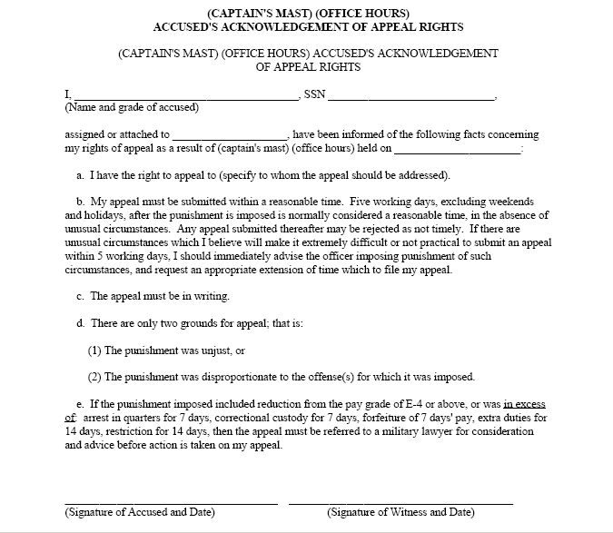

Slide 45
Item 13
If the Marine submits appeal, type appeal date in
this item.
If the Marine does not appeal type
“Not Appealed.”

Slide 46
Item 13
11. The accused has been advised of the 12. Having been advised of and understanding 13. DATE OF APPEAL,
right to appeal. My right of appeal, at this time I (intend) IF ANY.
(do not intend) to file an appeal.
___________________________________ ___________ _____________________________
(DATE) (Signature of CO who took final action in 9) (DATE) (Signature of Accused)
Not Appealed.
2007/06/14 J. A. BEGOOD
2007/06/14 RONALD B. PARE

Slide 47
Item 14
If Marine appeals, enter final action and date
decision is made.
If the Marine did not appeal - block is left blank.

Slide 48
Item 15
Date of Notice to the accused of the decision of
appeal.
If the Marine did not appeal – block is left blank.

Slide 49
Examples of Appeals
14. DECISION ON APPEAL, (IF APPEAL MADE), DATE THEREOF, AND 15. DATE OF NOTICE TO SIGNATURE OF CO WHO MADE DECISION. ACCUSED OF DECISION
OF APPEAL.
Appeal Denied – 25 Jun 07
25 Jun 2007 J. A. BEGOOD
(DATE) (Signature of CO making decision of appeal)
25 Jun 2007
14. DECISION ON APPEAL, (IF APPEAL MADE), DATE THEREOF, AND 15. DATE OF NOTICE TO SIGNATURE OF CO WHO MADE DECISION. ACCUSED OF DECISION
OF APPEAL.
Appeal granted, punishment set aside
25 Jun 2007 A. BEGOOD
(DATE) (Signature of CO making decision of appeal)
25 Jun 2007
14. DECISION ON APPEAL, (IF APPEAL MADE), DATE THEREOF, AND 15. DATE OF NOTICE TO SIGNATURE OF CO WHO MADE DECISION. ACCUSED OF DECISION
OF APPEAL.
Red set aside, no further relief granted
25 Jun 2007 J. A. BEGOOD
(DATE) (Signature of CO making decision of appeal)
25 Jun 2007

Slide 50
Item 16 - Remarks
Anything from a vacated suspension to forwarding
offenses to next superior commander.
Refusing to sign items 2 and 12.

Slide 51
Example Vacation
of Punishment
16. REMARKS 17. Final administrative action, as
appropriate, has been completed.
UD#_______ DTD _________INIT___
Forf of $250 per mo for 1 mo imposed
and susp on 14 Jun 07 vacated –
21 Aug 07.

Slide 52

Item 17 - Admin Action
When administrative action is complete.
Administrative action are UD entries

Slide 53
Item 17 - Admin Action
Final administrative action, as appropriate has been completed.
UD#__________________ DTD _________________INIT______________
0179 2007/06/18 FJH

Slide 54
Item 18 - Unit
Unit of accused.
18. UNIT
CO A, 1st Bn, 10th Mar, 2d MarDiv, CamLej

Slide 55
Items 19-21
Item 19 - Name
Item 20 – Grade, Rank
Item 21 - SSN
19. INDIVIDUAL (Last name, First name, Middle initial) 20. GRADE 21. SSN
PARE RONALD B PFC, E-2 123 45 6789
PARE Ronald B
Pare Ronald B
refer to MCO 1070.12, pg 2-10, par 2(a)

Slide 56
Disposition Instructions
The UPB Binder consists of:
Attached Pages
Appeals
Summary Transcripts
Filed Alphabetically
New Binder Every Year
Hold for 2 Calendar Years

Slide 57
Disposition Instructions
File the original in the SRB
Copy to Official Military Personnel File
Copy to unit files (UPB Binder)
Copy to member

Slide 58

Questions?

