Slide 1
General Environmental Awareness Training
MCAS NEW RIVER
provided by the Installation & Environment Department

Slide 2
Training Objectives
When you’ve completed with this training you will…
Have a general awareness of the environmental programs at MCIEAST-MCBCAMLEJ & MCAS New River
Understand the importance of taking care of the environment at MCIEAST-MCBCAMLEJ & MCAS New River
Know what you can and should do to protect the environmental resources that support MCIEAST-MCBCAMLEJ & MCAS New River’s missions and your quality of life

Slide 3
Benefits You’ll Receive From This Training
You’ll learn…
How to save money at home by using less water, less electricity, and generating less waste
About outdoor recreation options available to you - like hunting, fishing, and accessing our beaches
What recycled/reusable materials are available to you at no cost
Mulch and compost
Harvest firewood
Materials and supplies for your Unit

Slide 4
MCAS New River Commanding Officer’s Environmental Policy Statement
“MCAS New River is dedicated to the continuous improvement of our environmental performance over time and to initiate additional projects and/or activities that will further reduce our impacts on the environment. Our commitment to the environment will conducted in a thoughtful, responsible way, with a view to preventing pollution and safeguarding our natural environment.”
MCAS New River will…
• Prevent pollution and minimize the distribution and use of hazardous materials to provide our tenant units and surrounding communities with safer and cleaner living environments;
• Preventive identification and evaluation of environmental risk, along with the implementation of measures to eliminate or control that risk;
• Set and review environmental objectives and targets, participate in external and internal environmental program assessments to allow for continued improvement
• Adoption of industry best practices and prevent pollution whenever possible;
• Clean contaminated sites and prevent future contamination or spills;
• Conserve our finite natural and cultural resources by encouraging training and awareness of environmental factors such as soil erosion, waste streams and fire hazards.
Why?…
In order to fulfill our obligation of good stewardship and to preserve the ability to fulfill our mission.

Slide 5
Environmental Policy Implementation
Our environmental policy is implemented through the use of an Environmental Management System (EMS)
EMS integrates environmental considerations and accountability into day-to-day decision making and long-term planning.
POLICY
The focus of EMS is continual improvement through planning, review and corrective action.
At the installation level, on behalf of the Installation Commander, the Installation & Environment (I&E) implements the EMS. The EMS Working Groups determine Objectives and Targets and ensure that Plans of Action and Milestones are met.
ACT
PLAN
Continual Improvement
CHECK
DO
The Environmental Management System

Slide 6
Environmental Management System (EMS)
Is part of everything we do on MCAS New River
Reduces the environmental “footprint” and liabilities
Integrates the environmental program across the workforce
Updates, consolidates and archives SOPs
Increases employee awareness and commitment to environmental performance
Empowers staff
Provides for accountability

Slide 7
MCAS New River Environmental Hierarchy
Commanding Officer (CO)
Installation & Environment Department (I&E)
Environmental Compliance Coordinators (ECCs)
If you serve at the Unit or Command Level, ECCs are your primary point of contact for environmental support

Slide 8
MCIEast-MCB CamLej’s Environmental Management Division
Environmental Management Division (EMD) Bldg 12, Post Lane, 451-5003
Environmental Compliance Branch (ECB)
Environmental Conservation Branch (ECON)
Environmental Quality Branch (EQB)
EMS / P2 / Recycling
EMD’s mission is to protect environmental resources and ensure compliance with environmental laws.
Please visit:
https://www.lejeune.marines.mil/Offices-Staff/Environmental-Mgmt/
for more information.

Slide 9
Important Environmental Issues at MCIEast-MCB CamLej
The following slides will address these environmental issues and discuss…
What is it?
What’s EMD doing about it?
What do I need to know?
What do I need to do?
Water
Drinking Water
Wastewater
Materials & Waste
Hazardous Materials
Hazardous Waste
Air
Air Quality
Asbestos
Noise
Water Conservation
Pesticides
Stormwater
Solid Waste & Recycling
Natural & Cultural Resources
Outdoor Recreation
Threatened and Endangered Species
Wetlands & Forestry
Cultural & Archeological Resources
Hunting
Fishing
Beach Access
Spills
Emergency Response
Installation Restoration
Ammunition, Explosives & Dangerous Articles
Release Protection and Response
National Environmental Policy Act
Lights
Computers
Equipment
Energy
9

Slide 10
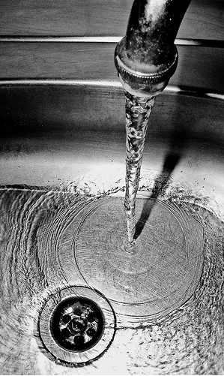
Water Resources
DID YOU KNOW…..
MCIEast-MCB CamLej provides 4-5 million gallons of water per day to employees and residents for drinking, bathing, and industrial and training operations
Water is pumped from approximately 54 groundwater wells to four water treatment plants, and then distributed for use
EMD samples both wells and treated water to ensure all water is safe for consumption and use
EMD publishes an annual report on water quality. For more information, go to https://www.lejeune.marines.mil/Offices-Staff/Environmental-Mgmt/Annual-Reports/
10

Slide 11
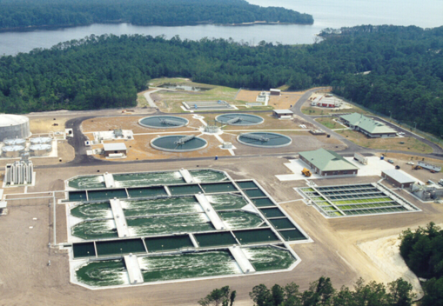
Wastewater Treatment
“Wastewater” is water that has been used in domestic processes (e.g., bathing or washing dishes), or for industrial processes (e.g., cleaning vehicle or parts) and therefore may contain waste products (e.g., soap, oil, grease, or metals)
MCIEast-MCB CamLej operates an Advanced Wastewater Treatment Plant capable of treating 15 million gallons of wastewater per day
The treatment plant removes pollutants to meet Clean Water Act standards, and then releases the cleaned water to the New River
Organic matter from the plant is applied to land to promote plant growth and provide food for wildlife
11

Slide 12
Why is Conserving Water Important?
Providing drinking water and treating wastewater requires a significant investment in energy, chemicals, infrastructure, and manpower
Conserving water means
We protect the groundwater supply which is in danger of overconsumption
The less we use, the less expense is required
Better use of our water and fiscal resources helps to ensure a more sustainable future for our mission and our community
12

Slide 13
What Can You Do To Help Conserve Water?
Be aware of your water usage! Use less water everyday.
In the office or at home turn off the tap between uses
If you live in Family Housing
Take a shower instead of a bath
Conserve water when washing your car or watering your lawn
If you work in an industrial setting, set timers or install process controls on water usage where possible
A full bath tub requires about 70 gallons of water, while taking a five-minute shower uses only 10 to 25 gallons.
Letting your faucet run for five minutes uses as much energy as letting a 60-watt light bulb run for 14 hours.
A typical single-family household uses 30 percent of their water outdoors for irrigation.

Slide 14
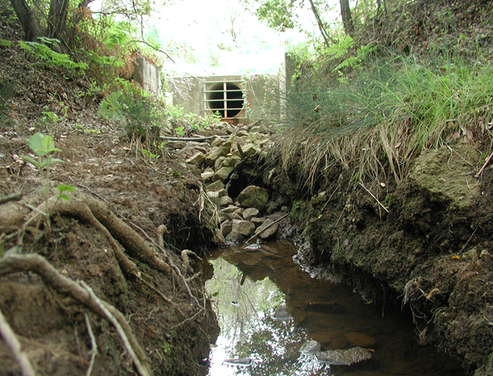
Stormwater Management
What is Stormwater? Rainwater that doesn’t soak into the ground or evaporate runs into storm drains and ditches, which lead to the New River
Any pollutants picked up by the rainwater end up in the river (like oil, grease, pesticides, animal waste)
Why is it important to prevent pollution from getting into storm water?
To provide a healthy environment
To sustain limited training areas
To maintain outdoor recreation and wildlife areas
To maintain compliance with regulations

Slide 15
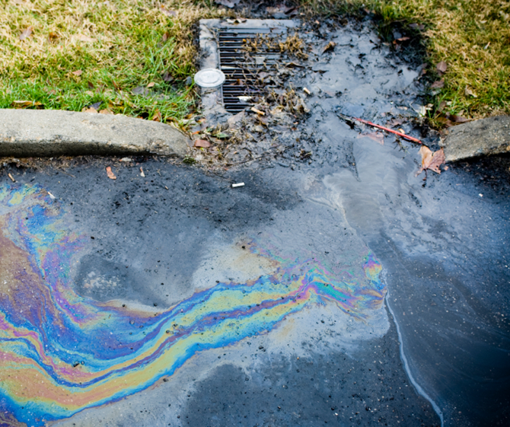
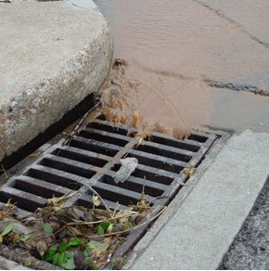
How You Can Help Prevent Pollution in Storm Water?
Don’t Pour Anything Down The Storm Drains!
Don’t dump fluids such as oils in storm drain
Don’t dump trash in or near storm drains
Don’t overfill containers, allow faucets to run continuously, or leave drain valves open
Don’t store oil-containing equipment outside
15

Slide 16
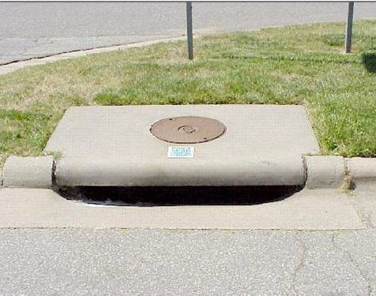
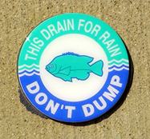
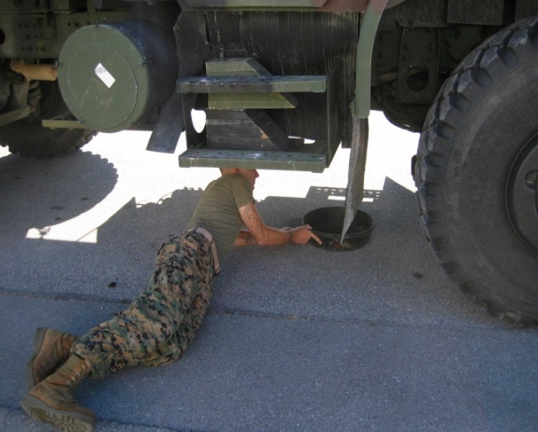
How You Can Help Prevent Pollution in Storm Water?
Continued……
Do wash vehicles only in designated areas (e.g., wash pads, wash racks, car washes)
Do properly dispose of pet waste in waste container
Do use drip pans during vehicle maintenance and storage
Do conduct maintenance of vehicles only in approved areas
16

Slide 17
POP QUIZ!
Which of these are considered stormwater?
Runoff from a lawn treated with pesticides.
Runoff from a parking lot where cars have leaked antifreeze and oil.
Dirt and clay in water leaving a construction site.
Fallen leaves and debris blown into the water from a storm.
All of the above.
e. All of the above!

Slide 18
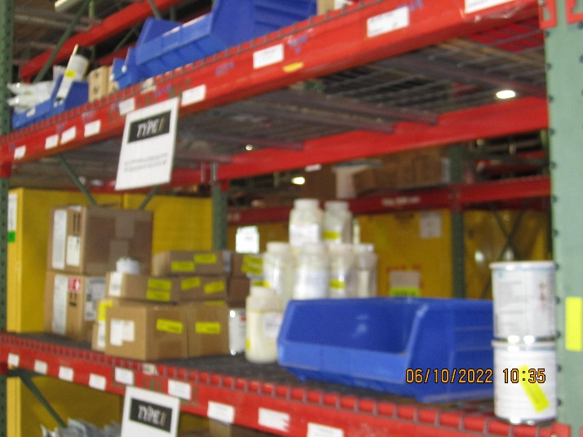
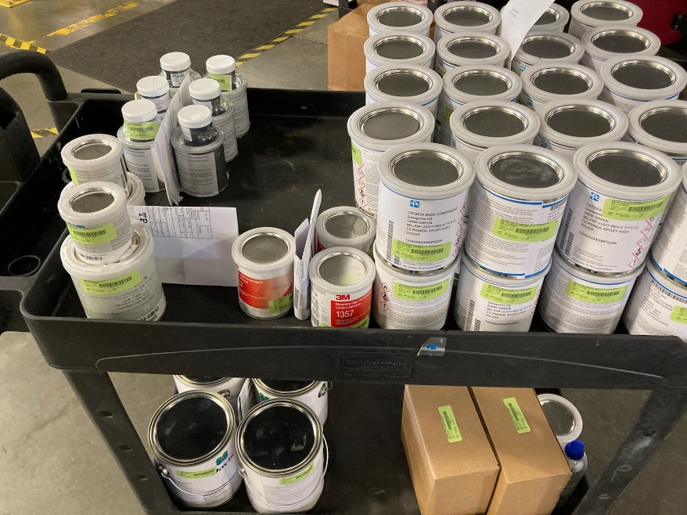
Hazardous Materials (HM)
What are hazardous materials?
Solids, liquids, or gases that pose harm to people, living organisms, property, or the environment when improperly used, treated, stored, transported, or disposed
Antifreeze
Cleaning Products
Paint
Gasoline
Why manage HM properly?
Proper management of HM protects Base personnel and prevents waste
Understanding the properties of materials can help reduce safety risks and environmental hazards
Lighter Fluid
Propane
Glues
Battery Acid

Slide 19
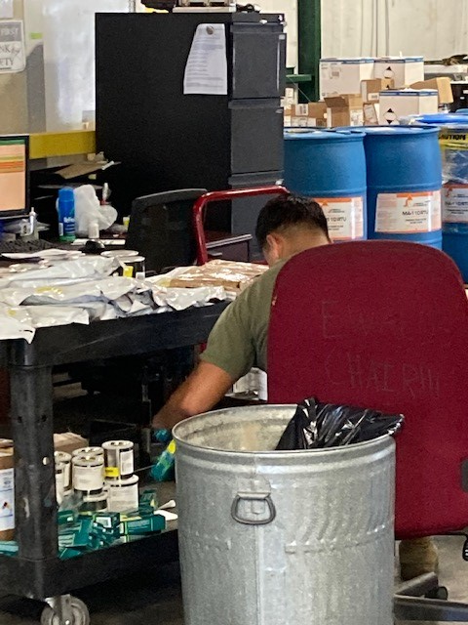
Hazardous Materials (HM) Management
I&E manages Hazardous Materials through the following methods…
Operates centralized HM storage and reissue facility (CHRIMP)
Limits on-hand quantities using the Authorized Use List (AUL) process
Trains personnel on HM management
Provides procedures on HM return and reissue
Tracks HM through the Hazardous Materials Management System (HMMS)

Slide 20
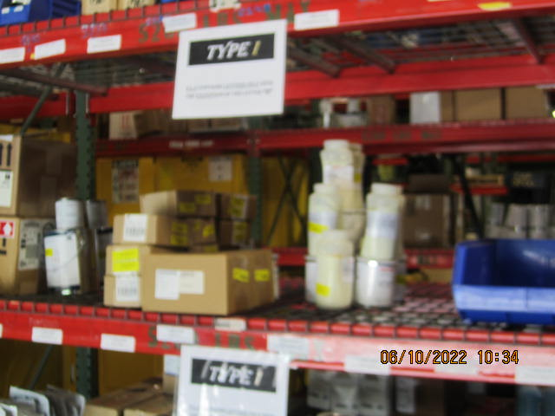
What Can You Do to Manage Hazardous Materials?
If your work or a project requires the use of hazardous materials:
Store hazardous materials authorized on your command’s AUL in designated locations. Containers must be closed, in good condition, and labeled.
Store flammable materials in HAZMAT flam lockers
Don’t store large quantities – Comply with your AUL quantity limits
Practice good Service-Life management
Maintain a Safety Data Sheet (SDS) for each material on-site along with a listing of all HAZMAT utilized by the command
Place materials stored outside in secondary containment to prevent spill/reduce releases
Stop work if you unearth a hazardous material (i.e., ordnance) and report to your environmental representative, ROICC or Contract Representative
Call 911 if a spill of HM occurs

Slide 21
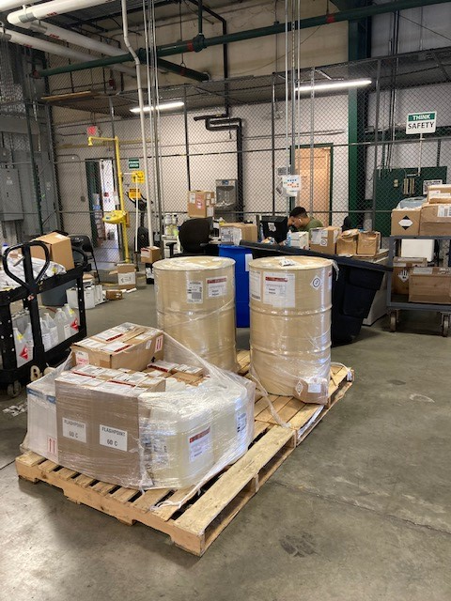
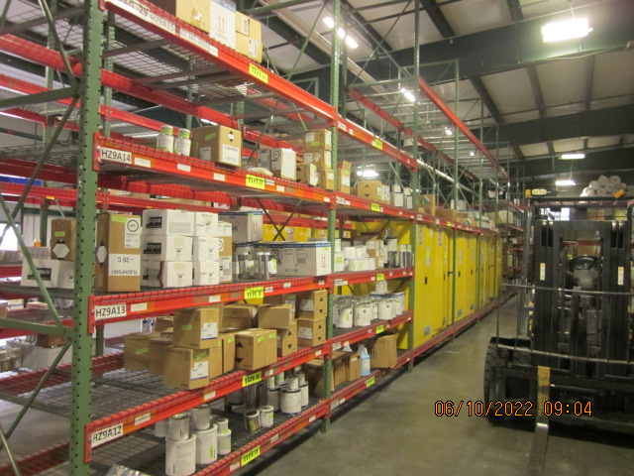
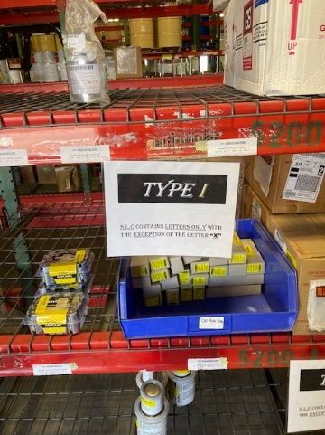
HM Shelf Life Management
WHAT IS SHELF-LIFE?
Shelf-Life is the total period of time beginning with the date of manufacture, cure, assembly, or pack (subsistence only), that an item may remain in the combined wholesale (including manufacturer's) and retail storage systems, and still remain usable for issue and/or consumption by the end user.
. Shelf-life is not to be confused with service-life.

Slide 22
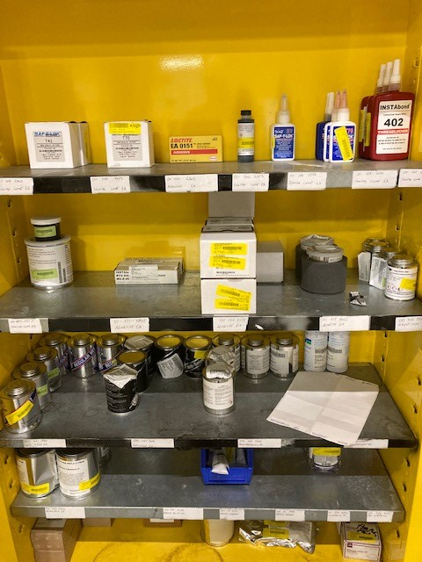
HM Service Life Management
WHAT IS SERVICE-LIFE?
A general term used to quantify the average or standard life expectancy of an item or equipment while in use. When a shelf-life item is unpacked and introduced to mission requirements, installed into intended application, or merely left in storage, placed in pre-expended bins, or held as bench stock, shelf-life management stops and service life begins.
Did you know… alot of HM turned in for disposal is unused and in their original packaging.
Disposing of these materials take a lot of time and money!

Slide 23
What Can You Do to Manage HM Shelf/Service Life?
Things to remember about HM Shelf/Service Life
Buy only the amount authorized on your unit AUL
“First In, First Out” – use oldest materials first
Buy only authorized items
Purchase “Green Materials”
Check shelf-life before receipting for HM from your issue point. Material with less than 85% remaining shelf life are non-conforming unless imminent consumption is expected
If you have materials that will expire prior to use or you have excess materials you cannot use – contact CHRIMP. We may be able to find another unit that can use the materials.

Slide 24
HazMat Dos and Don’ts
DO
DON’T
Read container label and MSDS/SDS before starting a job
Keep work area clean
Use protective equipment
Follow safety rules
Use approved containers for storing and transporting HM
Label containers (including transfer containers) with contents & associated hazards
Store chemicals properly
Leave containers open when not in use
Depend on a funny smell to detect hazardous gases
Mix chemicals with another substance – even water – Follow material use instructions exactly
Pour water into acids
Smoke, eat or drink around chemicals

Slide 25
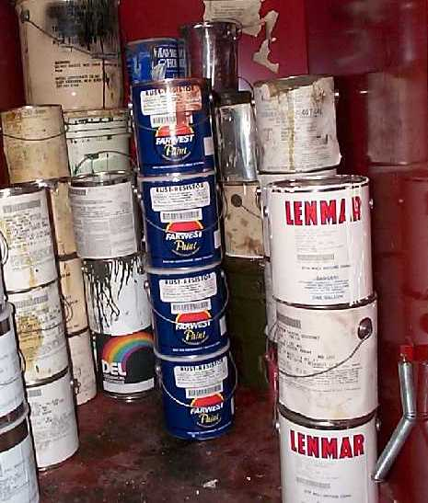
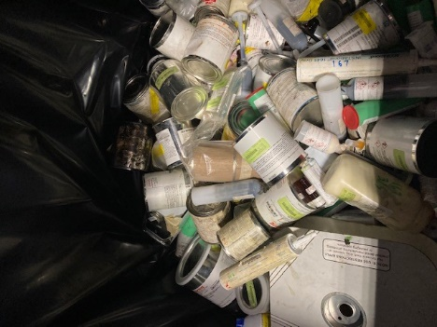
Hazardous Waste (HW)
What is hazardous waste?
Solid Wastes that exhibits characteristics listed in the federal regulations and pose a substantial risk to human health or the environment when improperly treated, stored, or disposed. Examples include…
Solvent Rags
Waste Paint
Solder
Why is it important to manage HW correctly?
Because these wastes may be:
Ignitable (flammable)
Corrosive (can corrode metal or flesh)
Reactive (explosive)
Toxic (poisonous)

Slide 26
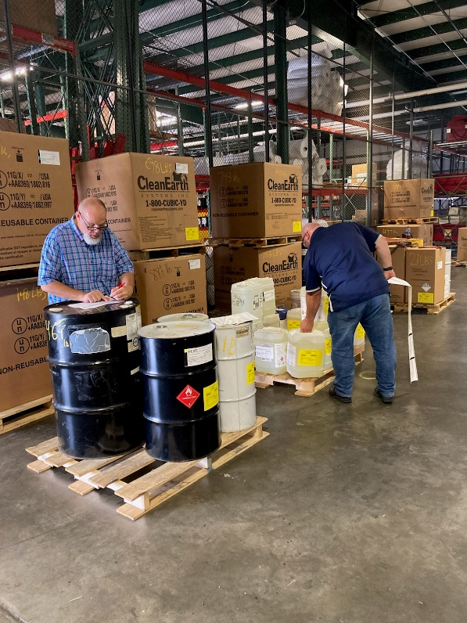
Hazardous Waste (HW) Management
Personnel that handle hazardous waste must be trained to understand the requirements for proper handling to prevent exposure to workers and the environment
If your organization generates hazardous waste you need training to properly manage it…
Contact your unit ECC to find out when the next EM101 (Hazardous Material/ Hazardous Waste training) and EM106 (Air Quality training) will be given.
Ensure you bring your MarineNet prerequisite certificates.
Contact I&E’s Comprehensive Environmental Training and Education Program (CETEP) Coordinator at 449-4550 or 449-6144 on additional available classroom courses.

Slide 27
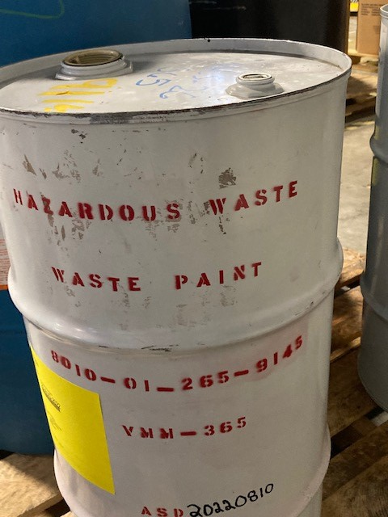
Hazardous Waste (HW) Management
What are the basics of HW proper management?
You MUST have authorization from the installation HW Manager in order to store HW.
Containers must ALWAYS be completely closed and wrench tight during storage, except when adding waste. Bungs must be secured as well.
All containers of HW must be marked with:
“Hazardous Waste”
Noun name of the contents
NSN
Unit
“ASD:______”
HW characteristic

Slide 28
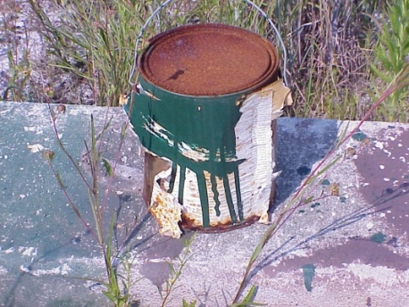
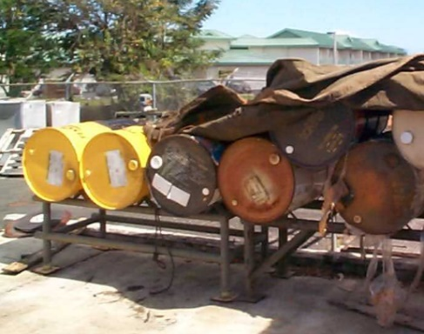
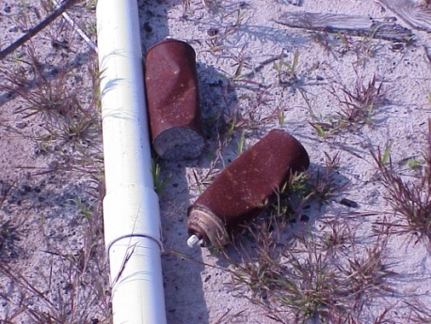
Hazardous Waste (HW) Management (cont)
Personnel must ensure containers are not damaged, rusting or leaking. If so, HW must be transferred to another approved container
Containers must be stored in an approved Satellite Accumulation Area (SAA), restricting access to only properly trained personnel.
Containers in HW accumulation areas must be inspected weekly and must be documented.
Be mindful of all storage requirements for each particular authorized area.

Slide 29
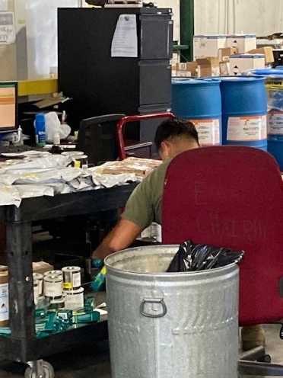
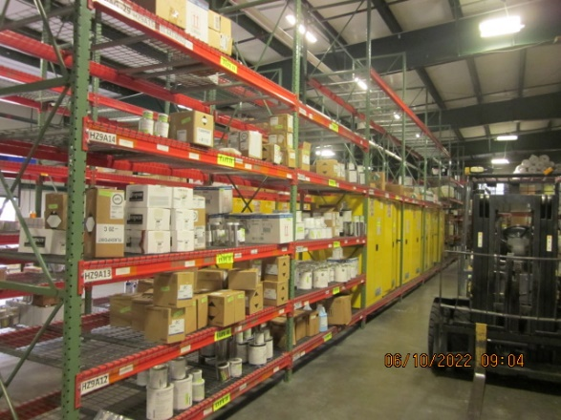
Household Hazardous Material Collection
CHRIMP operates a free Household Hazardous Materials Collection Program for installation residents
Bring hazardous materials to AS-3525 on Perimeter Road, Monday – Friday
0730 – 1500
Things to keep in mind:
Bring only acceptable materials [HOUSEHOLD CLEANERS, SOLVENTS/THINNERS, AUTO FLUIDS, PAINTS, LIGHTER FLUIDS, MOTOR OIL, HOUSEHOLD PESTICIDES]
Make sure product labels are original and legible
Transport materials safely and make sure containers are securely closed
Bring your Military ID

Slide 30
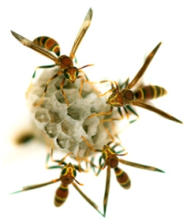
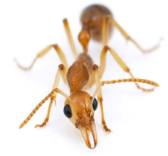
Pesticide Management
What is the Pesticide Management Program? A program focused on control of pests & vegetation through safe, environmentally sound, & cost effective control of pests through Integrated Pest Management (IPM).
IPM depends on
Education
Chemical & non-chemical control methods
All personnel that apply or supervise the application of pesticides must be trained & certified.
Who is responsible for pesticide management?
The Environmental Management Division is responsible for pesticide management of structures, grounds, & turf. Most pest control is done by contractors. Service requests for pest control can be made by the unit or organization by submitting a work request through the Public Works Division.
Residents of military quarters and housing are responsible for maintaining good sanitation & correcting minor nuisance pest problems. Grounds maintenance for common areas at Family Housing is contracted by AMCC.
Golf course and recreation field pest management is provided by the Head & Assistant Golf Course Superintendants who are both certified pest applicators.
Use of Ready-to-Use Roundup is allowed on a limited basis through the Base’s Self-Help Program. All requests for use must be made by the unit or organization by submitting a work request through the Public Works Division.
Pest Survey
Individual responsibility

Slide 31
POP QUIZ!
If I handle hazardous waste or materials as part of my job, do I need special training?
True.
False.
a. True. You’ll need courses EM 101 & 102.

Slide 32
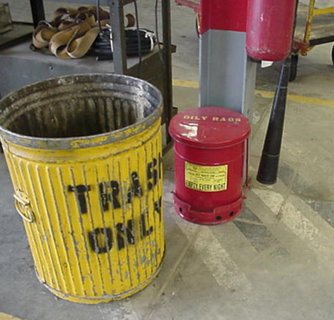
Solid Waste
What is “solid waste”? Commonly known as garbage, rubbish or yard waste, it can be defined as discarded material including
Containers, packaging, and food wastes (e.g., cans, cardboard boxes, milk cartons and coffee grounds)
Miscellaneous non-soluble wastes (e.g., paper, metal scrap, wall board)
Sludge from water treatment, or other discarded materials, durable and non-durable goods
Yard trimmings
Where does it go? Solid waste that is not recycled is disposed in the Base’s landfill
Landfill capacity is a valuable and finite resource that must be conserved
32

Slide 33
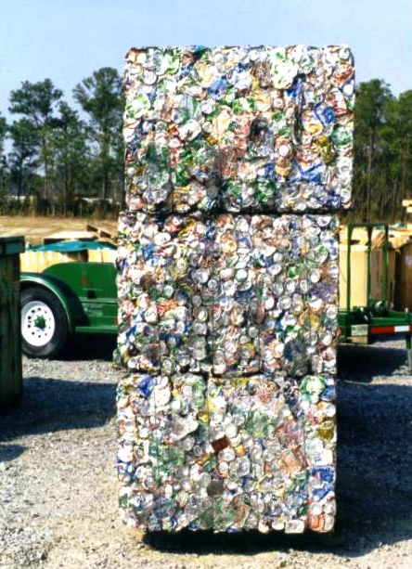
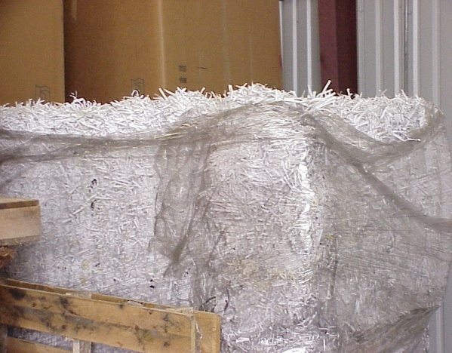
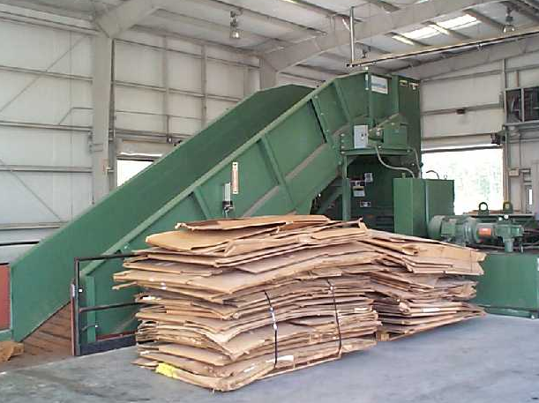
Recycling
What solid waste does MCIEast-MCB CamLej recycle?
Materials that are recycled include…
Paper products, office paper and cardboard
Aluminum and food and beverage cans
Plastics (PETE #1 and HDPE #2)
CD Rom disks and toner cartridges
Did you know… MCIEast-MCB CamLej diverts more than 50% of waste through recycling and composting!
33

Slide 34
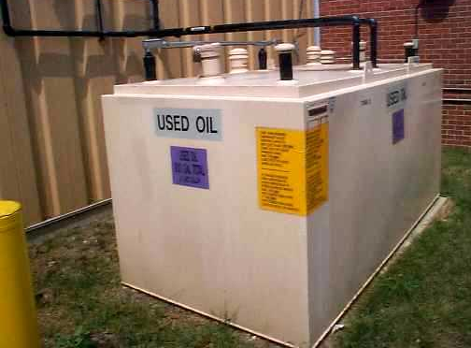
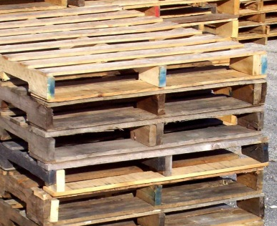
Recycling
Materials MCIEast-MCB CamLej Recycles… (continued)
Glass
Metals and textiles
Military tires
Used oil and antifreeze
Construction and demolition debris like wallboard, wood, concrete
Wood boxes and pallets
Yard debris, tree trimmings, horse manure
Compost is available for FREE at the Landfill Material Recovery Facility, Bldg 978, on Piney Green Road (load and haul your own)

Slide 35
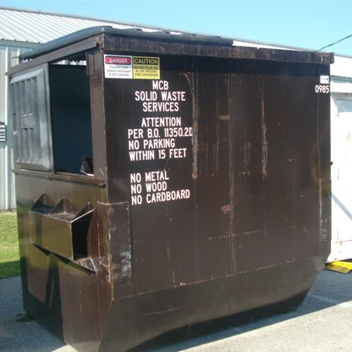
What Can You Do To Recycle and Manage Solid Waste?
Reduce/Reuse/Recycle when possible!
DO NOT put unauthorized wastes into general trash dumpsters
Recyclable products should be placed in appropriate containers & not co-mingled with solid waste
Office Recycling Bins can be purchased at Bldg 1606, Serve Mart
DO NOT use government-owned dumpsters for contractor waste and debris
Recyclables are processed at the Landfill Material Recovery Facility (Bldg 978) located on Piney Green Road. Additional questions can be forwarded to the Base Recycling Coordinator at 451-4214.
Locations for Recycled Material drop-offs can be found by contacting the Landfill office.
During a typical year MCIEast-MCBCamLej diverts over 1,000 tons of cardboard and paper!

Slide 36
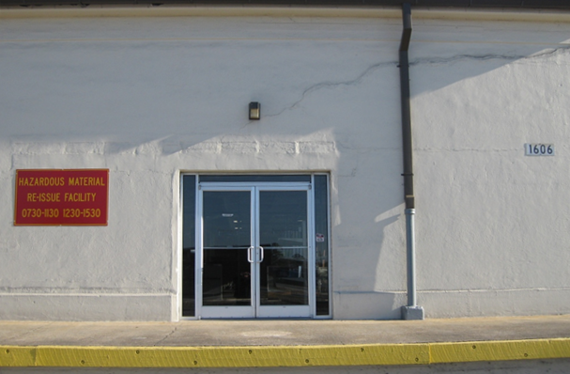
What Can You Do To Recycle and Manage Solid Waste?
Military Family Housing residents can put everything into one recycling bin and place on curb for pick-up!
Newspapers, magazines, paper bags, telephone books, cans, glass, plastic, cardboard, yard waste
Remember… Household Hazardous Materials on MCAS New River must be collected & delivered to the CHRIMP at AS-3525 located on Perimeter Road
36
36

Slide 37
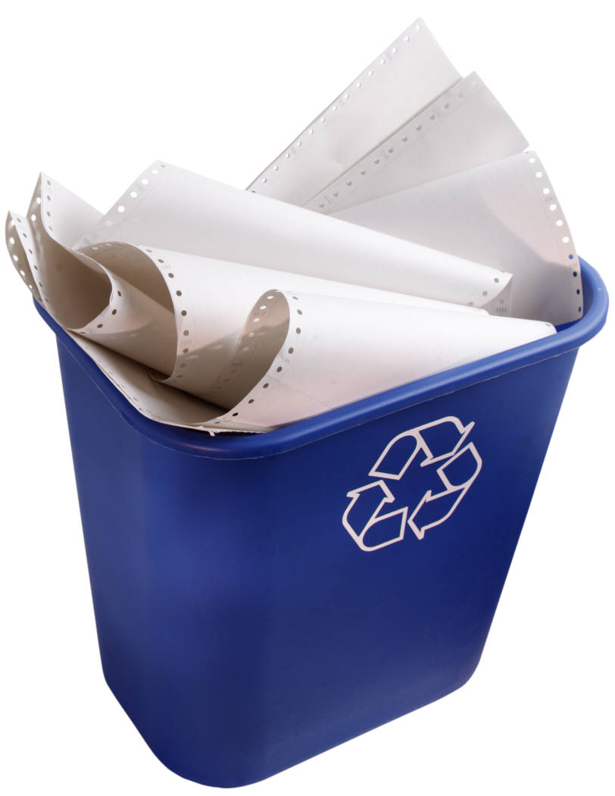
Recycling Facts
Each ton of recycled paper saves
17 trees
380 gallons of oil
Three cubic yards of landfill space
4,000 kilowatts of energy and
7,000 gallons of water
Do your part! Recycle!

Slide 38
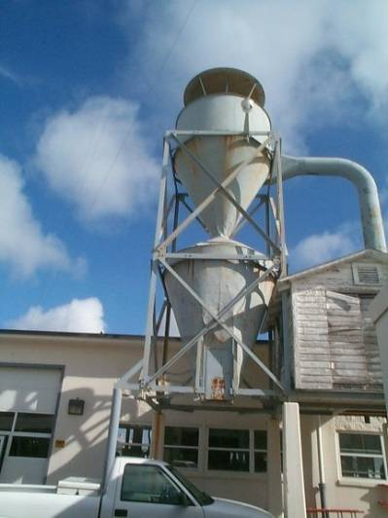
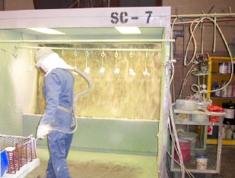
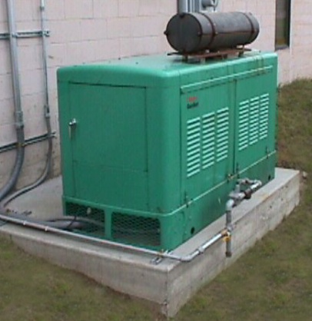
Air Quality Program
The Air Quality Program’s focus is on improving air quality and maintaining compliance with permit requirements
The goal is to reduce overall emissions through the use of cleaner technologies or by removing pollution sources
Various sources generate air emissions
Steam Plant
Boilers
Paint booths
Generators
Petroleum storage tanks
Fire-fighting training
Abrasive blasting
Dry cleaning
Welding
Woodworking
38

Slide 39
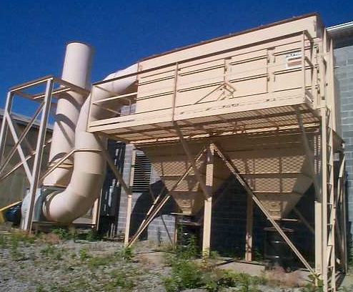
How Can I Help Improve or Manage Air Quality?
What do you need to do if your work could impact air quality?
Follow equipment air permit requirements, including keeping records for material usage
Notify the ROICC or Contract Rep & EMD Air Quality Program Manager
Before installing new equipment on site
Before modifying existing permitted sources (including physical and material changes)
Prior to beginning operations that generate emissions contact your unit ECC to ensure the proper paperwork is being filled out.
39

Slide 40
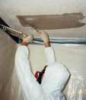
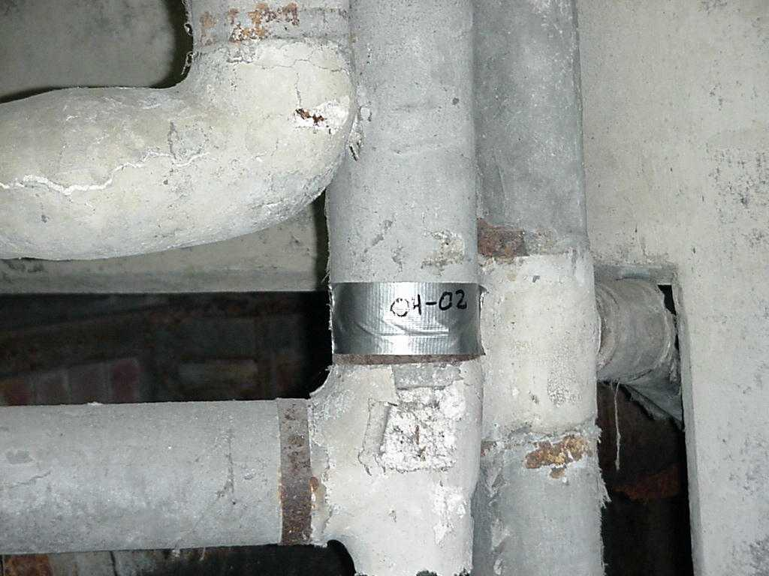
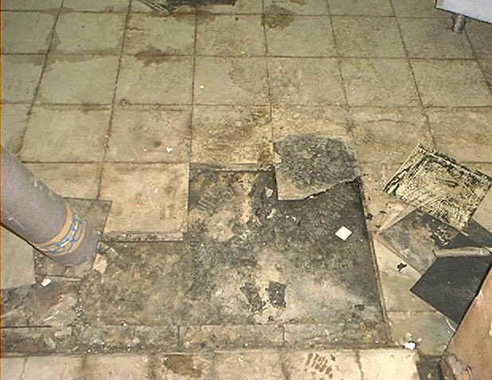
Asbestos Management
What is Asbestos? Asbestos is a fiber used in building construction materials for insulation and fire-retardation
Used in roofing shingles, ceiling and floor tiles, cement products, automobile clutch, brake, and transmission parts, heat-resistant fabrics, packaging, gaskets, and coatings
When asbestos-containing materials are damaged or disturbed by repair, remodeling or demolition activities, microscopic fibers become airborne and may be inhaled and cause significant health problems
What do you need to know?
Intact and undisturbed asbestos in buildings does NOT pose a health risk to occupants
Prior to renovating any buildings, contact EMD to verify that no asbestos is present
Most buildings have asbestos surveys typically located in the mechanical room and on the building’s official bulletin board
40
40

Slide 41
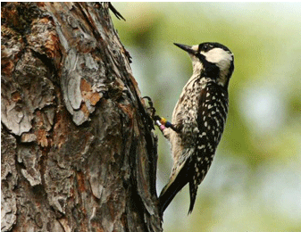
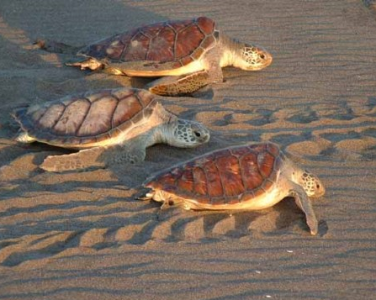
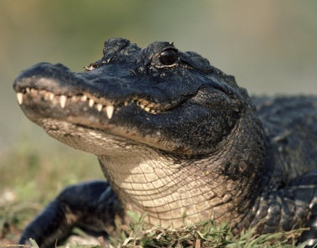
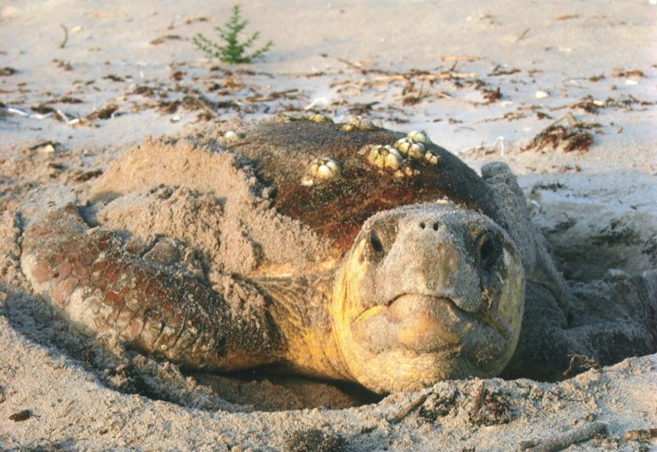
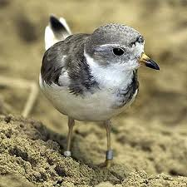
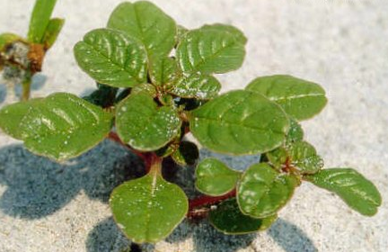
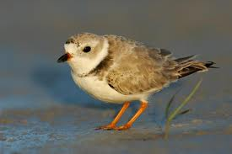
Threatened and Endangered Species
Loggerhead Sea Turtle
MCBCL is home to seven Federally-listed endangered species
Piping
Plover
Sea Beach Amaranth
Rough Leaved Loosestrife
American Alligator
Red-cockaded woodpecker
Green Sea Turtles

Slide 42
How Can You Protect Threatened and Endangered Species?
Obey all signs in marked “Endangered Species” habitat areas
Do not feed or harass wildlife
There is special training on how to protect woodpeckers and sea turtles
Familiarize yourself with the following documents:
Range Control SOP/Environmental Handbook for Trainers/Camp Lejeune Quick Look Guide (S3-Owned Docs)
MCIEAST-MCB CAMLEJO 5090.11 – Protected Species Program
MCIEAST-MCB CAMLEJO 5090.111 – Driving on Onslow Beach Aboard Camp Lejeune
Abiding by these guidelines keep areas open for training. EMD works with the Marines to protect habitat while meeting training needs.

Slide 43
Wetlands Management
What are Wetlands? Low-lying areas of land that are saturated with moisture (e.g., marshes and swamps)
You MUST contact EMD (451-5063) prior to any land-disturbing activity involving wetlands
EMD’s Wetlands program strives to support the Marine Corps mission while ensuring compliance with Federal and State regulations. Wetlands are protected by Federal law (the Clean Water Act), and the regulations are enforced by the U.S. Army Corps of Engineers.

Slide 44
Forest Management
There are over 95,000 forested acres on MCIEast-MCB CamLej!
Do not damage or deface trees in
any way
Do not perform land clearing
operations without EMD approval
Be aware of ongoing timber harvest
and prescribed burning operations.
Current prescribed burn notices are
posted at http://www.lejeune.marines.mil/
*An uncontrolled fire can cause problems for training, destroy timber, adversely affect some wildlife, and threaten humans! Report wildfires to the Base's Fire Dispatch office by dialing 911!

Slide 45
Cultural and Archeological Resources
The Installation manages a variety of historic and prehistoric archaeological sites, as well as historic structures.
If you have a bone, bottle, or piece of pottery that you think might have archaeological or historic interest, don’t pick it up. Mark the area and notify EMD’s Archeologist at 451-5063.

Slide 46
National Environmental Policy Act (NEPA)
What is NEPA? NEPA requires the environmental analysis of any action that could impact the environment, an archaeological site, or an historic building
Why is it important? It allows the review of environmental impacts before project implementation, so impacts can be minimized and money can be saved with appropriate planning
Actions that need NEPA review
All field training exercises
All facility or building maintenance activities
All landscaping, grounds maintenance and trail rehabilitation
All construction activities
All real estate transactions
For questions regarding whether a proposed action needs NEPA review, Call EMD (451-5063) to discuss requirements.

Slide 47
Outdoor Recreation
Outdoor recreation activities and resources include…
Hunting
Game include deer, turkey, rabbit, quail, dove, waterfowl
Fishing
Species include bass, bluegill, sunfish, catfish, flounder
Boat Launch
Onslow Beach Access
Off-Road Recreation Vehicle Use
Trapping, Harvesting Firewood
Base Skeet and Archery Ranges
These activities require permits and training!
Please visit http://www.lejeune.marines.mil/OfficesStaff/
ConservationLawEnforcement.aspx or contact the Conservation
Law Enforcement Office (CLEO) at (910) 449-4776/7

Slide 48
Underground and Aboveground Storage Tank (UST/AST) Program
What does the UST/AST program do?
Assesses and remediates contaminated sites that result from leaking USTs/ASTs, overfills, spills, and any other petroleum related contamination
Currently there are 303 no further action remediation sites,
18 remediation sites under assessment,
and 9 active remediation sites
Permitting and monitoring of USTs aboard the Base
In 1991, the Base had 505 regulated and 4,400 non-regulated (heating oil) USTs. Today the Base maintains 27 USTs.
Maintains the Spill Prevention Control and Countermeasure (SPCC) Plan for approximately 600 ASTs aboard the Base as well as drum storage, transformers, etc.

Slide 49
Prevention of Spills
To minimize leaks, keep aircraft and vehicle maintenance up-to-date
Always use drip pans and absorbents under equipment during maintenance
Conduct field servicing of vehicles only at approved locations
Keep maintenance bay floors and grease rack areas clean

Slide 50
Prevention of Spills
Avoid the common errors of overfilling, failing to disconnect lines, leaving drain valves open, and leaving fill valves open to precipitation
Prepare for spill response by having an overpack and absorbent materials available

Slide 51
What You Need To Know About Spill Clean Up
A release of hazardous materials, fuels and oils must be promptly reported to Fire & Emergency Services (FESD)/Aircraft Rescue and Fire Fighting (ARFF) at 911
Trained personnel may only respond to spills of oil or antifreeze. For any other type of HM spill/release, personnel must secure the area & wait for guidance from FESD/ARFF. Trained personnel may:
Collect all the material and anything contaminated. This includes liquid residue from drip pans, absorbent material used to clean up the spill, and contaminated soil.
Collected residue and contaminated material should be placed in bags, drums, or other containers, and returned to your unit's home site.
Turn in all collected materials in to CHRIMP (AS-3525).
FESD/ARFF will contact I&E at 449-5997/6144 if assistance with cleanup is required.

Slide 52
Installation Restoration Program (IRP)
What does the Installation Restoration Program do? Assesses and remediates contaminated sites that resulted from past disposal practices, and spills and leaks of hazardous materials and waste
In 1983, an initial Navy assessment identified 76 areas of concern, 22 that warranted investigation
None of the sites pose an immediate threat to human health or the environment
56 sites are cleaned-up and/or need no further action or investigation
Further investigation to assess the potential long term impacts is ongoing at 4 sites
Active remediation and/or long-term management at 27 sites
Formal information is exchanged through the Restoration Advisory Board (RAB) which is made up of elected community members
The RAB meets on a quarterly basis and is a forum for the exchange of information and for community members to provide input and guidance on how the IRP should be run and its future actions.
(https://www.lejeune.marines.mil/Offices-Staff/Environmental-Mgmt/Restoration-Advisory-Board/)
For additional information on the IR Program, please contact the IR Program Manager at 451-9385.

Slide 53
Ammunition, Explosives, and Dangerous Articles (AEDA)
To obtain clearance to leave a training area, the unit must completely police it for expended brass and ammunition residue.
Ranges other than Rifle Range Complex
Before conducting training each unit must verify they have personnel, appointed in writing by their CO, who are technically qualified to certify & verify AEDA as being inert & free of explosives before turning those articles in to DRMO.
Appointed personnel must coordinate with DRMO & be familiar with DRMO processing procedures.
Be sure to separate live from expended cartridges. Also, check to see if ammunition containers can be reused or recycled.
53

Slide 54
Energy Conservation
For MCIEast-MCB CamLej energy is mission critical. You have the power to make a difference.
Turn off lights when leaving a room or office for more than a minute
Turn off printers, copiers, and monitors when idle
Keep windows and doors closed when heating or air-conditioning is running - Report heating and air conditioning problems promptly
Turn off coffee pots, radios, fans and other appliances in offices
Avoid using space heaters
54

Slide 55
Family Housing – How To “Go Green”
For those living in Family Housing remember these facts to help protect our environment
Do not pour grease down the drain. The grease clogs pipes, leading to spills and overflows.
Place pet waste into approved containers
Wash cars in designated areas where water won’t runoff into a storm drain
Put all recyclables into one recycling bin and place on curb
Recycle all the materials you can - newspaper, plastics, aluminum, glass, cardboard
Place yard debris in a pile next to refuse and recycling for collection
Take used oil and used antifreeze from your personal vehicle to designated disposal facility/business for proper disposal
Conserve water and energy everyday
Take Household Hazardous Materials to AS-3525

Slide 56
How Do We Provide Environmental Training and Outreach?
The Comprehensive Environmental Training and Education Program (CETEP) is established to support full compliance with environmental requirements and pollution prevention goals.
CETEP includes various professional development initiatives, public outreach projects, program development strategies, and research efforts to ensure that appropriate environmental instruction and information is provided at all levels of the Marine Corps.
Please see https://em.usmc.mil/sites/le/CETEP/default.aspx for a description of the environmental class options in the matrix below, or call the CETEP Coordinator @ 451-9654
 | CO/XO/STAFF EM100 | HM/HW INITIAL & REFRESHER EM101 & EM102 | HM TRSPT EM103 | ECC/ ECO TRNG EM 104 | AST/ UST MGMT EM105 | AIR QUAL EM 106 | OWS EM 108 | GENL ENV AWARENESS
ALL BASE PERSONNEL |  |  |  |  |  |  |  | x
CO/XO/Staff | X |  |  |  |  |  |  | X
ECC/ECO |  | X |  | X | X | X | X | X
HW SITE MGR/HANDLER |  | X |  |  |  |  |  | X
HM SITE MGR/HANDLER |  | X |  |  |  |  |  | X
MW SITE MGR |  | X |  |  |  |  |  | X
UST/AST OPERATOR |  |  |  |  | X |  |  | X
AIR SOURCE OPERATOR |  |  |  |  |  | X |  | X
USMC MV Operators |  |  | X |  |  |  |  | X
MOTOR T SHOP PERSONNEL |  |  |  |  |  |  | X | X

Slide 57
Summary
Protecting the environment is everyone’s job at MCIEAST-MCB CAMLEJ & MCAS New River
Do your part to conserve our resources and preserve our ability to complete our mission
Follow the directions and information provided in this training and remember to:
Conserve water and energy
Manage hazardous materials correctly
Reduce solid and hazardous waste generation
Protect natural and cultural resources
Know how to respond to spills, releases and emergencies
Contact I&E with environmental questions, issues, or needs

Slide 58
MCAS New River Installation & Environment Department
Director
910-449-5442
Administration
910-449-6518
Deputy Director
910-449-5441
CETEP Instructor
910-449-4550
Environmental Supervisor
910-449-6143
Environmental Compliance
910-449-6144
Hazardous Waste Manager
910-449-5997
Motor Vehicle Operator
910-449-5997
Laborer/ Recycling
910-449-5997
Conservation Law Enforcement Officer
910-449-4776/4777

Slide 59
Camp Lejeune Environmental Management Division
Director
910-451-5003
Administration and Finance Office
910-451-5003
Environmental Management System (EMS) / P2
910-451-0151
Environmental Compliance Branch
910-451-5837
Environmental Conservation Branch
910-451-5063
Environmental Quality Branch
910-451-5068
HazWaste/HazMat Mgmt
OWSs/Used Oil Mgmt
Compliance Evaluations
Laboratory
Water/ Wastewater Compliance
Environmental Training
Asbestos
Pesticides
Stormwater/SEC Compliance
Spill Response
Threatened & Endangered Species
Game & Non-Game Management
Wetlands/Erosion Control
Forestry
NEPA
Cultural & Historic Resources
Conservation Law Enforcement
Encroachment Partnering
Air Quality
Water/Wastewater/Stormwater
Project Management for EMD
IR / Ranges
ATSDR
UST / AST compliance and remediation
RCRA/EPCRA
59

Slide 60
MCIEast-MCB Camp Lejeune (MCIEAST-MCB CAMLEJ) & MCAS New River
GENERAL ENVIRONMENTAL AWARENESS TRAINING
This certifies that I have completed the annual training for MCIEast- MCB Camp Lejeune & MCAS New River General Environmental Awareness Training.
1/31/2011
(NAME)
(DATE)
(UNIT/DEPT)
(This completion certificate is to be provided to your command Privacy Act Coordinator)

